Slide 1
Earthquakes
By Natalie.s, Tia.h, salma.k

Slide 2
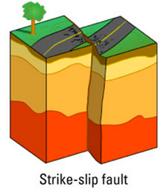
Intro
An earthquake happens when two pieces of land slide or slip against each other, earthquakes usually have different levels of danger.

Slide 3
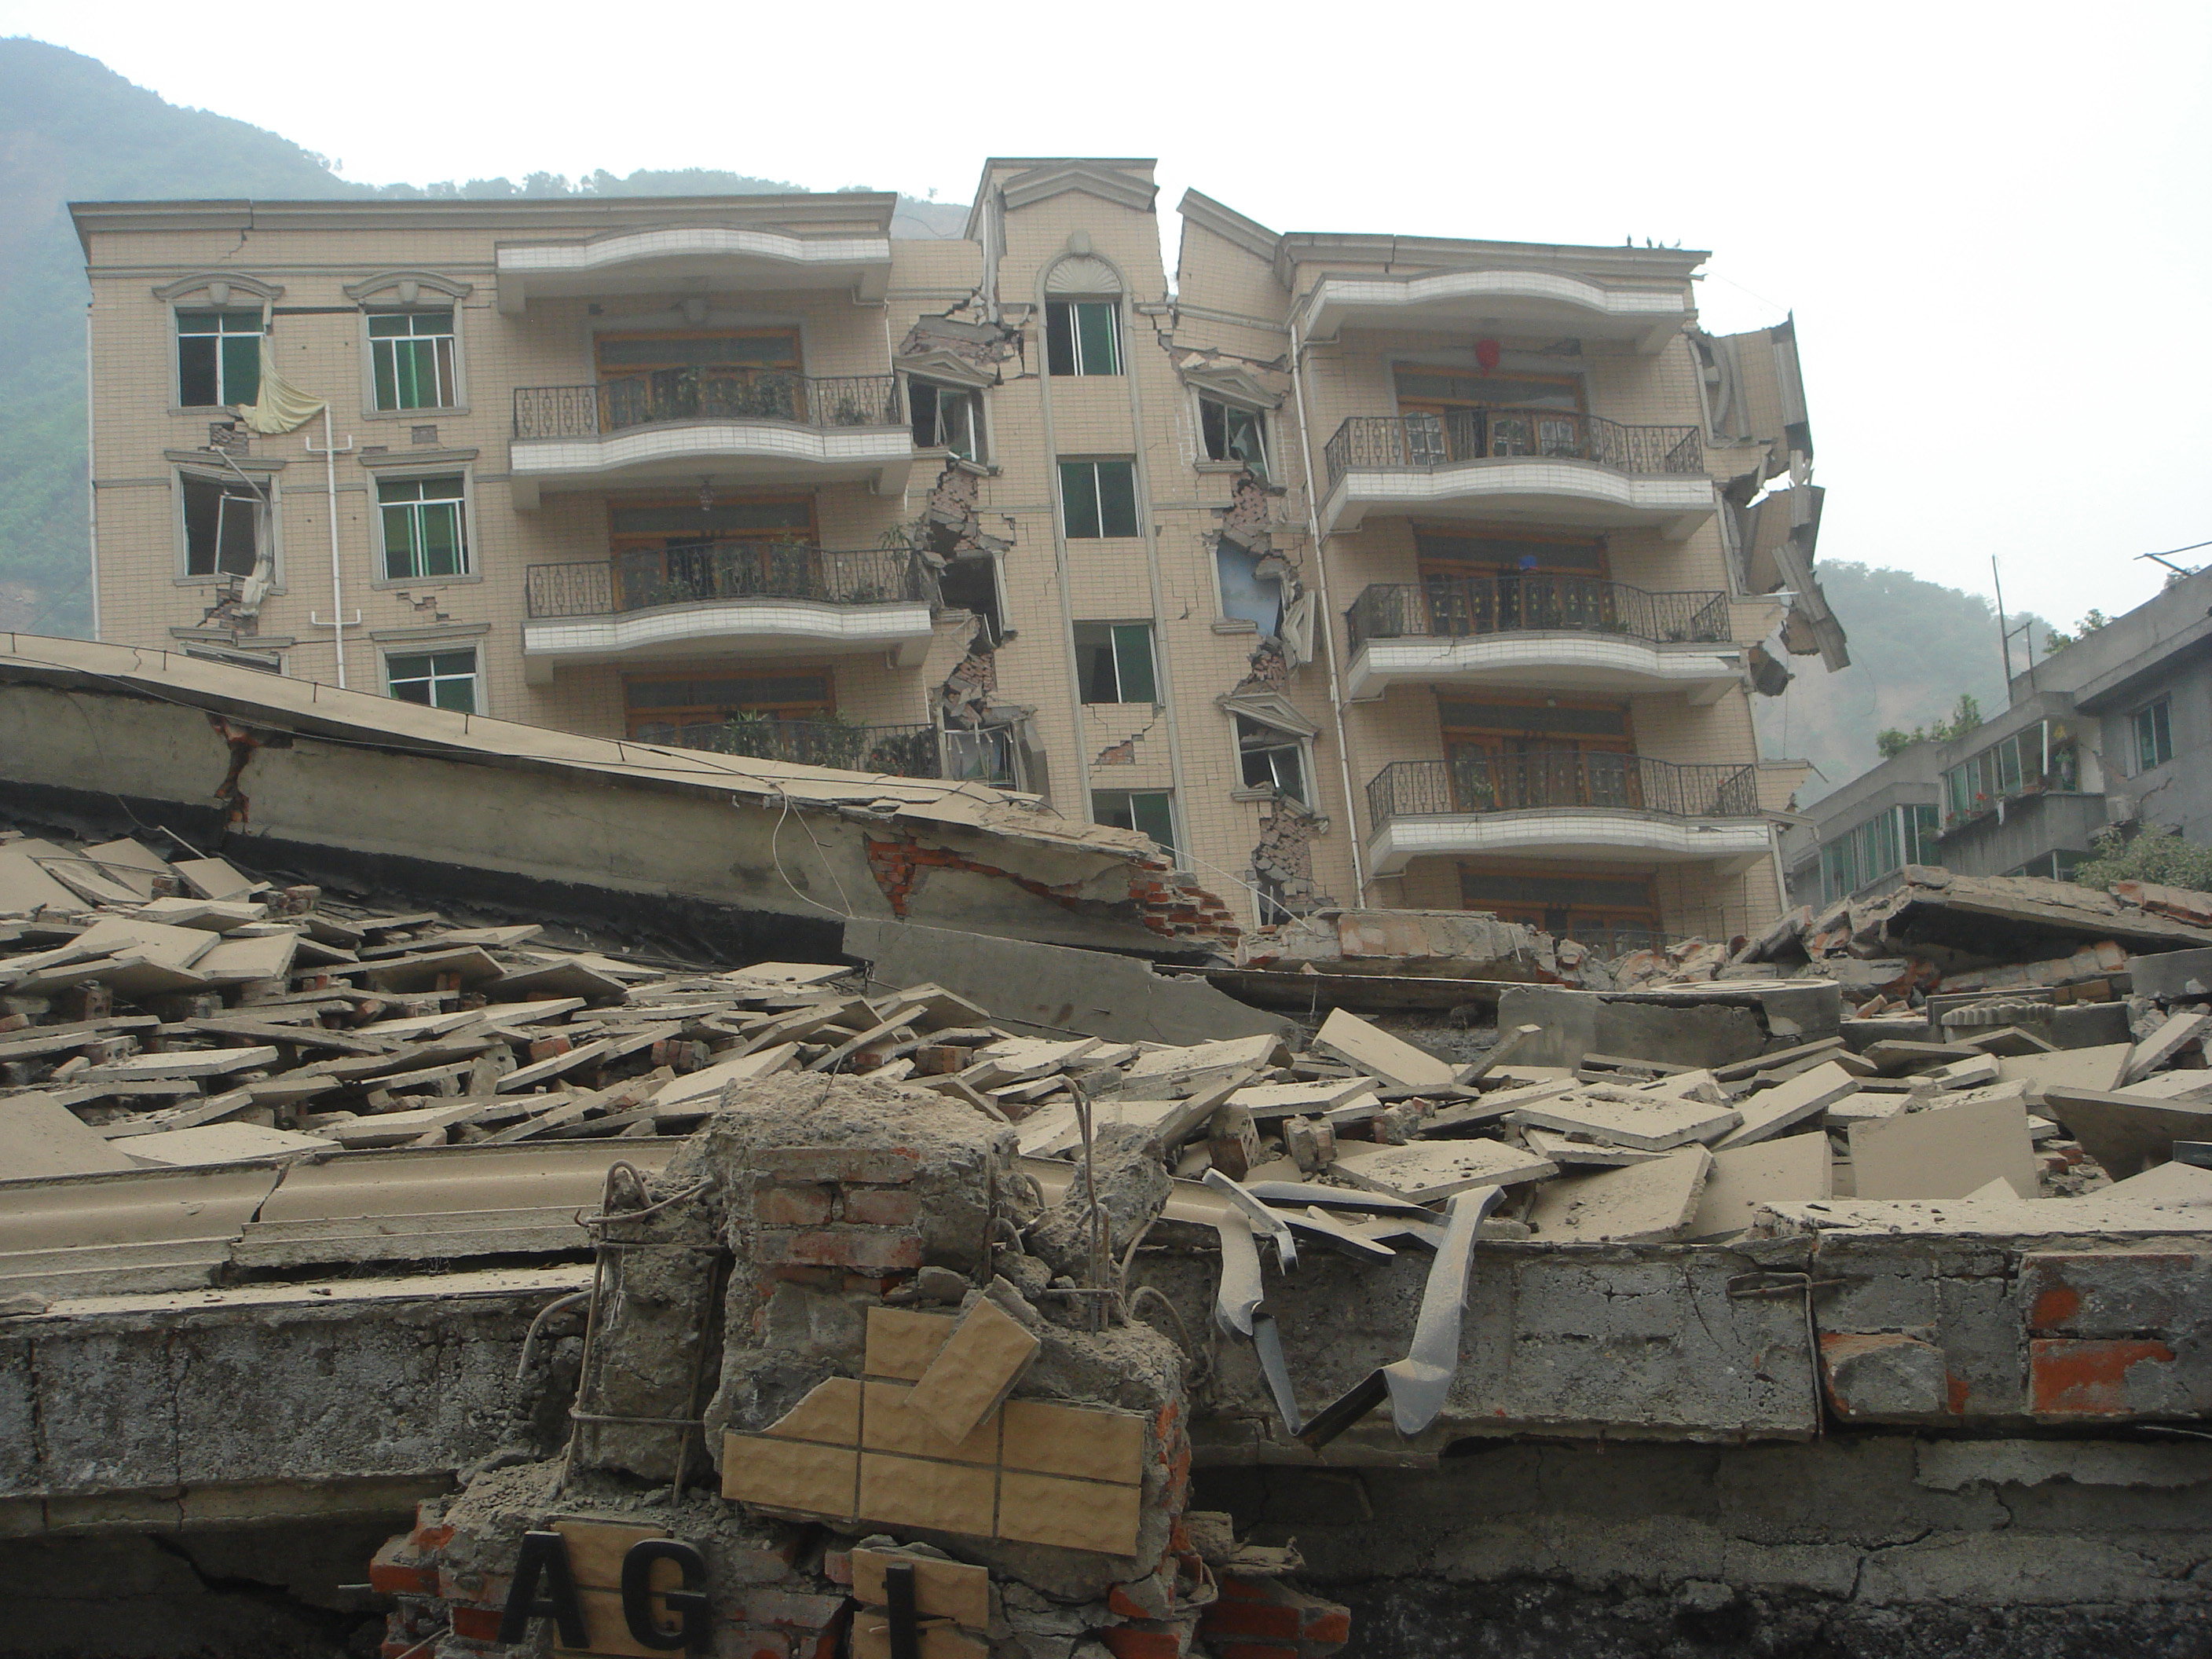
Different levels of earthquakes
Magnitude (level) | 5.5 to 6.0 | 6.1 to 6.9 | 7.0 to 7.9 | 8 or greater
The earthquake effect | Slight damage to buildings and other structures | May cause a lot of damage to very populated areas | Major earthquakes Serious damage | Great earthquake. Can totally destroy communities ear the epicenter

Slide 4
Foreshock and aftershocks
“Foreshock” and “Aftershock” are relative terms.
Aftershocks are like mini earthquakes, that occur within 1-2 fault lengths away and during the period of time before the background seismicity has resumed or continued.
Foreshocks are larger earthquakes that occur I the same area of the earthquake. there’s a small gap between the earthquake and aftershock.

Slide 5
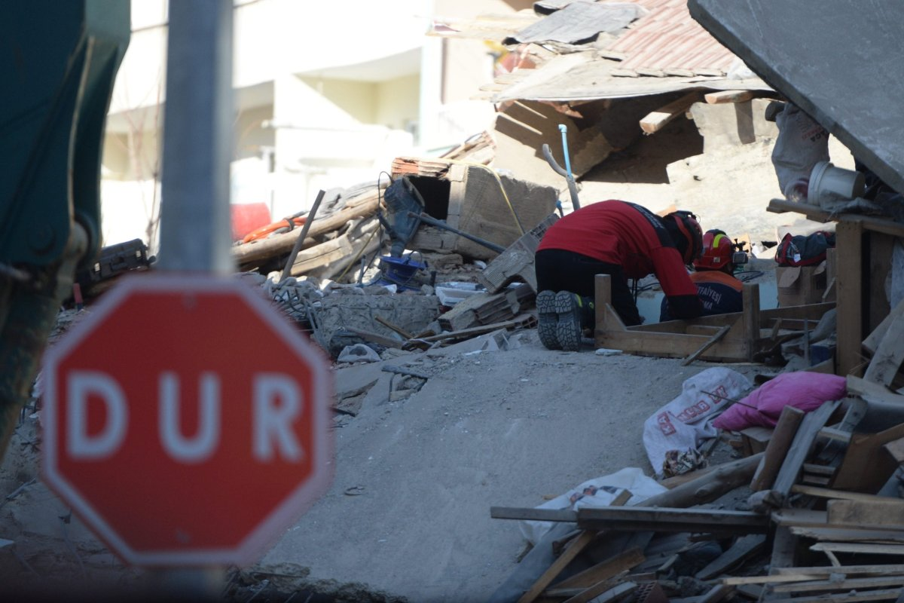
Consequences of earthquakes
Earthquakes can destroy communities just like the very recent earthquake In turkey were we lost may lives. The local area had been destroyed while Jordan had only felt a mild vibration.
This Photo by Unknown Author is licensed under CC BY-SA-NC

Slide 6
Resources
USGS.gov
Spaceplace.nasa.gov
Nationalgeographic.org
Samhsa.govs
Ready.gov
Emsc-csem.org

