Slide 1
Earthquake
By Rashed and Tayseer

Slide 2
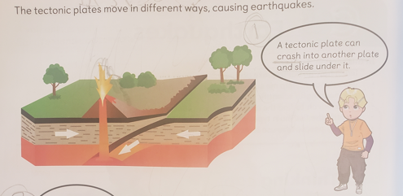
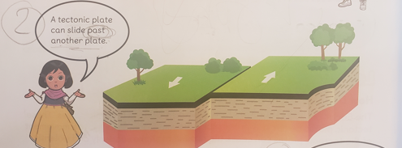
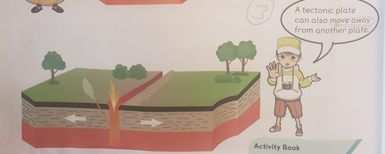
What is an earthquake?
Notes:
An earthquake: is an intense shaking of Earth’s surface. The shaking is caused by movements in Earth’s outermost layer(crust). The crust is actually made up of giant puzzle pieces called tectonic plates. Tectonic plates are constantly shifting

Slide 3
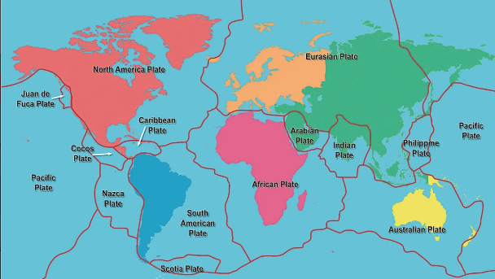
What causes an earthquake?
Notes:
Plate tectonics: are always slowly moving, When the stress on the edge overcomes the friction, there is an earthquake that releases energy in waves that travel through the earth's crust and cause the shaking that we feel.
Induced quakes: They are caused by human activity, like underground mining, tunnel construction, filling reservoirs.

Slide 4
The effects of earthquakes
Notes:
the 5 earthquake hazards are: Ground rupture ground shaking soil liquefaction landslide and in some areas tsunami

Slide 5
The impacts of earthquakes on the natural environment and ecosystem
Environmental Effects:
dust clouds, tsunamis, fires, trees shaking and jumping stones.
Infectious Diseases
emerging during the post-earthquake period are considered as secondary earthquake effects on public health. (ex. Respiratory, burns, injuries and skin diseases)
Marine Environment:
earthquake could result in benthic fauna such as corals, sea stars, crustaceans, bottom fish, and others being buried or disturbed.

Slide 6
What are the factors that affect the intensity and frequency of earthquakes?
Notes:
The main factors are (1) The distance away from the epicenter. {2} The depth of the earthquake. {3} The population density of the area affected by the earthquake. {4} The local geology of the area (5) magnitude

Slide 7
Methods used to detect measure and predict earthquakes
Notes:
Seismometers allow us to detect and measure earthquakes by converting vibrations due to seismic waves into electrical signals, which we can then display as seismograms on a computer screen.

Slide 8
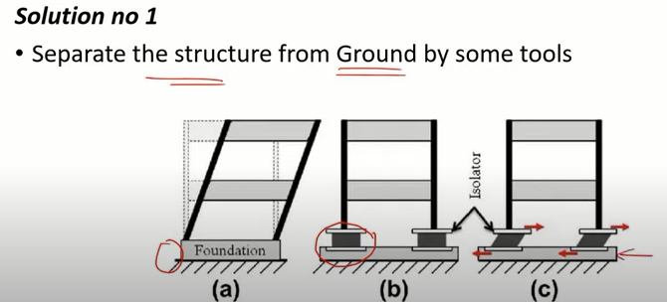
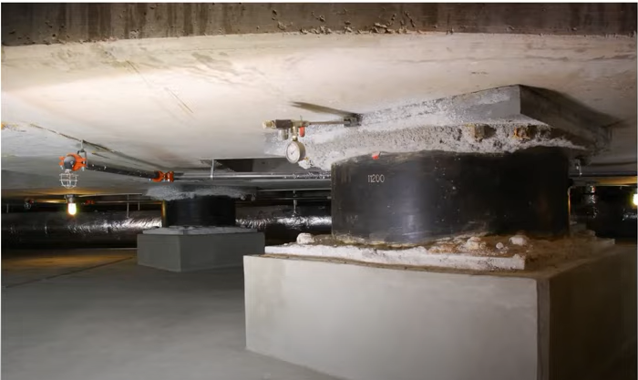
What are the solutions to earthquake?
Notes:
We cant prevent earthquakes but we can significantly migrate their effects by identifying hazards, building safer structures, and providing education on earthquake safety.

Slide 9
How to survive an earthquake
Notes:
Cover your head and neck with your arms. If a sturdy table or desk is nearby, crawl underneath it for shelter. If no shelter is nearby, crawl next to an interior wall (away from windows). Crawl only if you can reach better cover without going through an area with more debris.

Slide 10
Sources
https://www.usgs.gov/
https://brainly.in/question/46493045
http://www.earthquakes.bgs.ac.uk/
https://www.phivolcs.dost.gov.ph/
https://www.ready.gov/
https://www.youtube.com/watch?v=W4CkCFQj0Ac

Slide 11
THANK YOU

