Slide 1
Overweight Breakthrough
By:Toleen Bosheh, Joelle Abu al itham, Ziad Qutaishat,Abdulatif Rbeihat

Slide 2
What is obesity as a social problem
Obesity is typically defined as a substantial accumulation of body fat that could impact health and raise the chances of severe illnesses
People who are obese can experience problems with their physical and mental health. However, society focuses significantly less attention on its physical impact and greater attention to its emotional impacts. Obese people are more prone to experience social exclusion, prejudgment, and humiliation.

Slide 3
How to prevent obesity
01
02
Choosing healthier foods
Limiting unhealthy foods
03
04
Increasing physical activity
Portioning your meals
whole grains, fruits and vegetables, healthy fats and protein sources
refined grains and sweets, potatoes, red meat, processed meat
Play sports , go for a run , go to the gym
Consuming the proper amount of food to continue your day

Slide 4
Choosing healthier foods
Eat a variety of foods each day, Fruits. Vegetables.
Keep a food diary to track what you eat.
Read food labels to learn what's in your food.
Choose foods that don't have a lot of sugar, saturated fats, and sodium.
Be aware of how many calories you need per day.

Slide 5
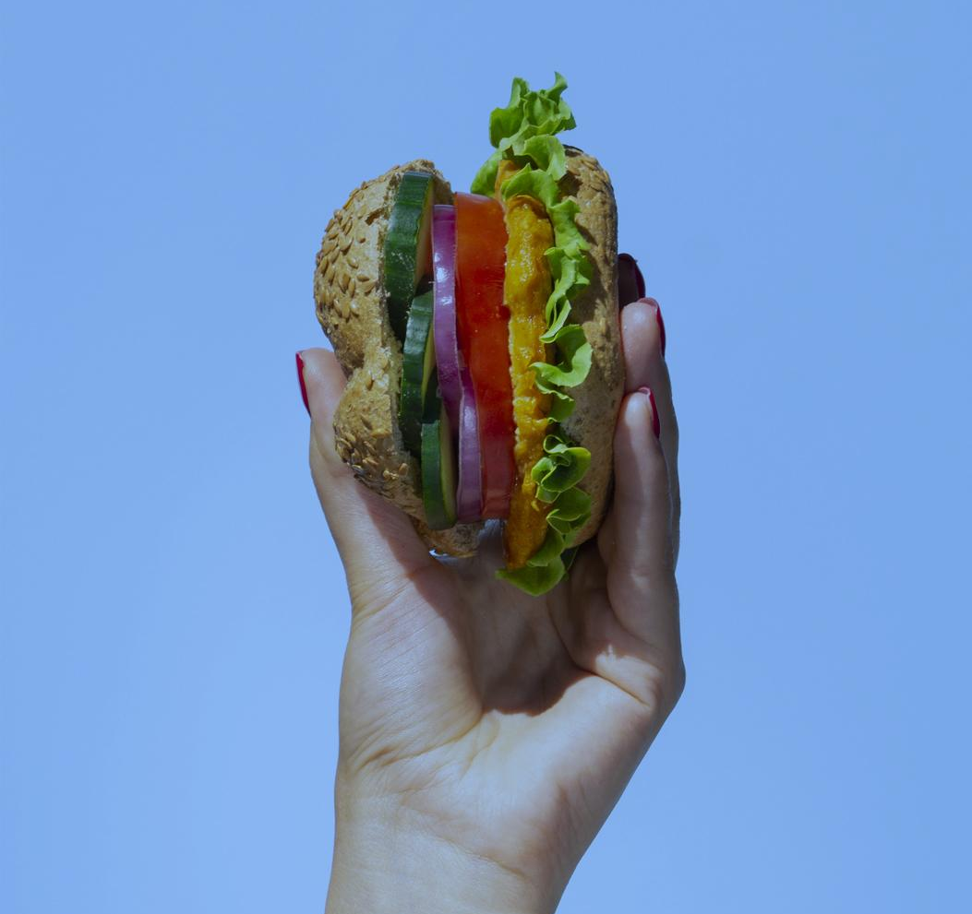
Limiting unhealthy food
Choose processed foods carefully. Avoid sodium from the six most common salty foods (bread and rolls; cold cuts and cured meats; pizza; burritos and tacos; soup; sandwiches). Read food labels and stay away from items that have sugar added, excess sodium and fat. Plan ahead and prepare healthy snacks and meals at home made from whole, fresh foods. Choose lean meats with less than 10 percent fat. Don’t skip meals (this can contribute to snacking on unhealthy foods when hungry).

Slide 6
Increasing physical activities
Replace a Sunday drive with a Sunday walk
Walk instead of drive, whenever you can.
Take a family walk after dinner.
Go to the gym , play boxing , sign up for dance classes , go for a run

Slide 7
Consequences of obesity
Blood problems
Addiction
Pancreatic issues
Heart problems
Consequences of Overweight
Can cause blood clot
Makes you addicted to unhealthy food
Causes cardiac arrest, heart attacks, and strokes
Type 1 and 2 diabetes are the biggest consequences of obesity

Slide 8
Resources
https://www.nia.nih.gov/health/infographics/choosing-healthier-foods
https://www.heart.org/en/healthy-living/go-red-get-fit/unhealthy-foods#:~:text=Read%20food%20labels%20and%20stay,on%20unhealthy%20foods%20when%20hungry).
https://myserenityhealthcare.net/obesity-as-a-social-problem/#:~:text=Obesity%20as%20a%20Social%20Problem%20%E2%80%93%20Obesity%20can%20cause%20both%20physical,%2C%20discriminated%20against%2C%20and%20humiliated
https://www.hsph.harvard.edu/obesity-prevention-source/obesity-prevention/#:~:text=Choosing%20healthier%20foods%20(whole%20grains,%2C%20and%20other%20%E2%80%9Csit%20time%E2%80%9D
https://www.who.int/news-room/fact-sheets/detail/healthy-diet
https://www.hsph.harvard.edu/nutritionsource/salt-and-sodium/
https://www.hsph.harvard.edu/obesity-prevention-source/obesity-consequences/#:~:text=The%20High%20Cost%20of%20Excess%20Weight&text=No%20less%20real%20are%20the,overweight%20does%20not%20decrease%20mortality.
https://www.verywellhealth.com/obesity-prevention-4014175

Slide 9
THANK YOU FOR LISTENING!!!!

