Slide 1
WATER CRISIS IN JORDAN
MADE BY: Omar Attiyyat, Zaid Bakeer, Sanad Salhi, Feras Abujiries 7E

Slide 2
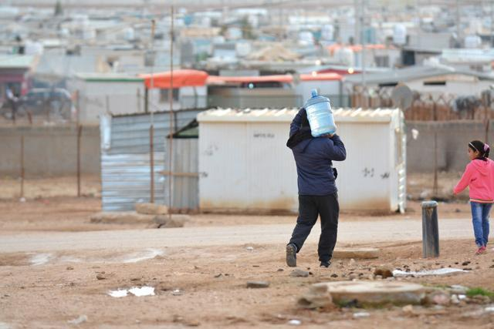
WATER CRISIS IN JORDAN
Jordan is one of the most water-scarce countries in the world. The country's renewable water supply currently meets around two-thirds of the population's water demands, with groundwater being used twice as quickly as it can be replenished.
Source: https://www.usaid.gov/jordan/water-resources-environment.

Slide 3
ISSUES OF WATER CRISIS IN JORDAN
⦿ Water Pollution
⦿ Water Shortage
Causes:
Causes:
Over-pumping of aquifers
The Overflow of wastewater pumping stations.
The decreased rainfall and depleted groundwater
Pollution of the Jordan River

Slide 4
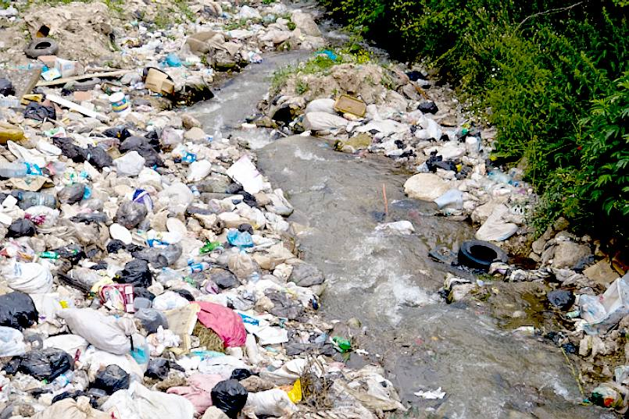
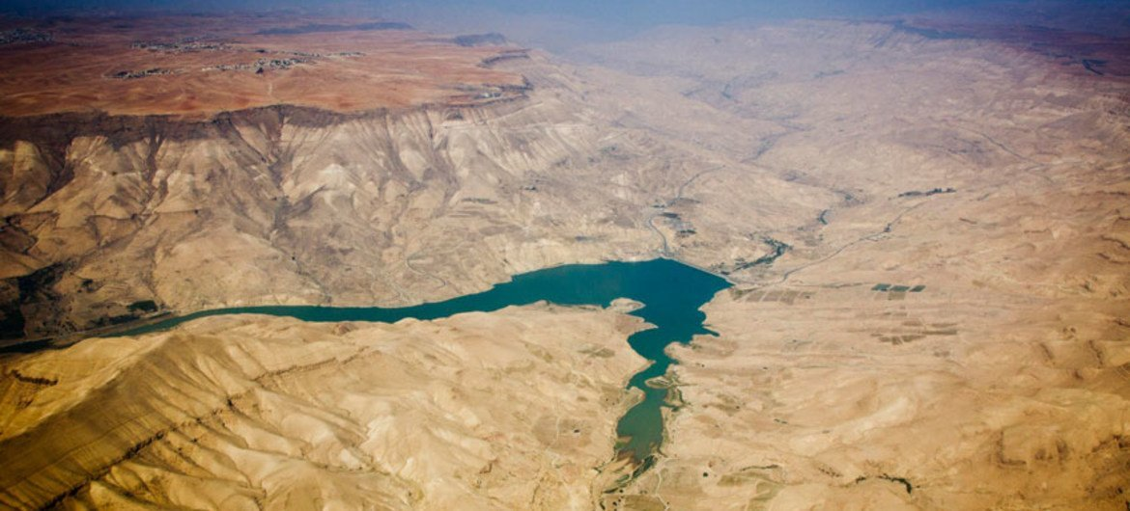
CONSEQUENCES
Water shortages could have a significant negative impact on the service sector through increased operational costs and increased complexity in supply chains. Water Pollution has resulted in a decrease in water quality and quantity making it difficult for farmers to irrigate their crops and for households to access clean water.

Slide 5

SOLUTIONS
One way to counter water scarcity in Jordan is by recycling and reuse of municipal wastewater which is an attractive method in terms of water savings. Infact, the reuse of the treated wastewater in Jordan has reached one of the highest levels in the world.

Slide 6
Credible Websites:
    https://www.ecomena.org/water-jordan
    https://www.usaid.gov/jordan/water-resources-environment
    https://borgenproject.org/water-scarcity-in-jordan
    https://news.stanford.edu/2021/03/29/jordans-worsening-water-crisis-warning-world
    https://www.unicef.org/jordan/water-sanitation-and-hygiene
Citations:
Water Resources &amp; Environment: Basic page: Jordan. U.S. Agency for International Development. (2022, August 16). https://www.usaid.gov/jordan/water-resources-environment
Saiesha. (2022, April 14). 7 facts about water scarcity in Jordan. The Borgen Project. https://borgenproject.org/water-scarcity-in-jordan
A. D. (2022, May 28). Water scarcity in Jordan: An overview. EcoMENA. https://www.ecomena.org/water-jordan
University, S. (2021, March 29). Jordan’s worsening water crisis a warning for the world. Stanford News. https://news.stanford.edu/2021/03/29/jordans-worsening-water-crisis-warning-world
Water, sanitation and hygiene. UNICEF Jordan. (2020, November 4). https://www.unicef.org/jordan/water-sanitation-and-hygiene

