Slide 1
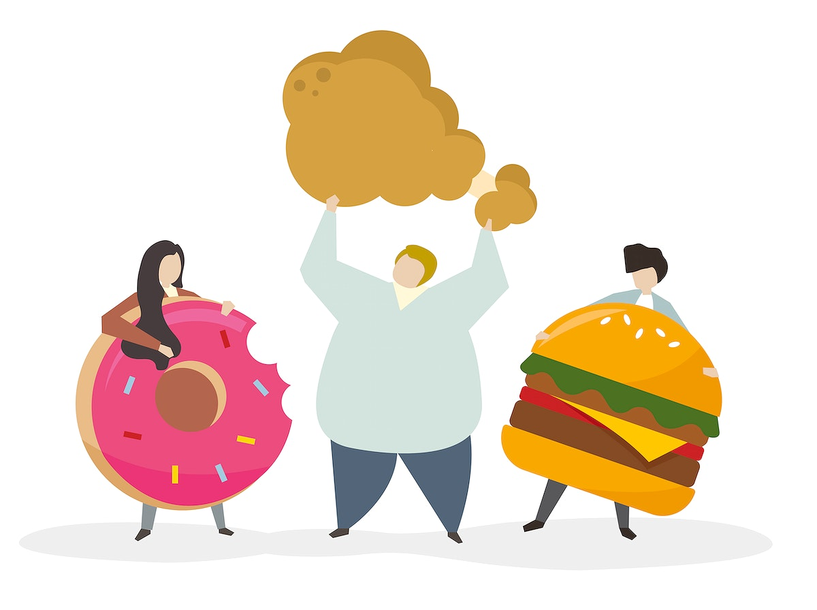
Obesity
Made by: Cynthia Nino, Katia Haddad, and Maya Wardat

Slide 2
What is obesity?
Overweight and obesity are defined as abnormal or excessive fat accumulation that presents a risk to health.

Slide 3
Causes of obesity
1. Obesity is generally caused by consuming more calories – particularly those in fatty and sugary foods – than you burn off through physical activity.
2. Research shows that genetics plays a role in obesity.
3. Some people don’t have access to supermarkets that sell affordable healthy foods, such as fresh fruits and vegetables.
4. Food advertising encourages people to buy unhealthy foods, such as high-fat snacks and sugary drinks.

Slide 4
Consequences of obesity
1. High blood pressure and high cholesterol are risk factors for heart disease.
2. Type 2 diabetes.
3. Breathing problems, such as asthma and sleep apnea.
4. Joint problems such as osteoarthritis and musculoskeletal discomfort.
5. Gallstones and gallbladder disease.

Slide 5
The solutions to obesity
1. you should exercise regularly so the fatty and sugary foods that you consume aren’t stored as fat.
2. you should go to a dietitian and let the doctor give you a meal plan that can help lose weight.
3. you should go to supermarkets or stores that sell healthy food that you can afford.
4. they should make more advertisements about healthy foods and less about unhealthy foods so that people aren’t encouraged by them.

Slide 6
Citation links:
1. World Health Organization. (n.d.). Obesity. World Health Organization. https://www.who.int/health-topics/obesity#tab=tab_1
2. Centers for Disease Control and Prevention. (2022, July 15). Consequences of obesity. Centers for Disease Control and Prevention. https://www.cdc.gov/obesity/basics/consequences.html#:~:text=Adults%20with%20obesity%20have%20higher,as%20clinical%20depression%20and%20anxiety

Slide 7
THANK YOU

