Slide 1
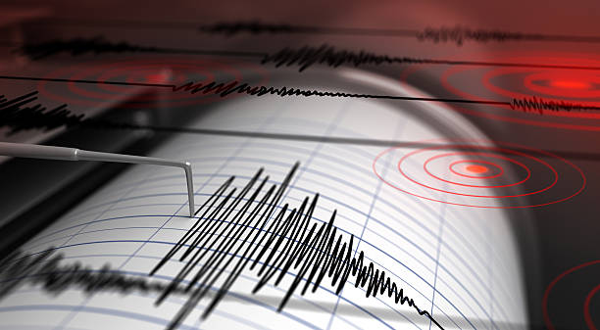
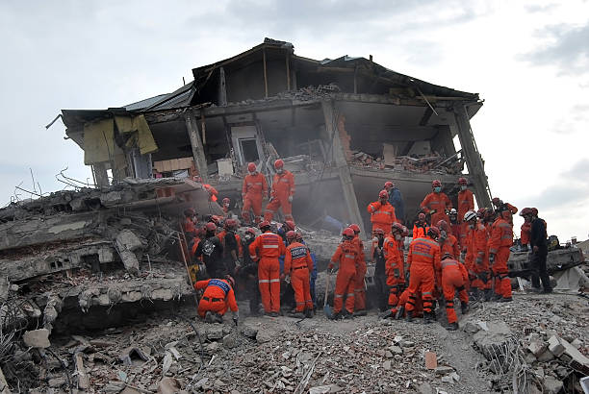
Earthquakes

Slide 2
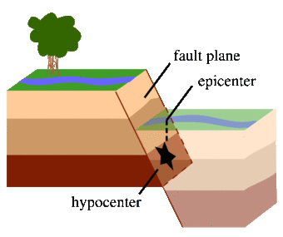
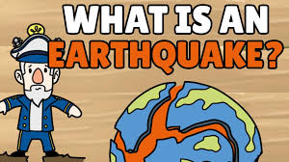
What is an earthquake?
Notes:
What is an earthquake?
An earthquake is what happens when two blocks of the earth suddenly slip past one another. The surface where they slip is called the fault or fault plane.
The location below the earth’s surface where the earthquake starts is called the
hypocenter, and the location directly above it on the surface of the earth is called
the epicenter. Sometimes an earthquake has foreshocks.
These are smaller earthquakes that happen in the same place as the larger
earthquake that follows. Scientists can’t tell that an earthquake is a foreshock until the
larger earthquake happens. The largest, main earthquake is called the mainshock.
Mainshocks always have aftershocks that follow. These are smaller earthquakes that occur afterwards in the same place as the mainshock. Depending on the size of the mainshock, aftershocks can continue for weeks, months, and even years after the mainshock!

Slide 3
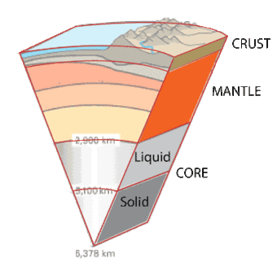
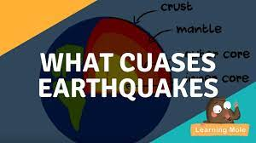
What causes earthquakes and where do they happen?
Notes:
What causes earthquakes and where do they happen?
The earth has four major layers: the inner core, outer core, mantle and crust. The crust and the top of the mantle make up a thin skin on the surface of our planet.
But this skin is not all in one piece – it is made up of many pieces like a puzzle covering
the surface of the earth. Not only that, but these puzzle pieces keep slowly
moving around, sliding past one another and bumping into each other.
We call these puzzle pieces tectonic plates, and the edges of the plates are called the
plate boundaries. The plate boundaries are made up of many faults, and most of the
earthquakes around the world occur on these faults.
Since the edges of the plates are rough, they get stuck
while the rest of the plate keeps moving. Finally, when the plate has
moved far enough, the edges unstick on one of the faults and there is an earthquake.

Slide 4
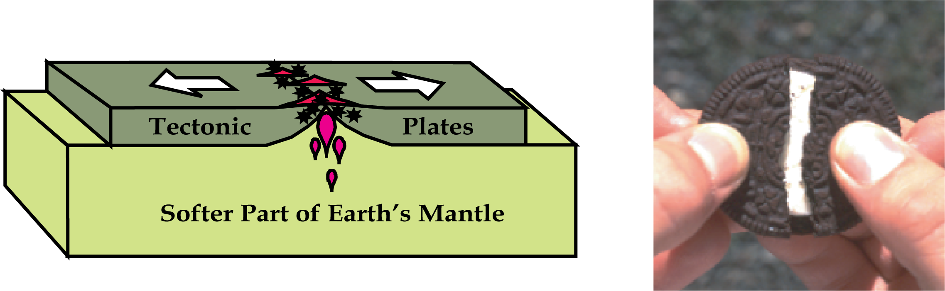
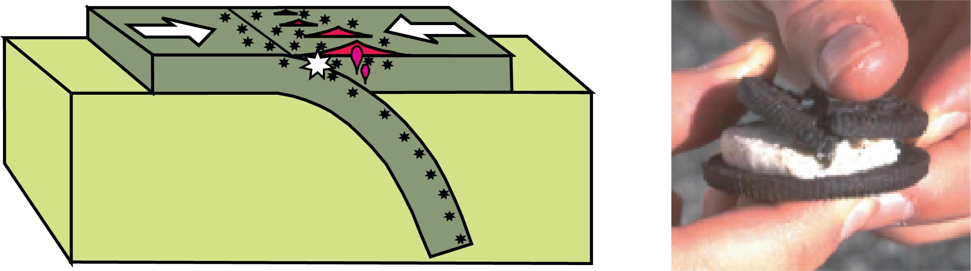
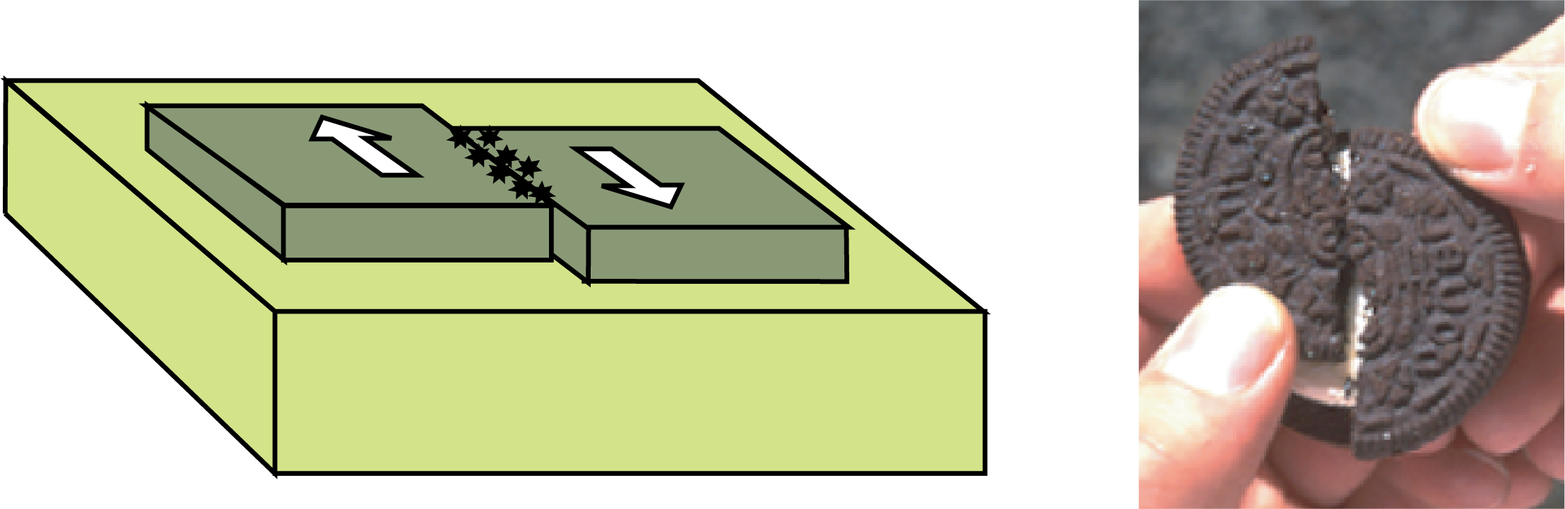
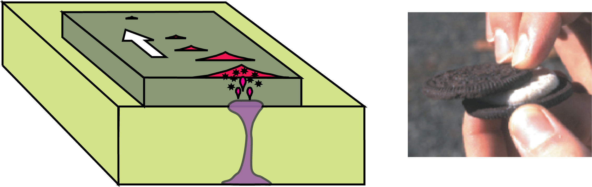
What are the Types of Plate Boundaries?
Divergent Plate Boundary Convergent Plate Boundary
Transform Plate Boundary Hotspot
Notes:
What are the Types of Plate Boundaries?
Divergent Plate Boundary
Volcanic eruptions and shallow earthquakes are common where plates rip apart.
Convergent Plate Boundary
Where plates crash together, one dives (“subducts”) beneath the other, causing volcanoes (red triangles) to erupt on the overriding plate and earthquakes (black
stars) at a variety of depths. The large white star represents the zone where plates lock together in centuries then suddenly let go, causing the largest
earthquakes.
Transform Plate Boundary
Shallow earthquakes and little volcanism occur where one plate slides laterally past another.
Hotspot
In places like Hawaii and Yellowstone, a plate rides over a rising plume of hot mantle, causing earthquakes and a chain of volcanoes.

Slide 5
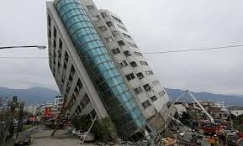
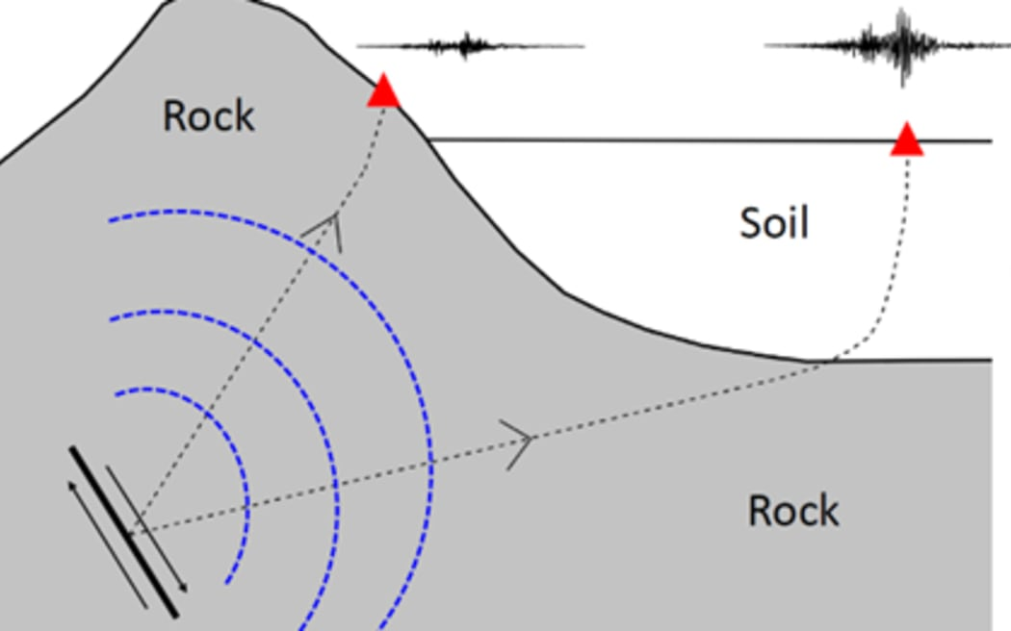
What are the Effects of an Earthquake, and
What are the factors that affect intensity and frequency of earthquake?
Notes:
What are the Effects of an Earthquake?
Ground shaking: Surface waves that are near the epicenter are responsible for the earthquake. The intensity of ground shaking depends on the duration, local geology, and distance. Damage to a man-made structure,
And An outbreak of fire and spilling of hazardous chemicals are the most effects of Earthquakes!
What are the factors that affect intensity and frequency of earthquake?
The earthquake's magnitude: Typically, you will feel more intense shaking from a big earthquake than from a small one. Bigger earthquakes also release their energy over a larger area and for a longer period of time.
Site's proximity to the fault: Earthquake waves diminish in intensity as they travel through the ground, so earthquake shaking is less intense farther from the fault.
local geology and soil type: Soils can greatly amplify the shaking in an earthquake. Passing from rock to soil, seismic waves slow down but get bigger. Hence a soft, loose soil may shake more intensely than hard rock at the same distance from the same earthquake.

Slide 6
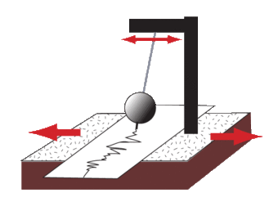
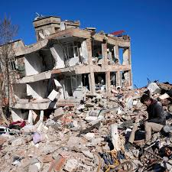
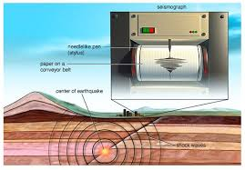
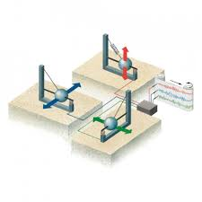
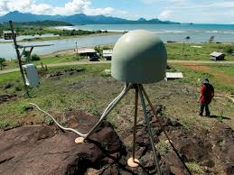
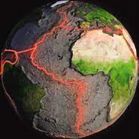
What are the Methods used to detect, measure and predict earthquakes?
How can scientists tell where the earthquake happened?
Can scientists predict earthquakes?
Notes:
What are the Methods used to detect, measure and predict earthquakes?
Earthquakes are recorded by instruments called seismographs. The recording they make
is called a seismogram. The seismograph has a base that sets firmly in the ground,
and a heavy weight that hangs free.
When an earthquake causes the ground to shake, the base of the seismograph shakes too, but the hanging weight does not. Instead, the spring or string that it is hanging from absorbs all the movement. The difference in position between the shaking part of the seismograph and the motionless part is what is recorded.
How can scientists tell where the earthquake happened?
Scientists then use a method called triangulation to determine exactly where the earthquake was. It is called triangulation because a triangle has three sides, and it takes three seismographs to locate an earthquake. If you draw a circle on a map around three different seismographs where the radius of each is the distance from that station to the earthquake, the intersection of those three circles is the epicenter!
Can scientists predict earthquakes?
No, and it is unlikely they will ever be able to predict them. Scientists have tried many different ways of predicting earthquakes, but none have been successful. On any particular fault, scientists know there will be another earthquake sometime in the future, but they have no way of telling when it will happen.

Slide 7
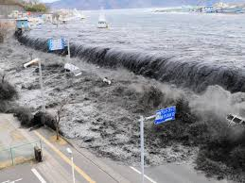
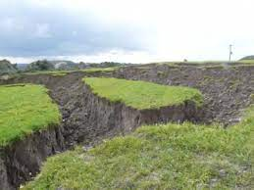
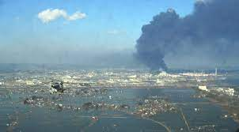
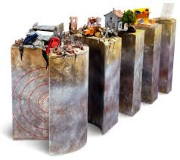
What are The impacts of earthquakes on the natural environment and ecosystem?
Notes:
What are The impacts of earthquakes on the natural environment and ecosystem?
Earthquake environmental effects are the effects caused by an earthquake, including surface faulting, tsunamis, soil liquefactions, ground resonance, landslides and ground failure, either directly linked to the earthquake source or provoked by the ground shaking.
Earthquake environmental effects are divided into two main types:
- Primary effects: which are the surface expression of the seismogenic source (e.g., surface faulting), normally observed for crustal earthquakes above a given magnitude threshold.
- Secondary effects: mostly this is the intensity of the ground shaking.

Slide 8
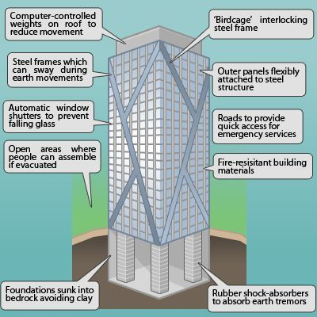
What are some solutions with some reasoning for Earthquakes?
Notes:
What are some solutions with some reasoning for Earthquakes?
Earthquakes can be induced by a wide range of causes including impoundment of reservoirs, surface and underground mining, withdrawal of fluids and gas from the subsurface, and injection of fluids into underground formations. While most induced earthquakes are small and present little hazard, larger and potentially damaging manmade earthquakes have occurred in the past.
We cannot prevent natural earthquakes from occurring, but we can significantly mitigate their effects by identifying hazards, building safer structures, providing education on earthquake safety and preparing for natural earthquakes we can also reduce the risk from human induced earthquakes.

Slide 9
Project Conclusion and Resources:
https://www.usgs.gov/programs/earthquake-hazards/science-earthquakes
https://www.earthquakecountry.org/putting-down-roots/shaking/
https://www.usgs.gov/faqs/can-we-cause-earthquakes-there-any-way-prevent-earthquakes
Project Team:
Mohammad Younes
Zaid Al Hishan
Murad Al Madaeen
Faisal Thalji
Notes:
Earthquakes shake the ground surface, can cause buildings to collapse, disrupt transport and services, and can cause fires. They can trigger landslides and tsunami.
Earthquakes occur mainly as a result of plate tectonics, which involves blocks of the Earth moving about the Earth's surface. The blocks of rock move past each other along a fault.
Smaller earthquakes, called foreshocks, may precede the main earthquake, and aftershocks may occur after the main earthquake. Earthquakes are mainly confined to specific areas of the Earth known as seismic zones, which coincide mainly with ocean trenches, mid-ocean ridges, and mountain ranges.
The point of origin of an earthquake is called the focus. The epicentre is the point on the Earth's surface directly above the focus. Most earthquake foci are within a few tens of kilometres of the Earth's surface. Earthquakes less than 70 km deep are classified as shallow-focus. Intermediate-focus earthquakes are 70-300 km deep, and deep-focus earthquakes more than 300 km deep. Shallow-focus earthquakes occur in all of the Earth's seismic zones, but intermediate- and deep-focus earthquakes are almost exclusively associated with seismic zones near ocean trenches.
The destructiveness of an earthquake depends on the size, the depth (shallow ones are more destructive) and the location. Earthquake size can be stated in terms of the damage caused (the intensity) or the amount of ground motion and the energy released by the earthquake (related to the Richter magnitude).

