Slide 1

Earthquakes
By: Lareine Hammad, Miral haddad, Zeina qudies, Rama hanaqta

Slide 2
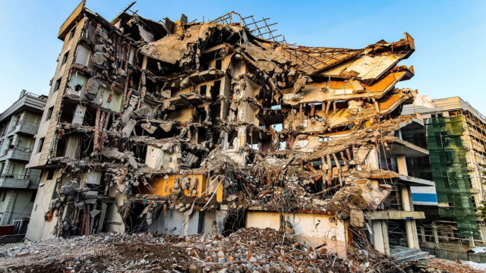
Notes:
What is an earthquake?
An earthquake is when two blocks of the earth suddenly slip past one another,
called a fault or fault plane. It can have foreshocks, mainshocks, and aftershocks that can
continue for weeks, months, and even years.

Slide 3
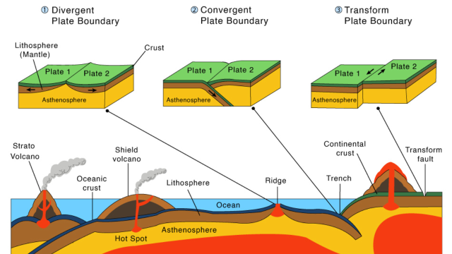
Notes:
Tectonic plate boundaries:
The Earth's outer layer is made up of three types of plate tectonic boundaries: divergent, convergent, and transform, which can cause earthquakes, volcanoes, and cracking of the crust.

Slide 4
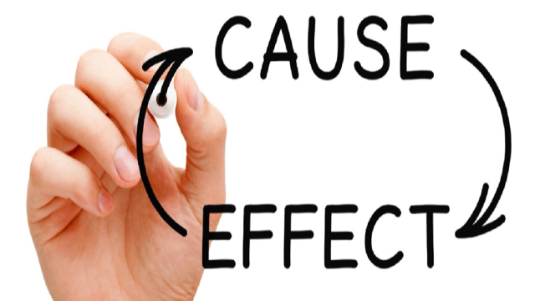
Notes:
Causes and effects:
Ground shaking can damage buildings, but low-frequency vibrations don't weaken as much as high-frequency ones.
Surface faulting, liquefaction, lateral spreads, and tsunamis are all caused by earthquakes, which can cause damage to buildings, roads, and tunnels.
Earthquakes are caused by natural or human causes, and the strength of the shaking depends on the depth, proximity, and type of ground.

Slide 5
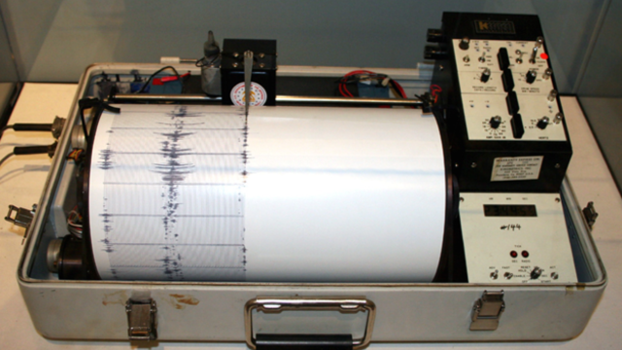
Notes:
Prediction methods:
Seismologists use seismometers to detect, measure and predict earthquakes, using historical data and trends to estimate the location, frequency, and magnitude of earthquakes. Radon emissions and animal behavior are also used for earthquake prediction. QuakeFinder is working to detect and analyze electromagnetic earthquake precursors.
The VAN method measures changes in the geoelectric potential to predict earthquakes, while seismographs measure magnitude and intensity scales measure shaking.

Slide 6
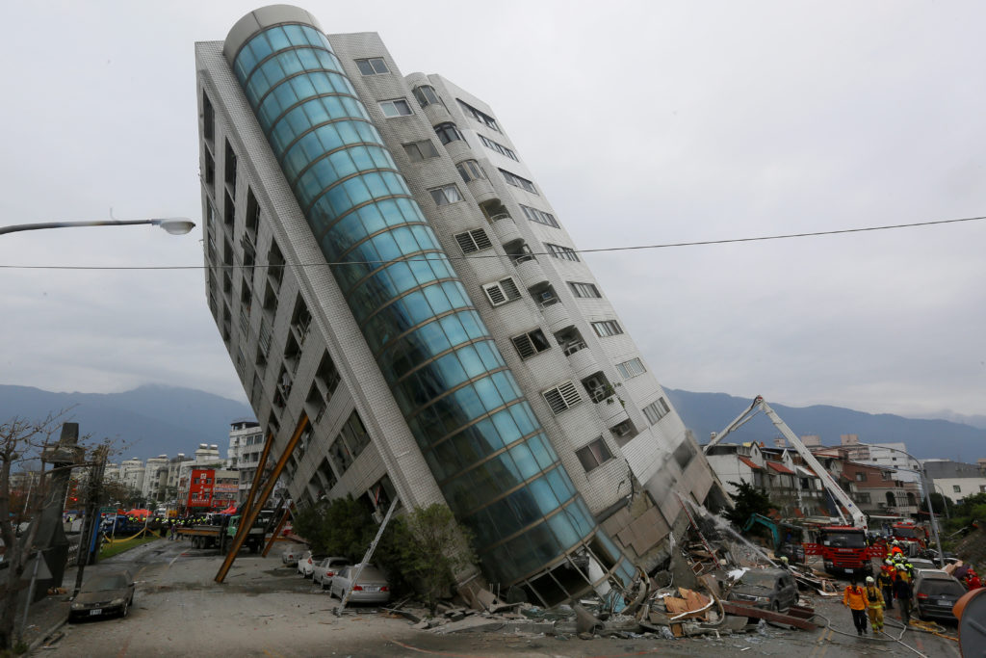
Notes:
Consequences of earthquakes
Earthquakes can cause damage and spread diseases, so it is important to have good hygiene, clean living conditions, and access to medical care to prevent them.

Slide 7
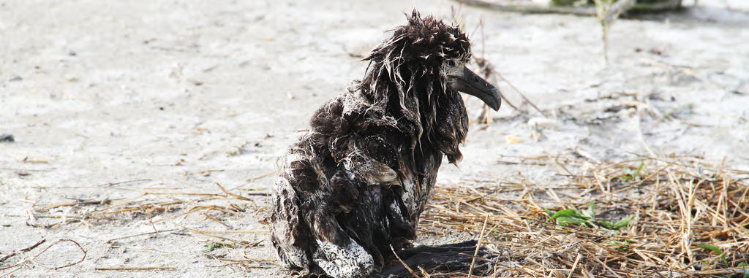
Notes:
consequences of earthquakes
Earthquakes can cause damage to people, animals, and buildings, as well as
spread diseases. To prevent this, it is important to have good hygiene, clean living
conditions, and access to medical care.
Earthquakes can cause damage to buildings, fires, bridges, roads, hills, and tsunamis,
as well as displacement of sediment in the marine environment, potentially burying or disturbing
benthic fauna.
Earthquakes can cause immediate and long-term health impacts.
The social impact of earthquakes is the most serious, with 125 million people affected
and 747.234 deaths between 1998 and 2017.
Solution
Be prepared, build stronger buildings, and teach people how to be safe during an
earthquake.

Slide 8
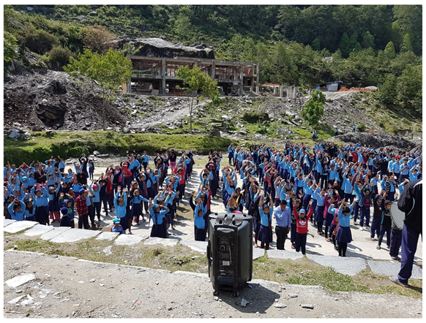
Notes:
Solutions to earthquakes
We can't stop earthquakes from happening naturally, but we can make things better by being prepared, building stronger buildings, and teaching people how to be safe during an earthquake. This will also help to make sure that people don't cause earthquakes by accident.

Slide 9

Notes:
Conclusion
In conclusion earthquakes can do a lot of damage to our environment, ecosystem
and can harm us too…. So if we don’t learn how to deal with them its going to cause
immense damage

Slide 10
Sources (websites used )
https://blog.jumpstartinsurance.com/
https://www.usgs.gov/
https://pubmed.ncbi.nlm.nih.gov/
https://oceanexplorer.noaa.gov/facts/plate-boundaries.html
https://ui.adsabs.harvard.edu/abs/2017EGUGA..19.3884M/abstract
https://analyticssteps.com/
https://news.mit.edu/
https://agupubs.onlinelibrary.wiley.com/
https://issuu.com/
https://www.who.int/
https://quantectum.com/

Slide 11


