Slide 1
Basketball
Made by miraldababneh

Slide 2
Basketball health benefits:
It teaches you to about being a good team player and can be a great social sport.
an hour of basketball can burn 630-750 calories
Improve balance and coordination
Build up muscles

Slide 3
Why should I play basketball?
Playing basketball allows me to make new friends and have fun while being active.
Playing basketball helps keep my muscles and joints flexible and strong.
Playing basketball stimulates my brain.

Slide 4
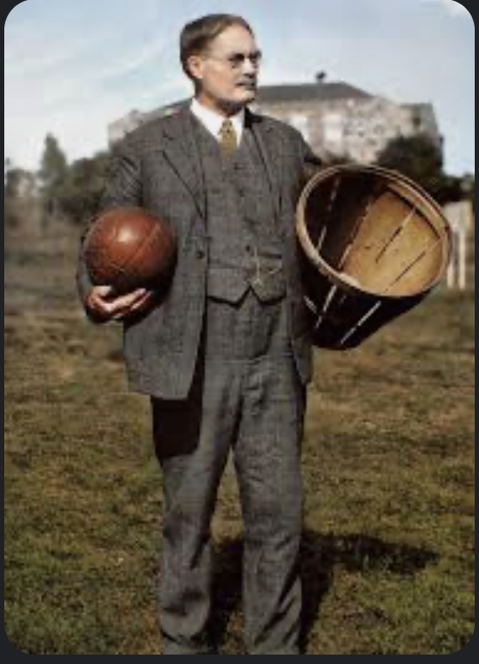
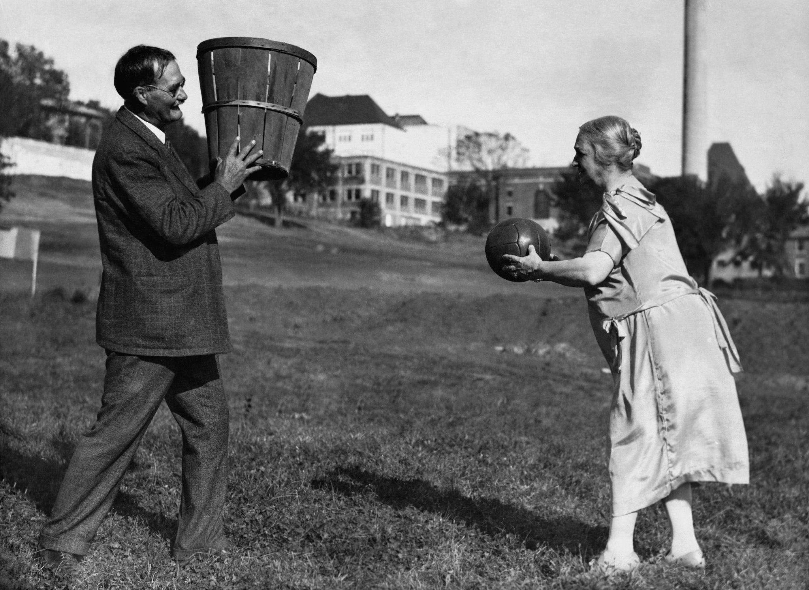
Basketball history
Basketball was invented at a YMCA in spring field,MA in 1891 by James Naismith.
When James first invented the game he used a soccer ball and peach basket as the hoop to create the sport
In 1893, he replaced the speech of basket with iron hoops and a hammock-style basket.eventually the net was made with a hole in it,so no longer had to recive the ball.

Slide 5
Basketball rules:
Each team should has 5 players on the court at a time with substitutes waiting on the bench.
The object of the the game is to shoot the ball through the basket and outscore the opposing team.
Goals can be worth 1-2 or 3 of points
Basketball is a non-contact sport so opposing players must defend their basket without making contact with a opposition player.
Defenders must steal the ball or presure opponents into missing their field goal attempt so as to rebound the ball and gain possession.

Slide 6
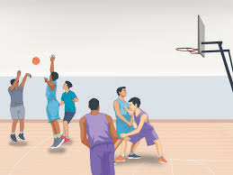
At the end of the lesson you must be able to know:
1:Basketball health benefits.
2: why should you play basketball
3:basketball history
4:basketball rules

