Slide 1

Earthquakes
By: Amir, Ramez, Zaid

Slide 2
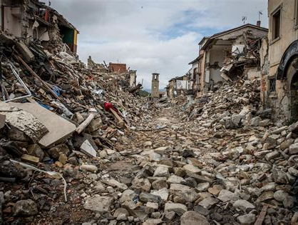
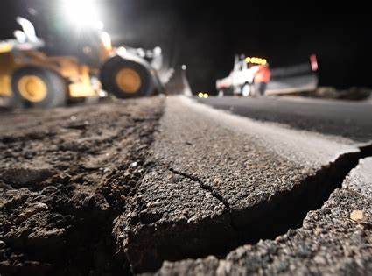
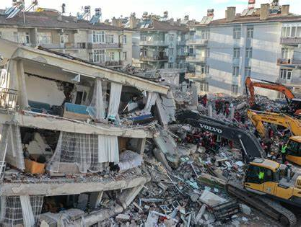
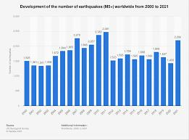
What are the issues of earthquakes
Health issues due to earthquakes can vary a lot according to the magnitude of earthquakes, and the nature of poorly build houses are in danger.
Made by: Zaid Barghouth

Slide 3
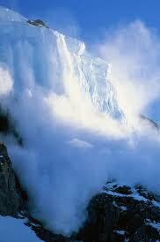
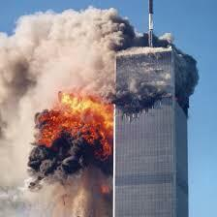
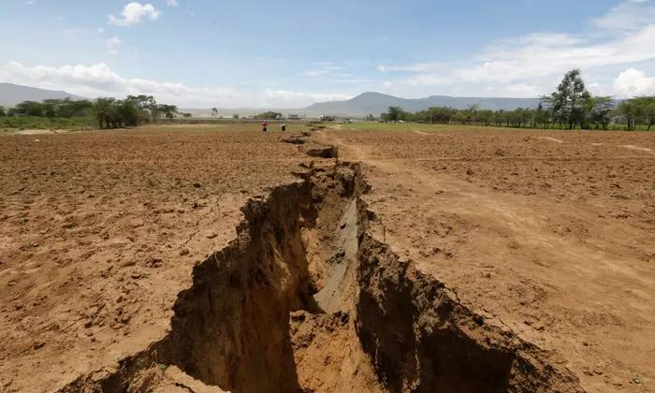
What are the issues of earthquakes
Made By: Zaid Barghout

Slide 4
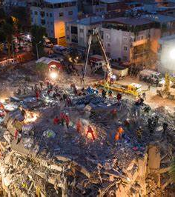
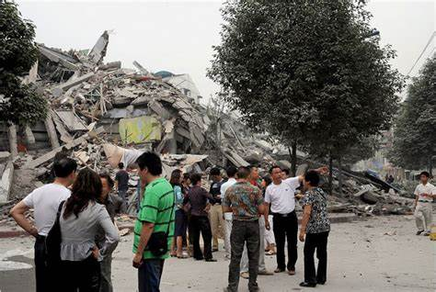
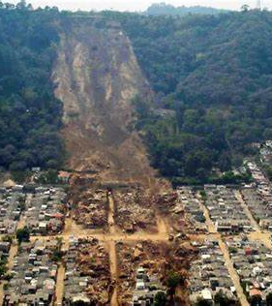
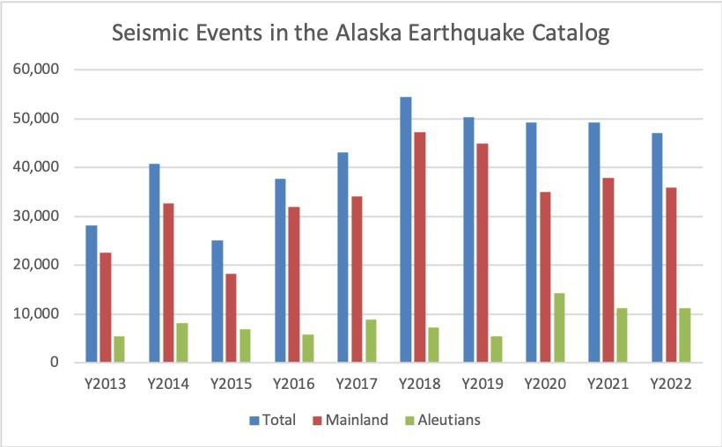
What are the consequences of earthquakes?
Earthquakes can result in ground shaking, landslides, fissures, avalanches in snowy areas fires and tsunami.
Made By: Amir Haddadin

Slide 5
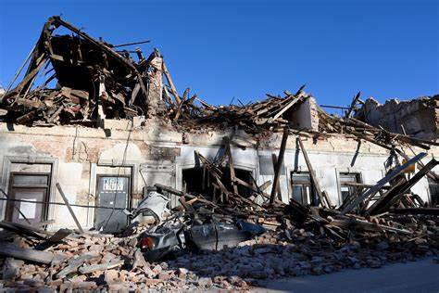
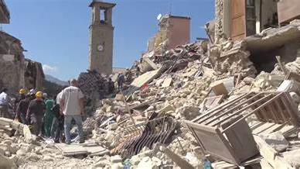
What are solutions for earthquakes
You can also protect yourself financially by talking to your insurance representative. You may want to consider increasing your earthquake insurance.
Made By: Ramez Zraikat

Slide 6
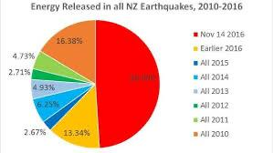
What are the causes earthquakes?
Earthquakes are usually caused when rock underground suddenly breaks along a fault. This sudden release of energy causes the seismic waves that make the ground shake.
Made By: Ramez Zraikat

Slide 7
References
Made By: The entire group
Fema.gov
Usgs.gov
Who.int
Mtu.edu

