Slide 1
Earthquakes
By:layan/Sama/Mireille

Slide 2
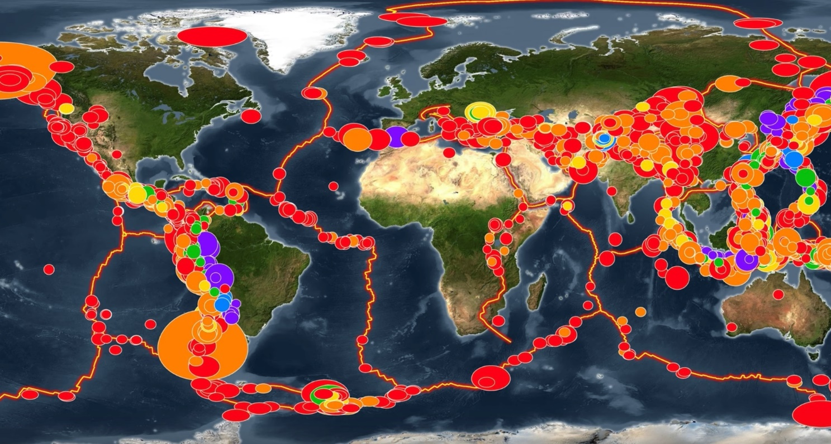
What is a earthquake?
earthquakes
Notes:
A sudden violent shaking of the ground typically causing great destruction as a result of movement within the earth crust or volcanic action .

Slide 3
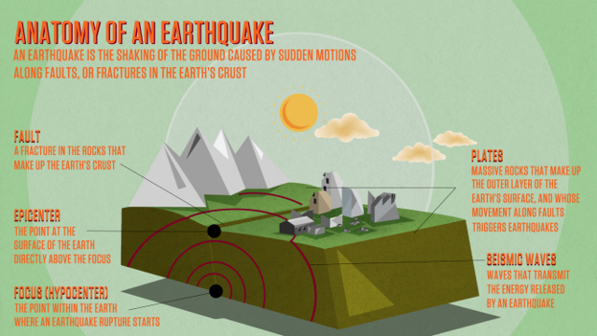
Effects of an earthquake
The effects of earthquake
Notes:
Earthquake environmental consequences include surface faulting, tsunamis, soil liquefactions, ground resonance, landslides, and ground collapse that are either directly related to the earthquake source or induced by the ground shaking.

Slide 4
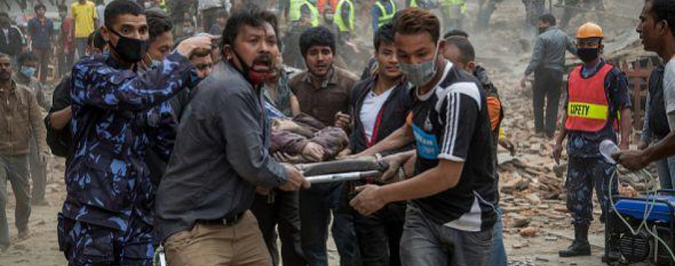
How many people died in turkey and Syria earthquake?
Injured people in turkey and Syria
Notes:
50,783 in Turkey and 8,476 in Syria.

Slide 5
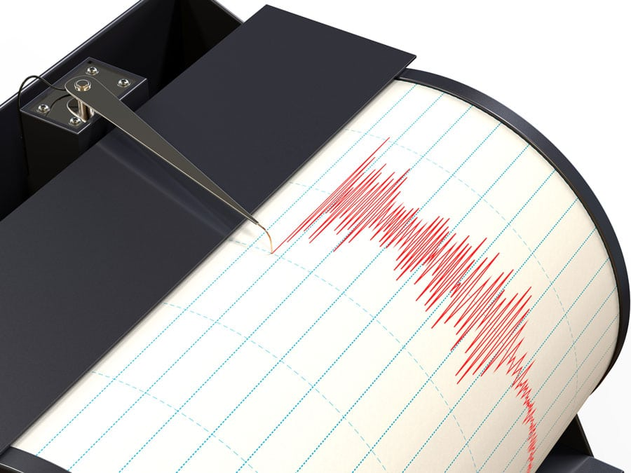
Methods used to detect, measure and predict earthquakes.
This is a seismometer that humas use to detect sounds
Notes:
Seismometers detect and quantify earthquakes by translating vibrations caused by seismic waves into electrical signals, which are subsequently shown on a computer screen as seismograms. Seismologists study earthquakes and can use this information to calculate the location and magnitude of an earthquake.

Slide 6
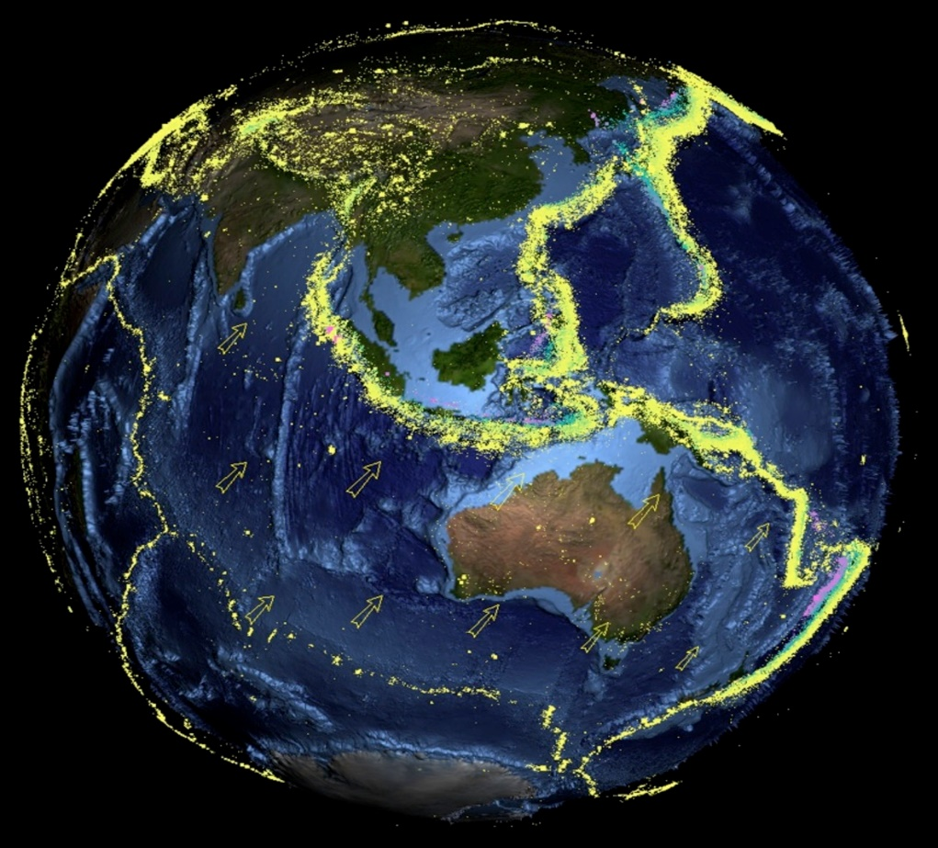
The factors that affect the intensity and frequency of earthquakes.
How hard earthquakes can come
Notes:
The extent of damage depends on how violently the ground shakes when an earthquake occurs. The depth of the earthquake, the distance from the fault, the underlying soil, and the features of the buildings, particularly their height, are the subsequent primary elements impacting earthquake shaking strength.

Slide 7
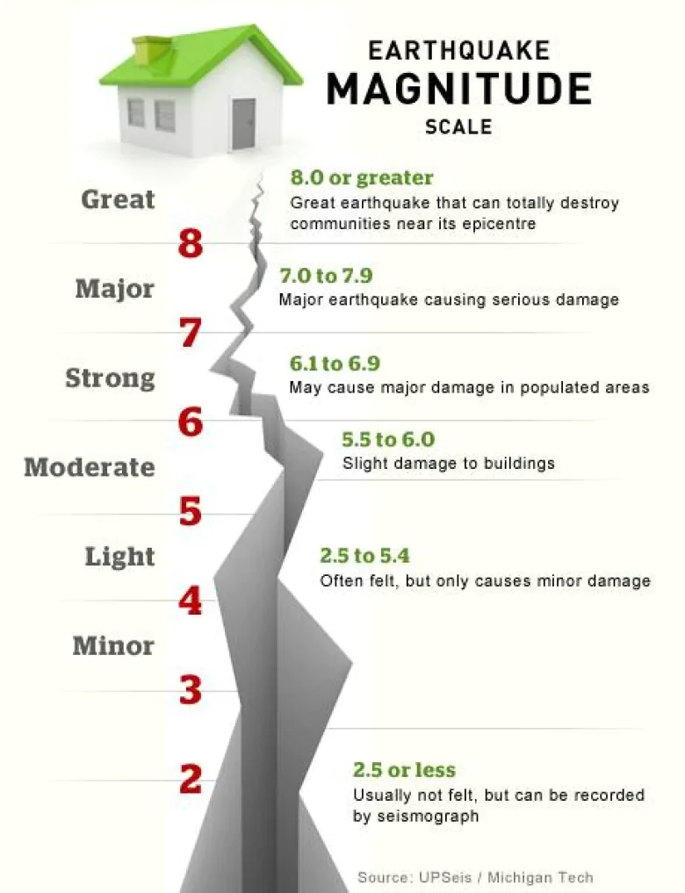
what was the magnitude of the earthquake
The magnitude of the earthquakes
Notes:
Between 4.1 and 7.8 magnitude in Syria
Between 4.5 magnitude and 7.8 magnitude in turkey

Slide 8
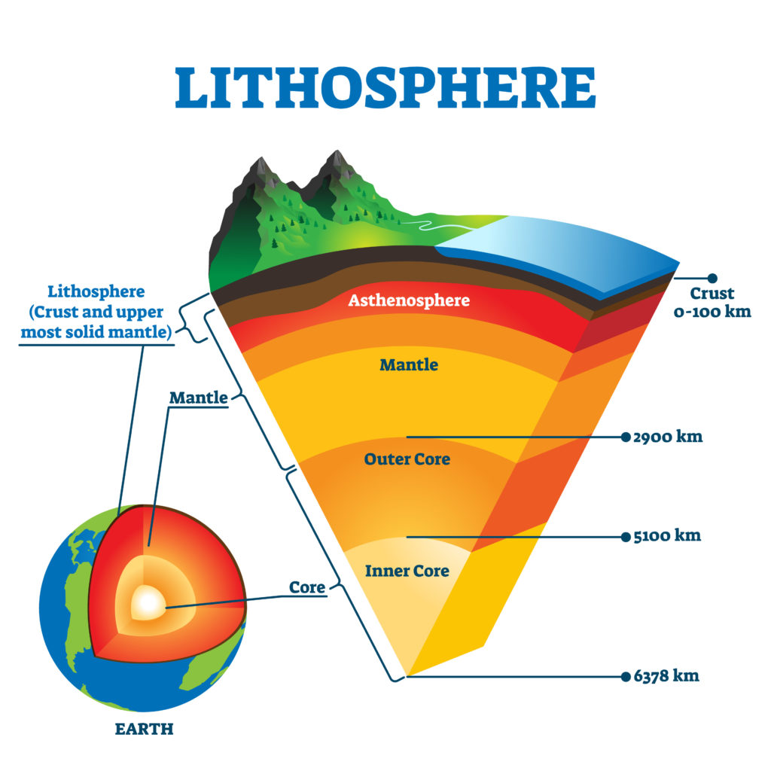
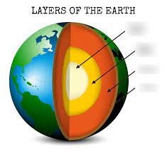
What causes earthquakes
Tectonic plates puzzle
Notes:
Earth is like a puzzle when 2 of the pieces called tectonic plates slide over each other an earthquake occurs.

Slide 9
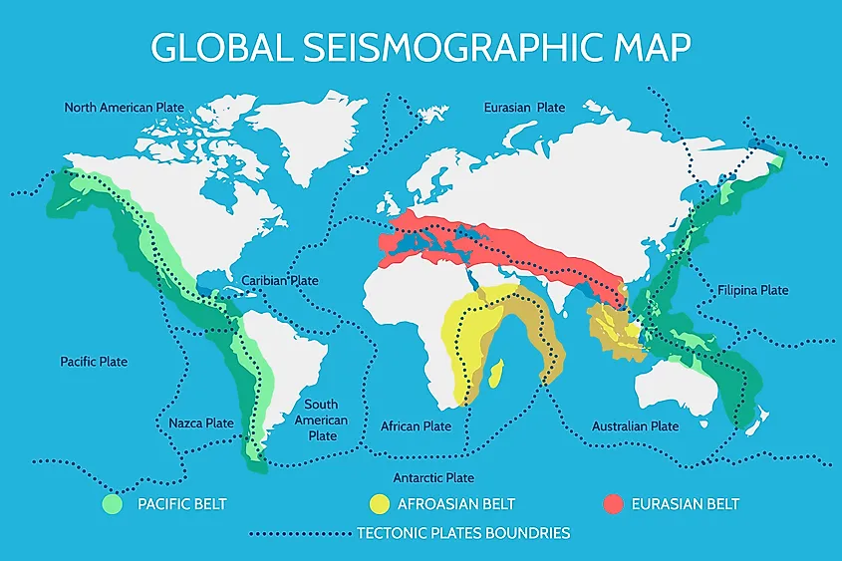
Where do earthquakes mostly happens in?
Where earthquakes happens the most
Notes:
Japan / turkey /U.S / Philippine / Syria / China /Lebanon / Indonesia

Slide 10
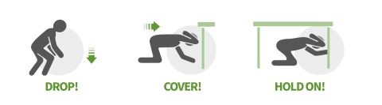
How to Protect Yourself During Earthquakes?
How to protect yourself from an earthquake

Slide 11
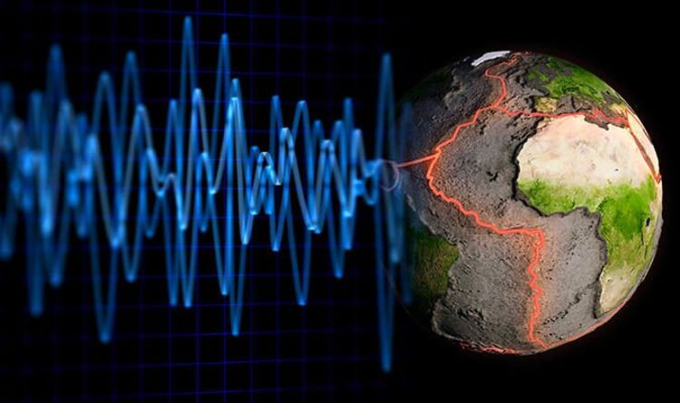
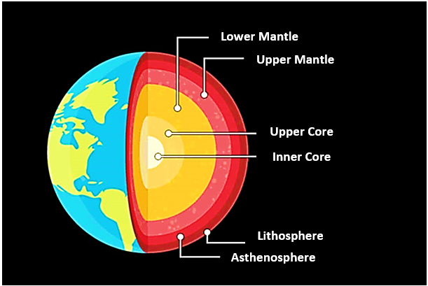
conclusion
The conclusion of the earthquake
Notes:
Earthquakes shake the earth, causing buildings to fall, disrupting transportation and services, and causing fires. They have the potential to cause landslides and tsunamis. Earthquakes are caused primarily by plate tectonics, which includes slabs of the Earth moving across its surface.

Slide 12

The resources we got our info from
Videos
https://kids.natio
https://www.britannica.com/science/earthquake-geology
https://www.redcross.org/get-help/how-to-prepare-for-emergencies/types-of-emergencies/earthquake.html
https://www.ready.gov/earthquakes
https://www.osha.gov/earthquakes/resources

