Slide 1
OBESITY
By: Taleen, Hamzeh, Christine and Sanad

Slide 2
INTRODUCTION
Obesity has become an epidemic, reaching alarming proportions and demanding immediate attention. In this presentation, we will explore the causes, consequences, and our solution to this complex and multifaceted problem.

Slide 3
TOPICS
01
03
Definition and Prevalence
Consequences
02
04
Causes
Our solution
(What is obesity?)
(In the long run)
(Key contributors to obesity)
(How will we address this problem?)

Slide 4
DEFINITION AND PRIVALENCE
Obesity is a medical disorder defined by an abnormally large buildup of body fat, which has a negative impact on an individual's health and well-being.
Obesity has become a worldwide health problem in recent decades as its prevalence has increased. In 2016, more than 650 million adults and 340 million children and adolescents were classed as obese by the World Health Organization (WHO).
These figures have been gradually rising, putting a major strain on individuals, families, and healthcare systems throughout the world.

Slide 5
CAUSES
Poor Diet
Socioeconomic Factors
1
6
Sedentary Lifestyle
Lack of Sleep
2
5
Genetic and Biological Factors
Emotional Factors:
3
4
Lacking essential nutrients
Processed foods high in sugars
Income disparities
Limited access to healthy food options
Increased screen time
Reliance on cars for transportation
Inadequate sleep
Poor sleep quality
Stress
Boredom
Using food as a coping mechanism
Predisposition to gaining weight
hormonal imbalances
underlying medical conditions

Slide 6
CONSEQUENCES
Increased Risk of Chronic Diseases
Economic Burden
Social and Psychological Impact on Children
Psychological and Emotional Impact
Joint Problems:
Healthcare costs related to obesity treatment and management
Reduced productivity
Cardiovascular disease
Type 2 diabetes
Certain cancers
Low self-esteem
Depression
Poor academic performance
1
2
3
4
5
Joint pain
Osteoarthritis
Reduced mobility
Low self-esteem,
Depression,
Anxiety

Slide 7
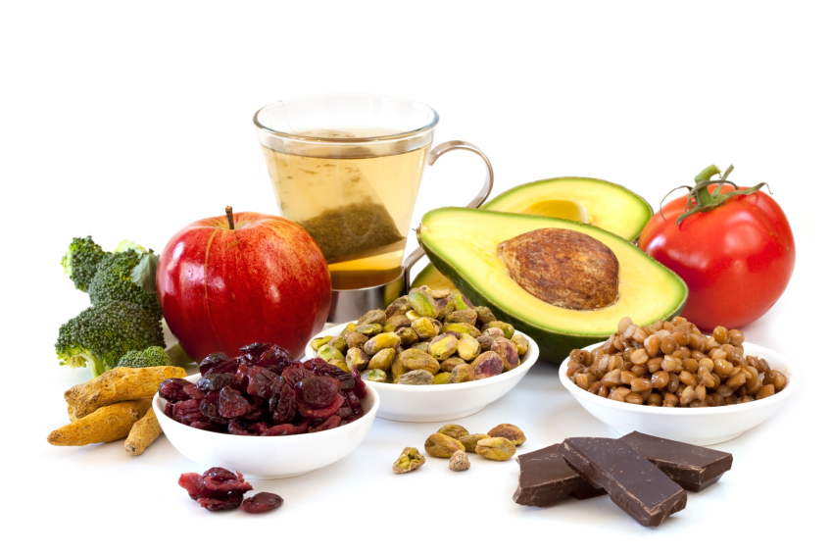
OUR SOLUTION
We have made a campaign called "Cook it from Scratch", where we believe that fresh, homemade meals are the foundation of a healthy and happy life.
In a world where convenience and processed foods dominate our diets, we want to empower people to take control of their health by cooking with whole, unprocessed ingredients.

Slide 8
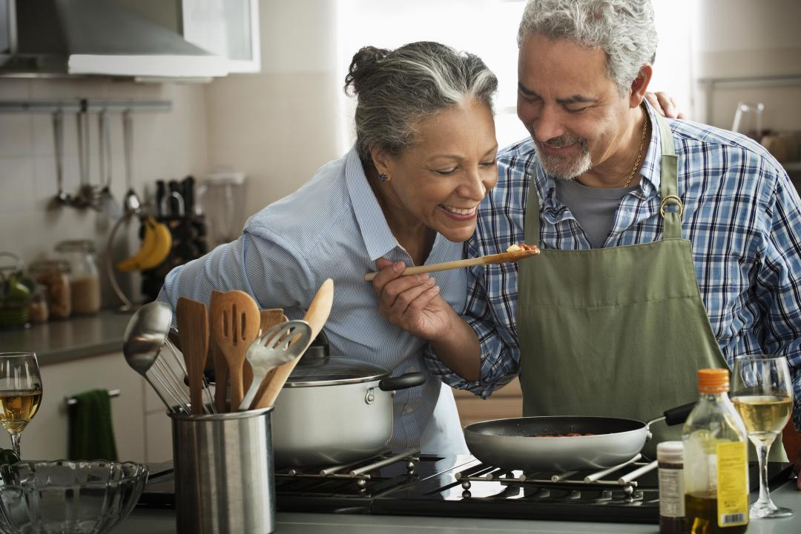
By cook it from scratch, you can enjoy delicious, nourishing meals that are tailored to your tastes and dietary needs.
You can also take pride in the fact that you are creating something with your own hands, and that you are making a positive impact on your health and the health of your family.

Slide 9
The cookbook features a diverse collection of recipes, carefully curated to incorporate wholesome ingredients and promote healthier eating habits.
Each recipe has been thoughtfully crafted to strike a balance between flavor, nutrition, and simplicity.
We understand that the journey toward a healthier lifestyle can sometimes feel overwhelming, which is why these recipes are specifically tailored to be accessible to individuals of various cooking skill levels.
As part of our comprehensive campaign to address obesity, we have developed a special cookbook that serves as a valuable resource for individuals seeking to make positive changes in their lives.
This cookbook is designed to provide practical guidance and inspiration for preparing delicious, nutritious meals that can contribute to weight management and overall well-being.

Slide 10
OUR AIM
Our aim is to make the path to healthier living enjoyable, sustainable, and empowering. We firmly believe that everyone has the potential to take control of their health and well-being through the simple act of cooking and savoring homemade meals.
Together, let's embrace the power of nutritious and delicious cooking as we combat obesity and foster a culture of wholesome living.

Slide 11
Thank you for listening!

