Slide 1
Made by: Majd ,shawqi ,sanad ,saif and yousef
Earthquakes

Slide 2

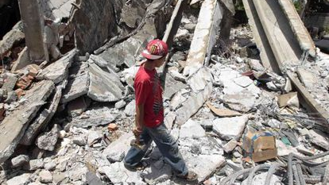



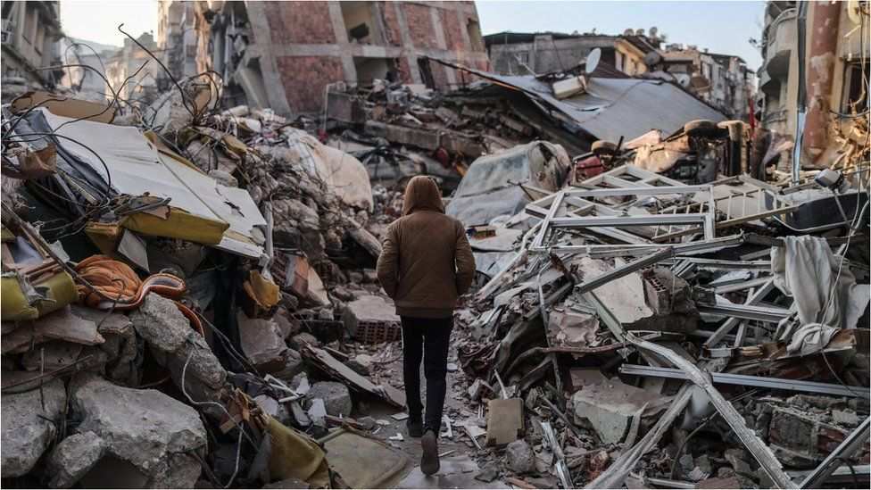

Issues of earthquakes
Notes:
On Feb. 6, a magnitude 7.8 earthquake occurred in southern Turkey near the northern border of Syria. This quake was followed approximately nine hours later by a magnitude 7.5 earthquake located around 59 miles (95 kilometers) to the southwest.

Slide 3
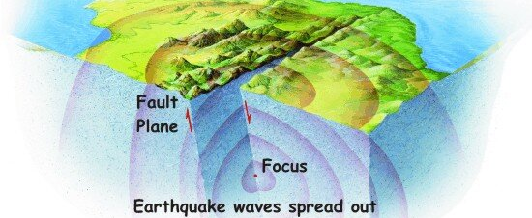
Causes of earthquake
Notes:
The tectonic plates are always slowly moving, but they get stuck at their edges due to friction. When the stress on the edge overcomes the friction, there is an earthquake that releases energy in waves that travel through the earth's crust and cause the shaking that we feel.

Slide 4
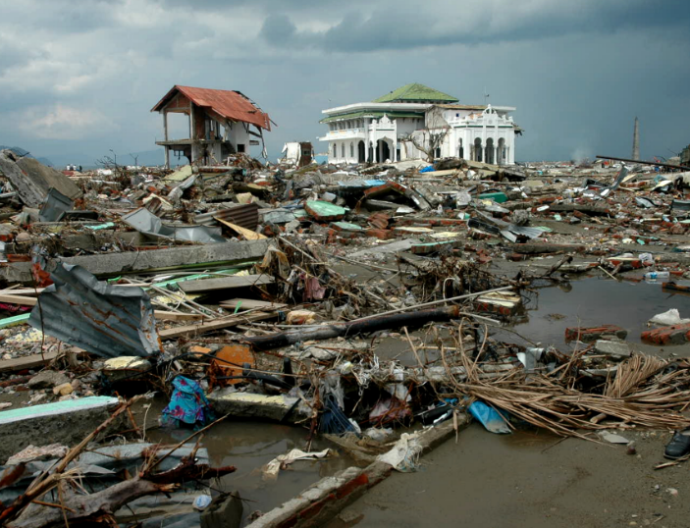
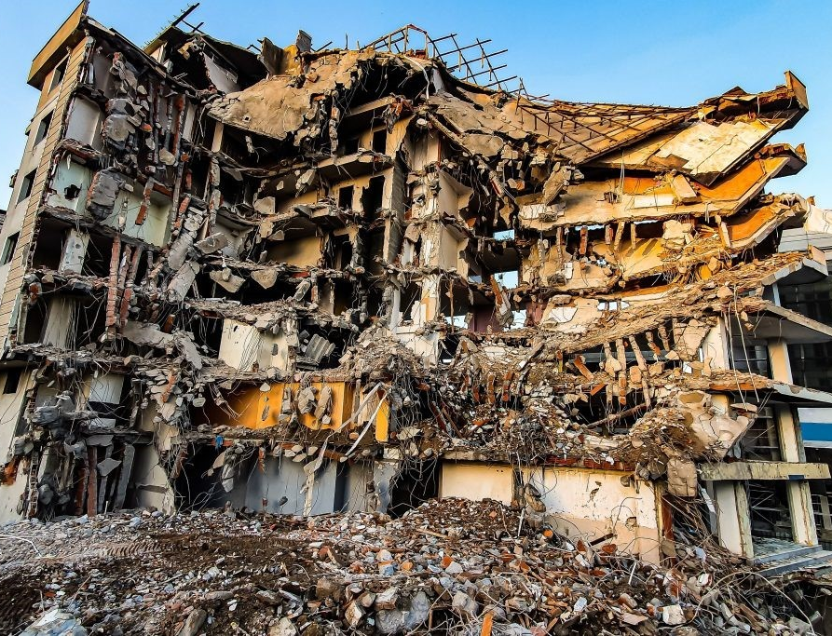
Consequences
Notes:
Earthquakes can result in the ground shaking, soil liquefaction, landslides, fissures, avalanches, fires and tsunamis. The extent of destruction and harm caused by an earthquake depends on: magnitude. intensity and duration

Slide 5

Solutions of earthquakes
Notes:
We cannot prevent natural earthquakes from occurring but we can significantly mitigate their effects by identifying hazards, building safer structures, and providing education on earthquake safety. By preparing for natural earthquakes we can also reduce the risk from human induced earthquakes.

Slide 6
Resourses
https://www.usgs.gov/faqs/what-earthquake-and-what-causes-them-happen#:~:text=The%20tectonic%20plates%20are%20always,the%20shaking%20that%20we%20feel.
disasterphilanthropy.org
Notes:
These are the web pages that we used

