Slide 1
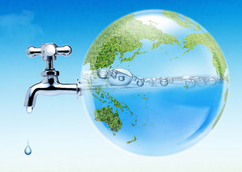
Water crisis
(3rd month project)
By : Noaf, Lara, Bana

Slide 2
Water crisis in jordan
Did you know that water crisis is a growing problem in all of Jordan? Many people don’t have access to clean water, and it’s affecting their health and well-being. It’s a really important issue that we should all be aware of. Jordan is one of the most water-scarce countries in the world, and it’s water resources are decreasing due to a combination of factors including climate change , population growth , and inefficient water use. So how can we as a society help or even stop this major problem?

Slide 3
causes of water crisis
There are several causes and issues related to water crisis in Jordan. One of the main issues is the country’s limited water resources which are decreasing , due to climate change and population growth.
Another issue is the inefficient use of water, particularly in the agricultural sector , which is the largest consumer of water in the country.
Finally , the on going conflicts in neighboring countries have put additional pressure on Jordan’s water resources, as refugees have fled to the country and increased demand for water

Slide 4
What will happen if jordan runs out of water?
If Jordan were to run out of water , the consequences would be severe. The country would face a humanitarian crisis, as people would be unable to access the water they need for drinking , cooking , and sanitation. This could lead to the spread of disease and illness, particularly among vulnerable populations such as children and the elderly.
The agricultural sector would be severely impacted , leading to food shortages and economic instability.
The lack of water could exacerbate existing conflicts and tensions in the region as countries compete for scarce resources.

Slide 5
Solutions
There are several solutions that could help to alleviate the water crisis in Jordan. Firstly , is to increase investment in water infrastructure and technologies, such as desalination plants and waste water treatment facilities. Secondly , is to promote more efficient use of water through the use of drip irrigation and other water-saving techniques. Next , there is a need to raise awareness about the importance of water conservation and to encourage individuals and businesses to adopt more sustainable practices. Finally , there is a need for regional cooperation and diplomacy, to manage shared water resources and to adjust the root causes of the water crisis.

Slide 6
Conclusion
In conclusion, the water crisis in Jordan is a complex issue that requires urgent attention and action. The country’s limited water resources , combined with inefficient use and a lack of investment infrastructure and technologies have led to a situation where water scarcity is a daily reality for many people. If left unaddressed, this crisis could have many dangerous consequences for public health , the economy , and regional stability. By taking action now , we can help to ensure that Jordan has a sustainable water supply for generations to come.

Slide 7
Resources
Link 1
Link 2
Link 3
Link 4
Link 5

Slide 8
THANK YOU

