Slide 1
-Earthquakes-
By: Celina , Raya , Dina , Kinda

Slide 2
-Outcome-
1.
3.
2.
4.
What are the effects and causes of earthquakes?
What are the methods to detect and measure earthquakes?
What are the impacts of earthquakes on the natural environment?
What are the factors that affect the intensity of an earthquake?

Slide 3
1.
What are the effects and causes of earthquakes?
Notes:
-the causes of earthquakes-
When the Earth’s crust doesn’t move for a long time.
the rock on either side of a fault slowly deforms over time due to tectonic forces.
when the underground rock suddenly breaks and there is rapid motion along a fault.
-The effects of earthquakes-
damage to bridges and highways
the ground shaking
soil liquefaction
landslides
fissures
avalanches
fires
tsunamis.
-

Slide 4
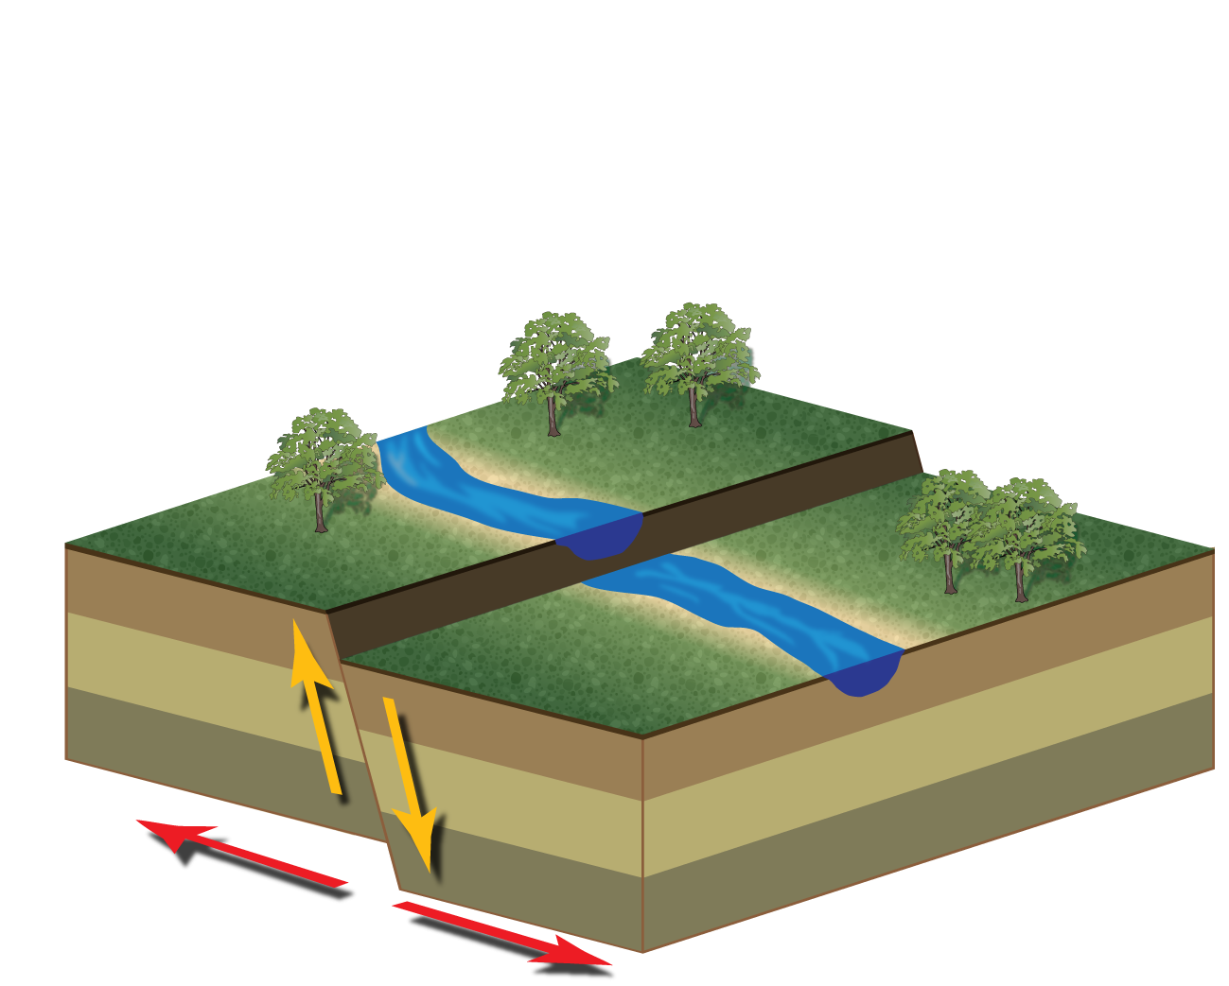
-
Notes:
-the causes of earthquakes-
When the Earth’s crust doesn’t move for a long time.
the rock on either side of a fault slowly deforms over time due to tectonic forces.
when the underground rock suddenly breaks and there is rapid motion along a fault.
-The effects of earthquakes-
damage to bridges and highways
the ground shaking
soil liquefaction
landslides
fissures
avalanches
fires
tsunamis.

Slide 5
What are the factors that affect the intensity of an earthquake?
2.
Notes:
earthquake depth
proximity to the fault
the underlying soil
building characteristics—particularly height

Slide 6
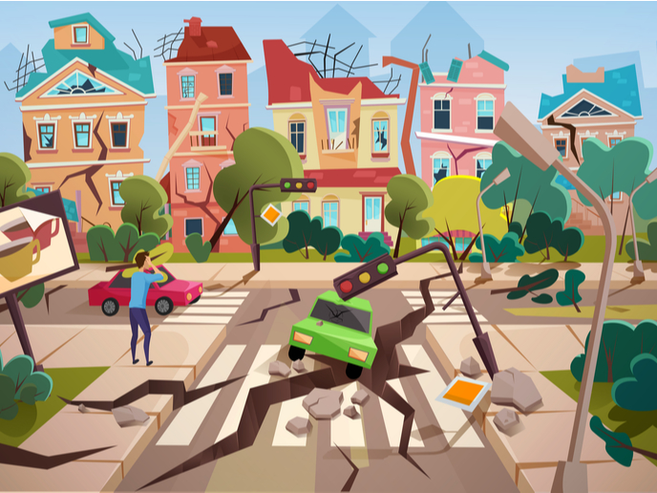
Notes:
earthquake depth
proximity to the fault
the underlying soil
building characteristics—particularly height

Slide 7
3.
What are the methods to detect and measure earthquakes?
Notes:
To detect and measure earthquakes we use Seismometers by converting vibrations due to seismic waves into electrical signals, which we can then display as seismograms on a computer screen.
Seismologists study earthquakes and can use this data to determine where and how big a particular earthquake is.

Slide 8
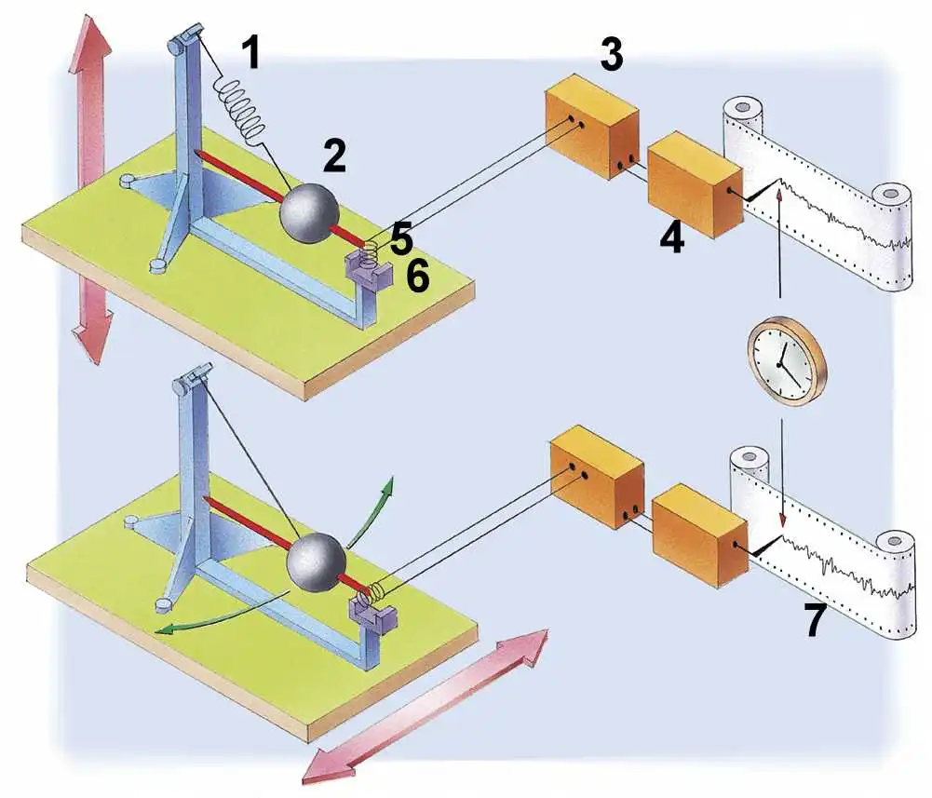
Notes:
To detect and measure earthquakes we use Seismometers by converting vibrations due to seismic waves into electrical signals, which we can then display as seismograms on a computer screen.
Seismologists study earthquakes and can use this data to determine where and how big a particular earthquake is.

Slide 9
What are the impacts of earthquakes on the natural environment?
4.
Notes:
Surface faulting
Tsunamis
Soil liquefactions
Ground resonance
Landslides
Ground failure

Slide 10
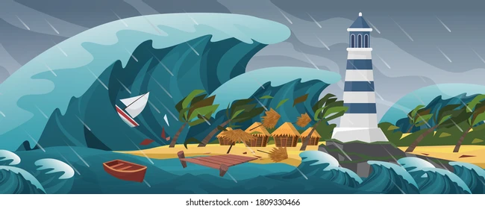
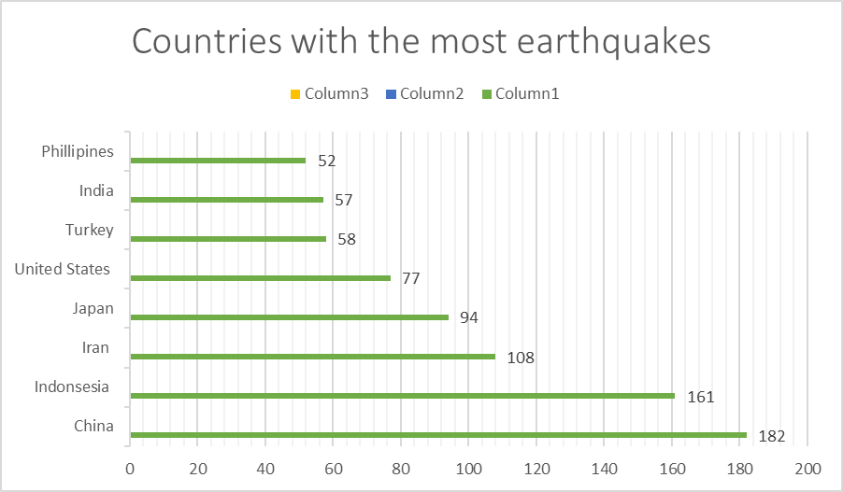
Notes:
Surface faulting
Tsunamis
Soil liquefactions
Ground resonance
Landslides
Ground failure

Slide 11
Thank you =)

