Slide 1
Obesity
By: Juan Abdullah and Tania Samara
8-A

Slide 2
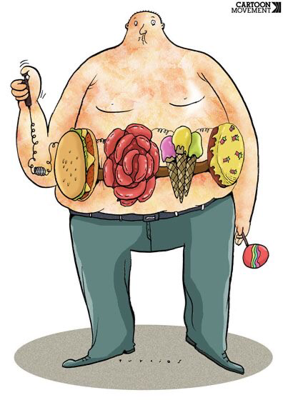
What is obesity?
Obesity is abnormal or excessive fat that presents a risk to health.

Slide 3
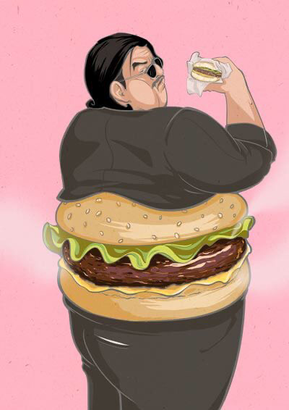
Obesity increases the risk of several debilitating, and deadly diseases, including diabetes, heart disease, and some cancers.
Why obesity is a problem?

Slide 4
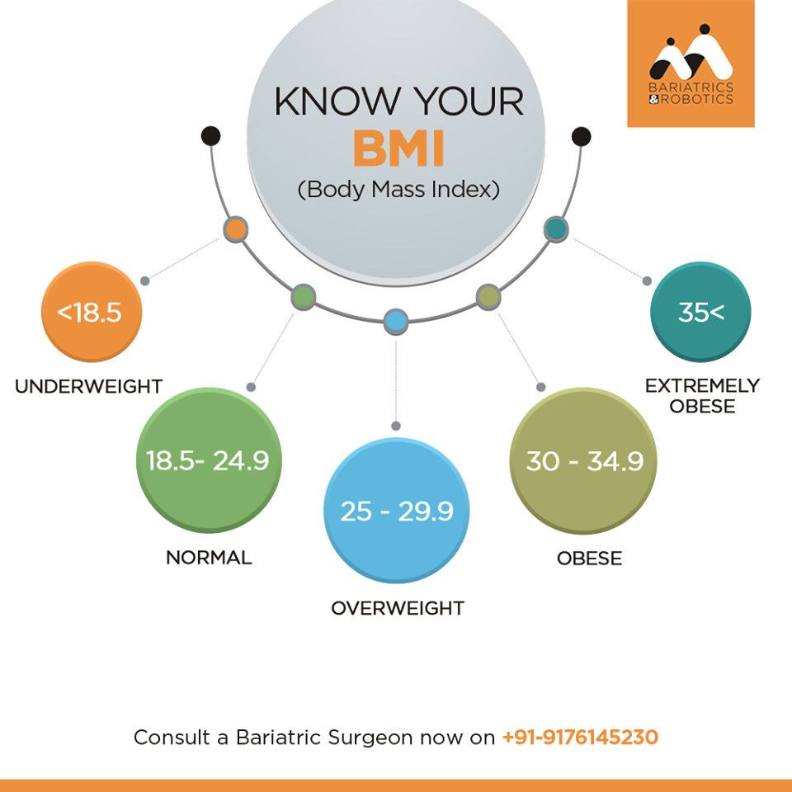
BMI SCALE

Slide 5
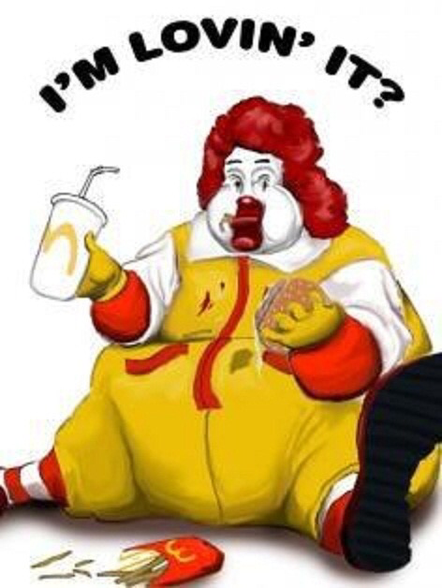
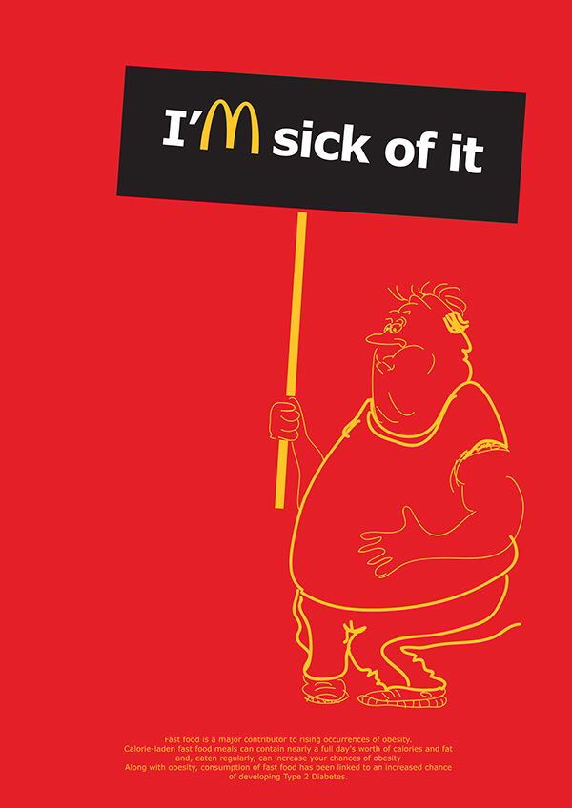
2 causes of obesity
High blood pressure
Extra fat tissue in the body requires more oxygen and nutrients. Your blood vessels will need to circulate more blood to the extra fat tissue.
Stroke
A stroke can cause damage to brain tissue and result in a range of disabilities, including speech and language impairment, weakened muscles, and changes to thinking and reasoning skills.

Slide 6

How to prevent obesity?
Choosing healthier foods (whole grains, fruits and vegetables, healthy fats and protein sources) and beverages. Limiting unhealthy foods (refined grains and sweets, potatoes, red meat, processed meat) and beverages (sugary drinks) Increasing physical activity. Limiting television time, screen time, and other “sit time”

Slide 7
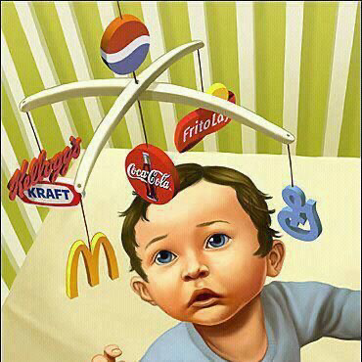
Child Obesity
https://youtu.be/gQK4vj1Lzlg

Slide 8
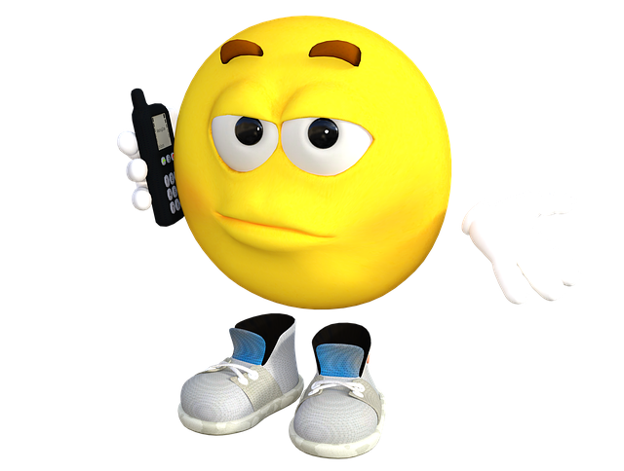

POP QUIZZ!!!!

Slide 9
Sources
https://www.healthline.com/health/obesity/managing-obesity-health-risks#type-diabetes
https://www.google.com/url?sa=t&rct=j&q=&esrc=s&source=web&cd=&ved=2ahUKEwjj_4bhrNn-AhV4-LsIHZDmDAEQFnoECBMQAw&url=https%3A%2F%2Fwww.hsph.harvard.edu%2Fobesity-prevention-source%2Fobesity-consequences%2Fhealth-effects%2F%23%3A~%3Atext%3DObesity%2520increases%2520the%2520risk%2520of%2Cchanges%2520in%2520hormones%2520and%2520metabolism.&usg=AOvVaw3rhXddORjxJxll7_DRvefK
https://www.google.com/url?sa=t&rct=j&q=&esrc=s&source=web&cd=&ved=2ahUKEwjIsPmzrNn-AhXX_7sIHd3pA1oQFnoECBUQAw&url=https%3A%2F%2Fwww.who.int%2Fhealth-topics%2Fobesity%23%3A~%3Atext%3DMore-%2COverview%2Cand%2520over%252030%2520is%2520obese.&usg=AOvVaw0V2zzwHuyntuFXMlEzippO
https://www.google.com/url?sa=t&rct=j&q=&esrc=s&source=web&cd=&ved=2ahUKEwiwqo--sNn-AhUD4aQKHaFwDAsQFnoECBMQAw&url=https%3A%2F%2Fwww.hsph.harvard.edu%2Fobesity-prevention-source%2Fobesity-prevention%2F%23%3A~%3Atext%3DChoosing%2520healthier%2520foods%2520(whole%2520grains%2C%252C%2520and%2520other%2520%25E2%2580%259Csit%2520time%25E2%2580%259D&usg=AOvVaw3M_yinFK2M3uWw_AmWtYbC

Slide 10
Thank you for listening!!

