Slide 1
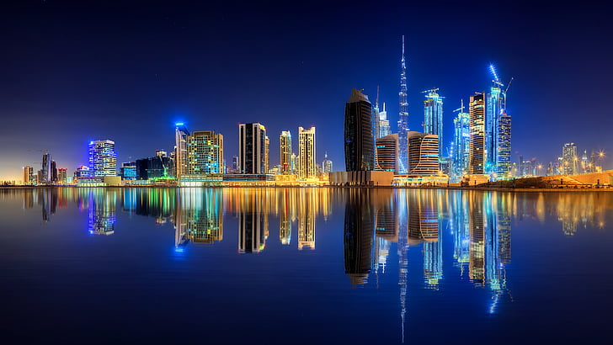
dubai

Slide 2
Dubai has become the region’s chief port for the import of Western manufactures. Most of the United Arab Emirates’ banks and insurance companies are headquartered there. After the devaluation of the gulf rupee (1966), Dubai joined the country of Qatar in setting up a new monetary unit, the riyal.
D

Slide 3
The emirate’s capital, also named Dubai, is the largest city of the federation. The city is located on a small creek in the northeast part of the state. More than nine-tenths of the emirate’s population lives in the capital and nearby built-up sections.
U

Slide 4
B
he second most populous and second largest state of the federation (area 1,510 square miles [3,900 square km]), it is roughly rectangular, with a frontage of about 45 miles (72 km) on the Persian Gulf. The emirate’s capital, also named Dubai, is the largest city of the federation.

Slide 5
AI
The Maktoum sheikhs of Dubai, unlike most of their neighbours, long fostered trade and commerce; Dubai was an important port by the beginning of the 20th century.

Slide 6
