Slide 1
Climate change
Mahmoud fadi tareq ahmad

Slide 2
Objectives
1.IDENTIFY WHAT IS GLOBAL WARMING
Add hon

Slide 3
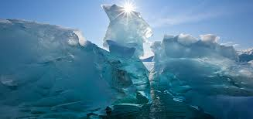
What is climate change
Climate change refers to long-term changes in the Earth's climate patterns, such as temperature, precipitation, and wind, that have occurred and are likely to continue as a result of human activity, most notably the release of greenhouse gases into the atmosphere.

Slide 4
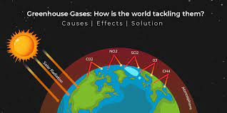
By which process does climate change occur?
The greenhouse effect is a natural phenomenon that regulates the temperature of the Planet. It works by capturing some of the sun's energy and preventing it from escaping back into space, so keeping the planet warm enough for life to exist. Greenhouse gases like carbon dioxide and water vapor play an important part in this process. Human activities, on the other hand, are increasing the concentration of these gases in the atmosphere, resulting in a higher greenhouse effect and potential effects on the climate and ecology.

Slide 5
questions

Slide 6
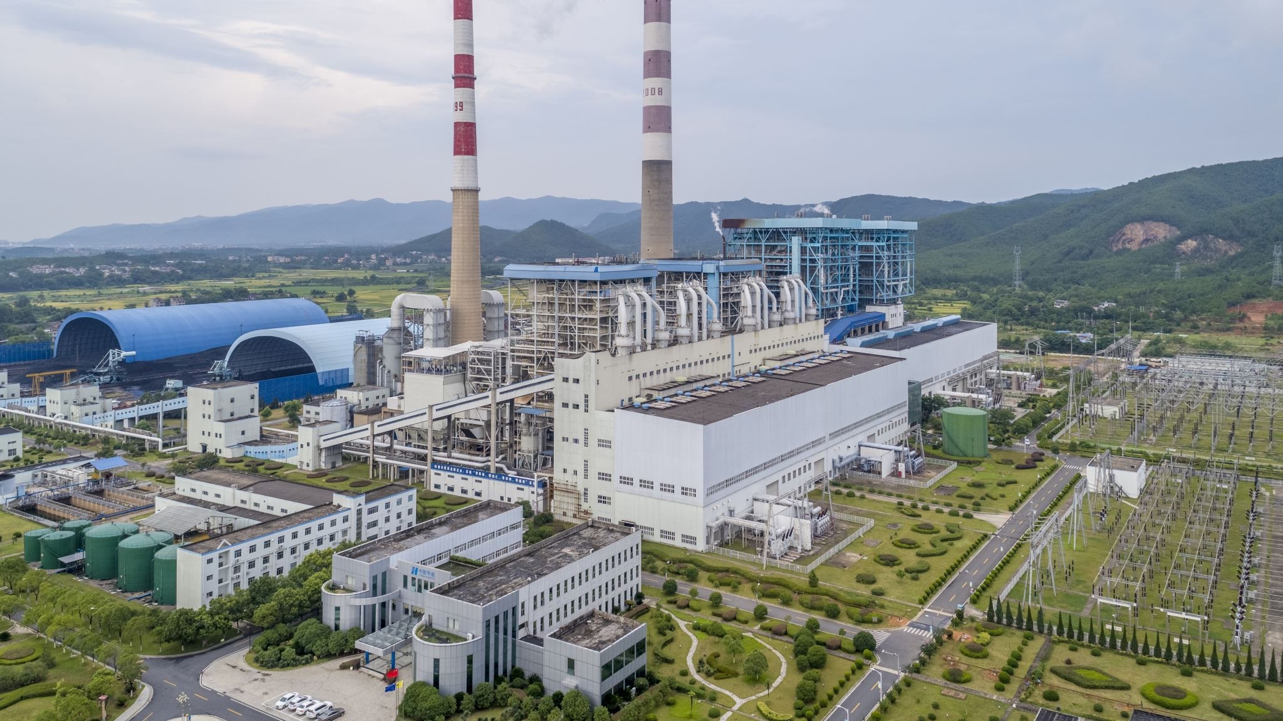
Greenhouse effect
The greenhouse effect is a process in which particular gases, known as greenhouse gases, absorb some of the sun's energy and prevent it from escaping back into space, thereby controlling the temperature of the Earth's atmosphere. The greenhouse effect requires to gasses in order to be successful the gasses are water vapor and carbon dioxide.
Carbon dioxide and water vapor are the most major greenhouse gases due to their strong ability to absorb long-wave radiation, which is emitted by the Earth's surface. These gases can trap long-wave radiation in the Earth's atmosphere, preventing it from escaping into space and adding to the overall greenhouse effect. This is due to the peculiar molecular configurations of these gases, which allow them to effectively absorb and re-emit long-wave radiation. Other greenhouse gases, such as methane and nitrogen oxides, contribute to the greenhouse effect, however to a lesser extent than carbon dioxide and water vapor.
The greenhouse effect is caused by the gases described above, such as carbon dioxide and water vapor. Without these gases, the Earth's atmosphere would be unable to trap any of the sun's energy and regulate temperature, rendering the planet uninhabitable to life as we know it. It is crucial to note, however, that too much of these greenhouse gases, as a result of human activities such as the use of fossil fuels, can lead to an amplified greenhouse effect, resulting in global warming and climate change.
DOUBLE CHECK EVERYTHING HON

Slide 7
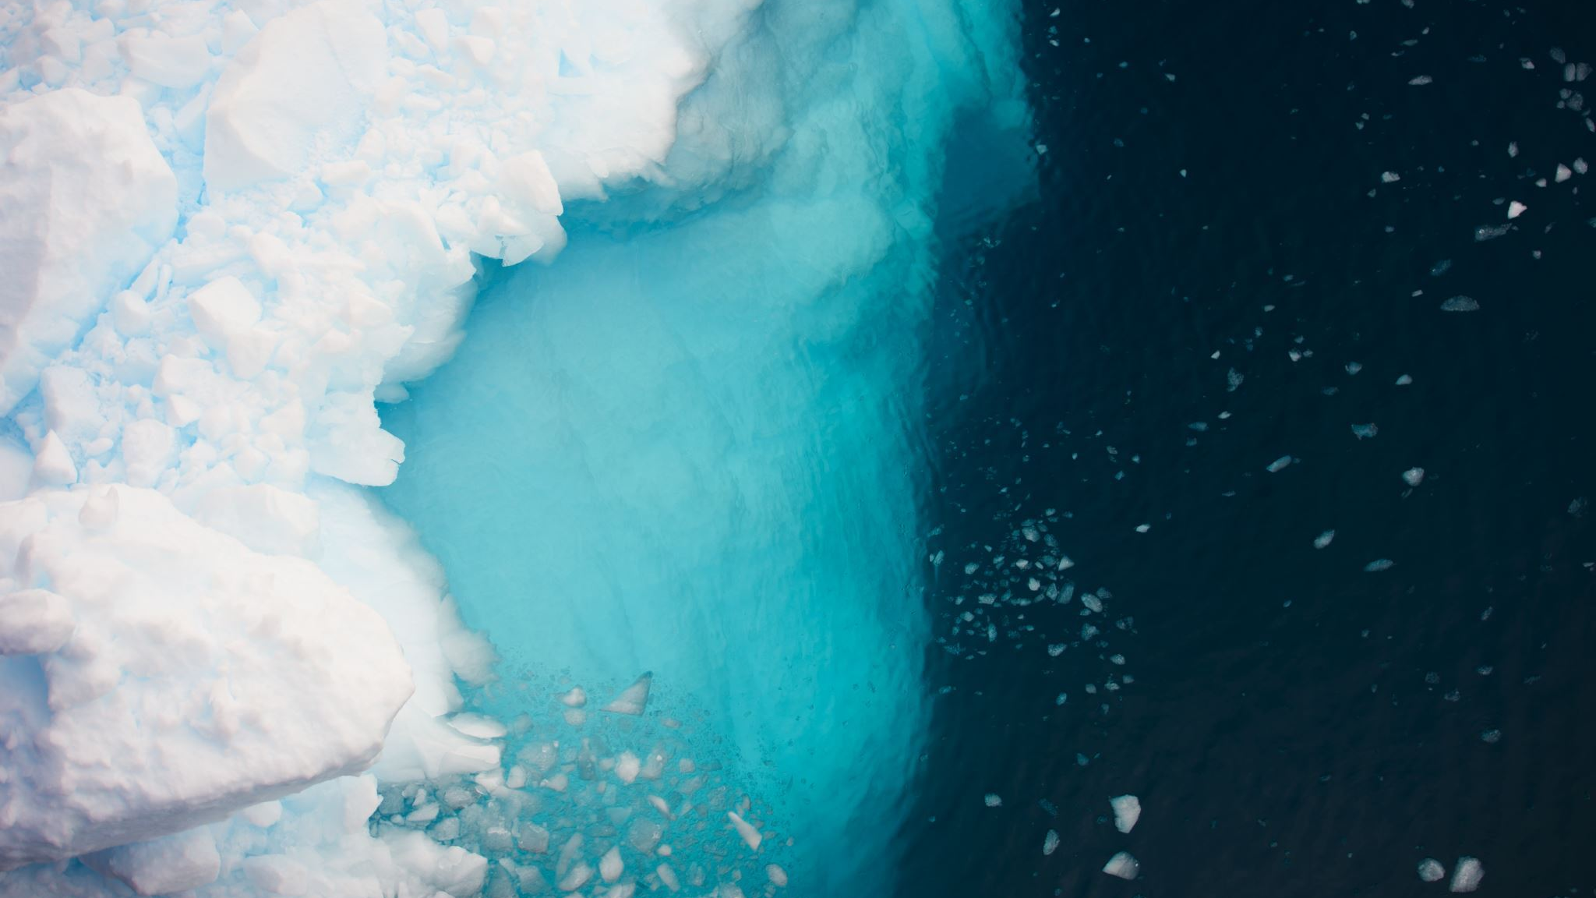
Greenhouse effect
This warming may cause changes in climatic patterns, such as more frequent and severe weather events, increasing sea levels, and adjustments in ecosystems and plant and animal species distribution. As a result, controlling greenhouse gas concentrations is critical for minimizing the effects of global warming and climate change.

Slide 8
The causes of the increased and negative greenhouse impact
The enhanced greenhouse effect is the increased warming of the Earth's atmosphere caused by larger concentrations of greenhouse gases, especially carbon dioxide, induced by human activities such as fossil fuel combustion and deforestation.
Since the beginning of the industrial revolution, there has been a well-documented relationship between rising carbon dioxide concentrations in the atmosphere and average global temperatures. For the last 200 years, as people have used more and more fossil fuels, the amount of carbon dioxide in the atmosphere has increased, trapping more of the sun's energy and contributing to global warming.

Slide 9
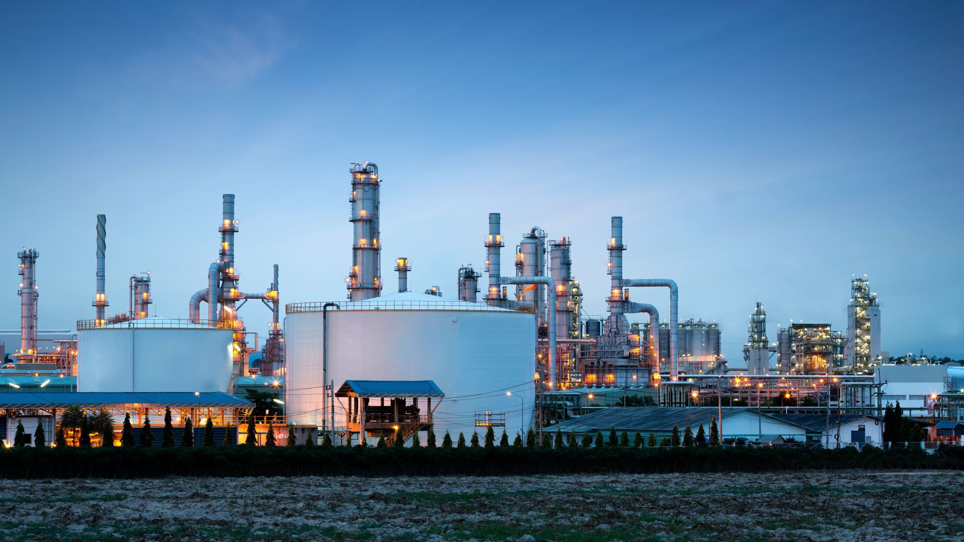
Reasons for the increase carbon emissions
Burning coal, oil and gas: Industries use coal, oil, and gas as energy sources to run their operations and manufacture goods and services. These fossil fuels are plentiful, relatively inexpensive, and have a high energy density, making them appealing sources of energy for many industrial operations. When burning them carbon dioxide is released into the atmosphere
Cutting down forests: Trees supply a variety of valuable resources, including lumber for construction and paper production, and land cleared of trees can be used for farming, mining, or other economic activities. We must remember that plants (which are mostly located in forests) preform photosynthesis which is When plants, algae, and some bacteria are exposed to sunlight, a chemical process happens. Water and carbon dioxide mix during photosynthesis to generate carbohydrates (sugars) and emit oxygen. logically when there are scarce number of plants carbon dioxide is not absorbed therefore increasing co2 concentration and emission.

Slide 11
Advantages
Advantages
The greenhouse effect contributes to the Earth's temperature regulation, making it hospitable for living beings.
Agricultural productivity may improve as a result of the greenhouse effect's warming impacts, as plants grow better at warmer temperatures.
By trapping heat in the atmosphere, the greenhouse effect can help to alleviate the consequences of very cold weather in some areas.
More frequent and severe weather events
Rising sea levels
Shifts in ecosystems and the distribution of plant and animal species
Decrease in Air water quality
Decrease in Human health

Slide 12
Solutions for enhanced greenhouse effect
Cutting down on greenhouse gas emissions:
Using renewable energy sources such as solar, wind, hydropower, and geothermal.
Energy efficiency in buildings, transportation, and industry is being promoted.
Carbon price and emission controls are being implemented.
Forest conservation and restoration:
Putting a stop to deforestation and encouraging reforestation and afforestation
Forest conservation and management on a long-term basis
Technology and innovation advancement:
Investing in low-carbon technology research and development
Promoting the use of green technologies in industry and transportation

