Slide 1
Global Warming
Our atmosphere, greenhouse gasses and more!
By: Julie, Ishmail and Reine

Slide 2
01
What is “global warmning”?
Causes and more …

Slide 3
What is “global warming”?
Global warming is the rapid increase in global temperature due the abundace of greenhouse gas emmision and release. A greenhouse gas is a gas that absorbs and re-emits infrared radiation in the Earth's atmosphere, acting as a medium that traps heat. Common examples of hazardous greenhouse gasses are water vapor, and CO2.

Slide 4
What is “global warming”?
global warming does not mean temperatures rise everywhere at every time by same rate. Temperatures might rise 5 degrees in one region and drop 2 degrees in another. However, global warming is 100% tied to the fluctuation of The Earth's temperature.

Slide 5
METHANE AND NITROGEN OXIDE:
METHANE
NITROGEN OXIDE
Nitrogen oxides (NOx) act as indirect greenhouse gases.
The impact of NOx gases on global warming is not all bad though, being a very small portion of it's cause. However, NO2 and other nitrogen oxides in the outdoor air contribute to particle pollution and to the chemical reactions that make ozone. Ozone is a greenhouse gas.
Over the first 20 years after it enters the atmosphere, methane has more than 80 times the warming power of carbon dioxide. Even though CO2 has a longer lasting effect, methane drives warming in the short term. Methane from human activity is responsible for at least 25% of today's global warming. Methane has been responsible for roughly 30% of global warming since pre-industrial times and is growing faster than any other greenhouse gas since records began being kept in the 1980s.

Slide 6
Infrared rays and their correlation to gasses!
Examples on these gasses:
Infrared rays are wavelengths emitted from our sun that remain invisible to the naked eye. Greenhouse gasses do absorb and re-emit these wavelengths, but this means that they need to be able to absorb a specific and limited amount of these waves. The more the gas absorbs there IR (infrared) rays, the more dangerous they become to have dispersed all throughout our atmosphere.
${CO}^{2}$: 12 to 19 microns
${CH}^{4}$: 3.5 and 8 microns
${CHC}^{∙}$: 10,000 times the absorption of ${CO}^{2}$
CFCs are otherwise known as chlorofluorocarbons, found in air fresheners. They are nontoxic, non-flammable and takes on many forms.

Slide 7
Does the warmed earth emit longer wavelength radiation?
Greenhouse gases allow short-wavelength radiation from the sun to enter the Earth's atmosphere. However, they absorb and re-radiate Earth's long-wavelength radiation back to the surface. The greenhouse effect is not necessarily a bad thing. The recent concern about greenhouse warming is based on abnormal levels of greenhouse gases leading to climate changes unseen in human history. Radiation from the warmed upper atmosphere, as well as some from the Earth's surface, is emitted into space. Most of the longwave radiation emitted warms the lower atmosphere, which in turn warms our planet's surface.

Slide 8
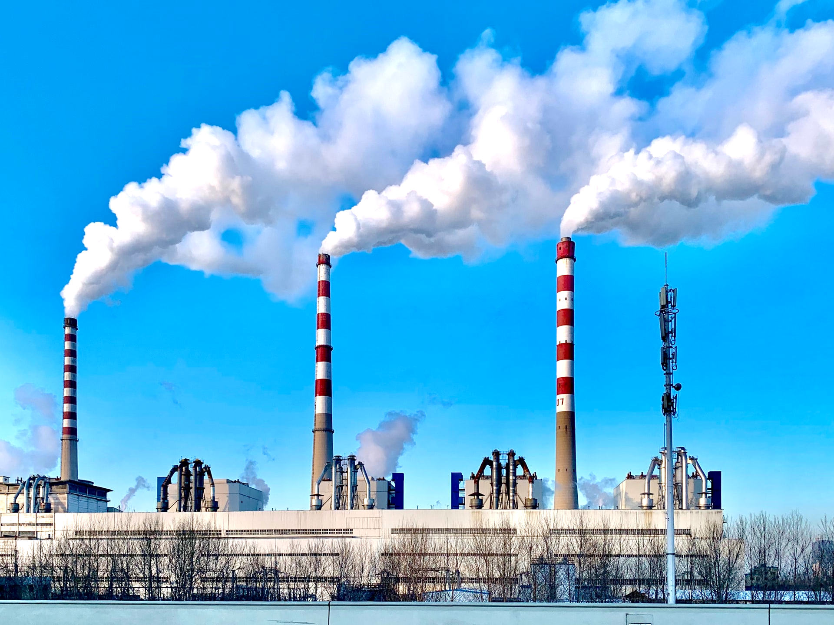
FOSSIL FUELS; COMBUSTION AND GAS RELEASE
What are fossil fuels?
Fossil fuels are a major factor in the increase of gas emission. To be able to recall the process of combustion; which releases these greenhouse gasses, we need to understand the source of fossil fuels.
Fossils are made up of aged and hardened organic matter. We use these fossils to extract fuel out of them for uses such as transportation, and energy sources. It takes over 10,000 years to form one of these fossils! Carbon monoxide, nitrogen dioxide, particles, and sulfur dioxide are some of the common pollutants produced by the combustion of these fuels. Hazardous chemicals can be attached to particles

Slide 9
Correlating global warming to the Industrial revolution:
The atmospheric emission of greenhouse gases has significantly grown due to human activity. Burning fossil fuels, such as coal and oil, has contributed to an increase in the atmospheric concentration of greenhouse gases since the Industrial Revolution began in around 1750.

Slide 10
The change in greenhouse gas levels throughout history:
1750
2021
Pre-industrial levels
Current day levels
278ppm.
417ppm.

Slide 11
Consequences:
Thank you for listening!
there are many effects of the enhanced greenhouse effect, which includes:
-Changes in global rainfall
-Ocean circulation
-Extreme weather events
-Increase in sea level
the consequences will further affect the humans’ health, biodiversity, and global agriculture. Continuing to increase the concentration of natural greenhouse gases caused by human activities which lead to an increasing amount of the global temperature.

Slide 12
Thank you for listening!

