Slide 1
The greenhouse effect
Sara/Ramsey/Makram

Slide 2
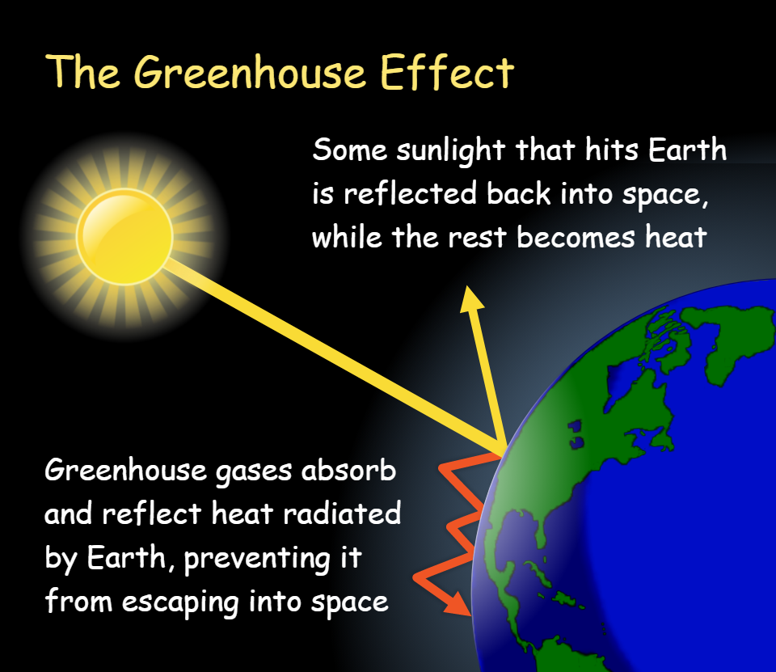
What is the greenhouse effect?
The greenhouse effect is a natural process that occurs in Earth's atmosphere, where certain gases trap and retain heat, similar to how a greenhouse traps heat to keep the temperature inside warmer than the outside environment.

Slide 3
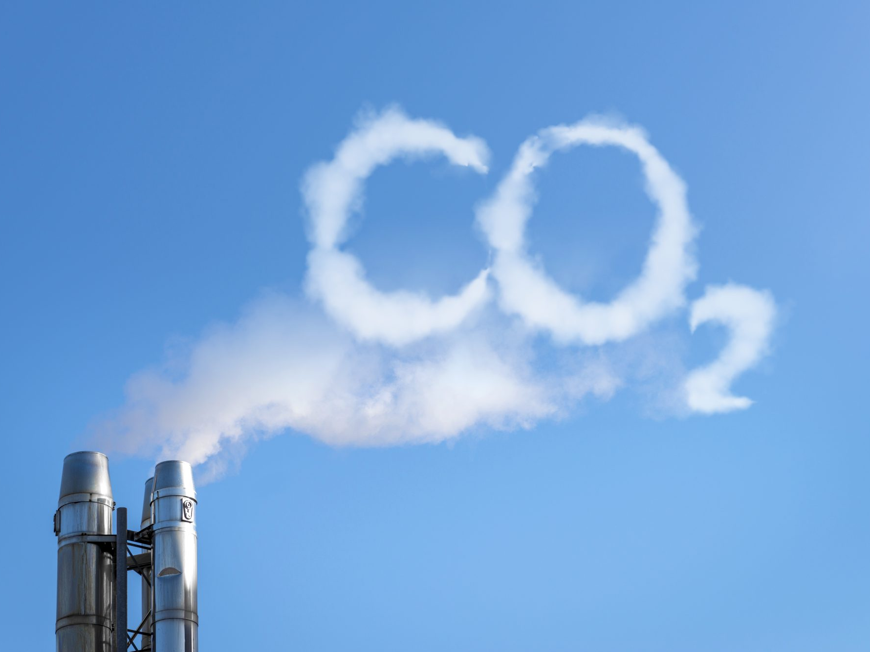
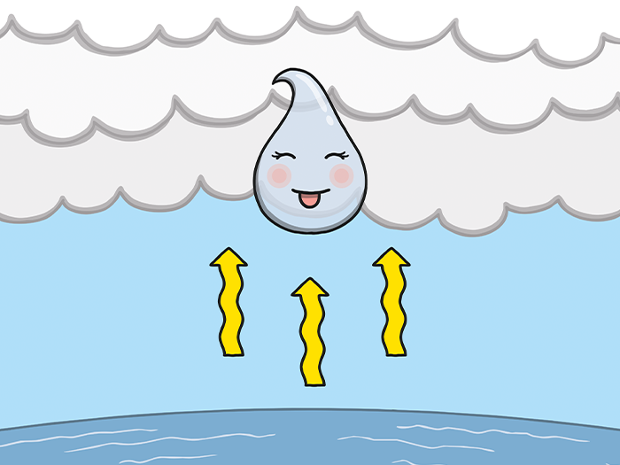
Greenhouse gases
Among the greenhouse gases, carbon dioxide and water vapor are the most significant in terms of their impact on the greenhouse effect. They are particularly effective at absorbing long-wave radiation, or heat, that is emitted by the Earth's surface. Other greenhouse gases, such as methane (CH4) and nitrogen oxides (N2O), also contribute to the greenhouse effect, but to a lesser extent compared to carbon dioxide and water vapor.

Slide 4
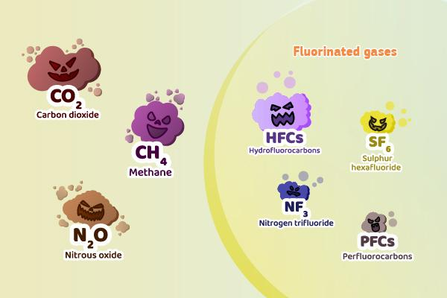
Impact of gases on different factors
The impact of a greenhouse gas on the greenhouse effect depends on two factors:
-its ability to absorb longwave radiation
-its concentration in the atmosphere.
Greenhouse gases with higher concentrations in the atmosphere are more effective at trapping heat. This is why carbon dioxide, despite being present in relatively small quantities in the atmosphere, has a significant impact on the greenhouse effect due to its ability to absorb long-wave radiation and its relatively high concentration resulting from human activities, such as burning fossil fuels.

Slide 5
Radiation and climate patterns
When the Earth's surface is warmed by sunlight, it emits longer wavelength radiation in the form of heat.
This heat is then absorbed by greenhouse gases in the atmosphere, including carbon dioxide and water vapor, which trap the heat and prevent it from escaping into space.
result: the Earth's atmosphere retains more heat, leading to an overall increase in temperature, known as global warming.
This increase in temperature can disrupt climate patterns and have wide-ranging effects on ecosystems, weather patterns, and sea levels, among other environmental impacts.

Slide 6
The industrial revolution and its consequences
The enhanced greenhouse effect refers to the increased trapping of heat in the Earth's atmosphere due to human activities, particularly the burning of fossil fuels such as coal, oil, and natural gas, which release large amounts of carbon dioxide (CO2) into the atmosphere. Since the beginning of the industrial revolution around 200 years ago, human activities have resulted in a significant increase in the atmospheric concentration of carbon dioxide.
The burning of fossil fuels for energy production, transportation, and industrial processes has released vast amounts of carbon dioxide into the atmosphere, disrupting the natural balance of greenhouse gases.
Deforestation and other land use changes have also contributed to the release of carbon dioxide into the atmosphere, as trees and plants act as natural "sinks" that absorb and store carbon dioxide through a process called photosynthesis.

Slide 7
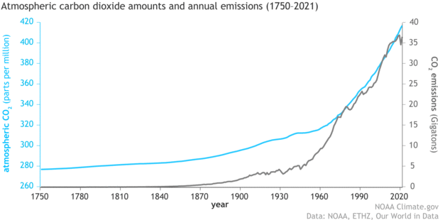
Correlation between Co2 and increased global temperatures
The enhanced greenhouse effect refers to the increased trapping of heat in the Earth's atmosphere due to human activities, particularly the burning of fossil fuels such as coal, oil, and natural gas, which release large amounts of carbon dioxide (CO2) into the atmosphere. Since the beginning of the industrial revolution around 200 years ago, human activities have resulted in a significant increase in the atmospheric concentration of carbon dioxide.
The burning of fossil fuels for energy production, transportation, and industrial processes has released vast amounts of carbon dioxide into the atmosphere, disrupting the natural balance of greenhouse gases.
Deforestation and other land use changes have also contributed to the release of carbon dioxide into the atmosphere, as trees and plants act as natural "sinks" that absorb and store carbon dioxide through a process called photosynthesis.

Slide 8
Greenhouse effect consequences
The enhanced greenhouse effect has significant consequences for the Earth's climate system, including changes in weather patterns, rising sea levels, shifts in ecosystems, and impacts on human societies and economies.
Mitigating greenhouse gas emissions, transitioning to renewable energy sources, conserving forests, and adopting sustainable practices are strategies being pursued to mitigate the enhanced greenhouse effect and its impacts on the environment.

Slide 9
Model
Now we will demonstrate a small example on the greenhouse effect.
Grab 2 cups
Put boiling water at equal temperature
Quickly cover 1 cup with plastic wrap
Results: One will remain the same temperature and the other will have a decrease in temperature.

