Slide 1

medicine
Eliana Alrabadi

Slide 2
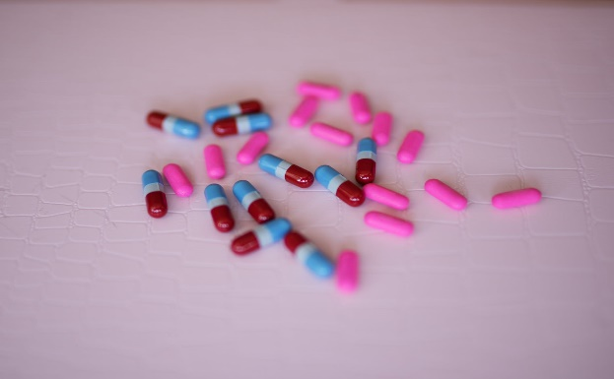
medicine
It is any substance used in the diagnosis or treatment of diseases that affect humans or animals, or that is useful in mitigating or preventing them. A medicine often increases or decreases a function in the body, and does not create a new one. Officially, it is every medicine licensed for legal use after making sure that it is (relatively) free from any physical or psychological harm to the person taking it. We use most drugs for the purpose of curing some diseases, such as using antibiotics to cure infection, and to treat some pathological conditions such as treating depression. With antidepressants, or to relieve symptoms such as using analgesics to reduce pain, medicine is also used to prevent diseases, such as vaccines such as the flu vaccine.

Slide 3
This is a chart of those who match with people who use the medicine

Slide 4
Medication and its damage
The medicine | its damage
Panadol | Anorexia. Vomiting and nausea. Stomach cramps and pain. Swelling or pain in the upper part of the stomach.
Amoclan | Nausea, diarrhea. Other severe skin reactions may include: changes in skin color, bumps under the skin, blistering, blistering, peeling, redness, pain, itching.
Revanin | Paracetamol (revanin) should not be used if any of the following health problems occur: Suffering from hypersensitivity to any of the components of this medicine.

Slide 5
Methods of administering the medicine
The medicine enters the body in different ways, and perhaps the most common way is to take the medicine orally, but if a person is unable to take the medicine orally for any reason, there are other ways for the drug to enter the body.
eye drops
ear drops
Transdermal: The medicine is applied to the skin via an ointment, cream, or skin patch. The drug passes through the skin into the blood vessels.
By inhalation: The drug is inhaled and enters the lung to act directly on it.
Rectal: The medicine is given through the anus (rectum) in the form of suppositories (suppositories), enemas, or creams, and it is absorbed through the blood vessels in the rectum.
Under the tongue.

Slide 6
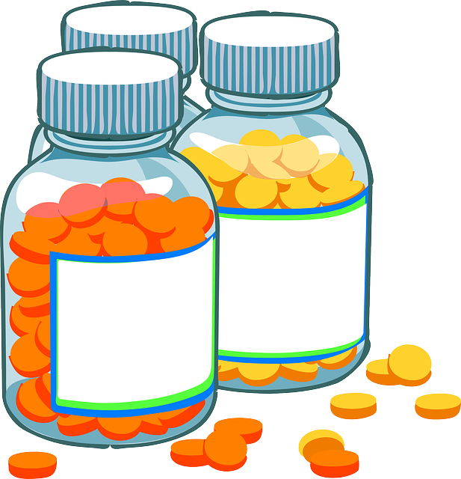
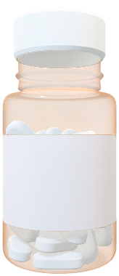
Types of medications
exchange method
medication effect
The medicinal source

Slide 7
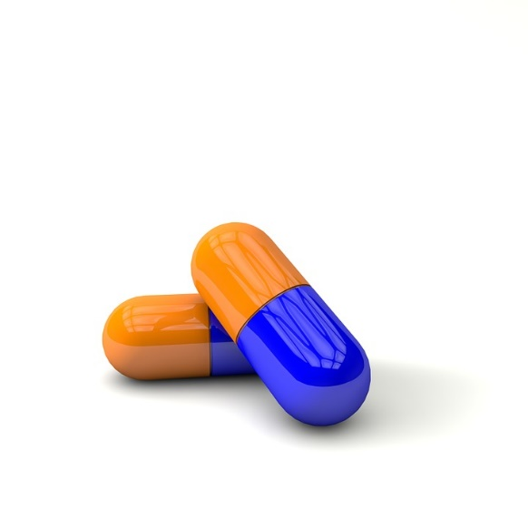
How to use the medicine
This type of medication is classified into two categories:
Medicines used by mouth: These are medicines that are taken orally, such as: tablets and capsules.
Medicines used in the form of injections: They are medicines that are given to the patient using (injection), in the area of ​​​​a blood artery, and are considered to have a rapid effect, compared to medicines that are given orally.

Slide 8
Pharmacokinetic results
They are the effects that result from the drug after it reaches the blood, and it performs its own function inside the body, and the drugs that are given intravenously are the most effective, compared to the effects of other types of drug, which need to be decomposed in the intestine, and then transmitted to the site of the disease, so It is recommended to take most medicines after eating a meal, so that the stomach first analyzes the food inside it, and avoids analyzing the medicinal ingredients, so that the medicine can relieve the symptoms of the disease.

Slide 9

How the Body Absorbs and Uses Medicine

