Slide 1
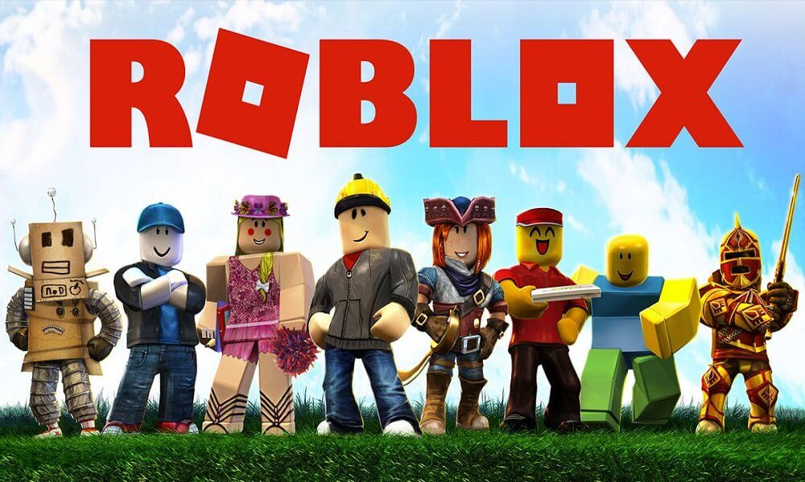
roblox
A fun game!

Slide 2
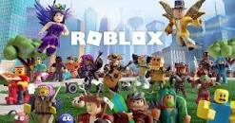
why roblox is fun:
1. it has many other games in it!
2.games can update every now and then.
3.you can chat with other people.
4.you can even make friends!

Slide 3
Roblox’s bad sides and good sides
This slide is completely right
Bad side:
Good side:
1.it has voice chat(only people above 13 years old).
2.the games kind of become bad and update late.
3.people can be rude sometimes.
1.people under 13 can play normally but sometimes people be rude.
2.games are very good but need a long time to practice the controls.

Slide 4
Some questions: (these are some of the games that are available in roblox)
1.What is in this picture?
Its has games of roblox.
2.Do you think these game are good?
Yes, I do.
3.How many games would you like to try from roblox?
All of them.
My fav

Slide 5
Sales of roblox

Slide 6
And that’s it thank you for reading my presentation ☺
Name :daniel qumsieh.
Teachers name: maissa odeh

