Slide 1
building a gym at school
By: Sameh, Nassif, Laith H

Slide 2
introduction
“If you want something you’ve never had, you must be willing to do something you’ve never done.”
A gym at school would be an excellent addition to our school, since it could be used during PE classes or individual private trainings that would help people inside the school or outside to make money, make students at the NOS school to be more healthier and fit and that would come with an average entrance fee or monthly.

Slide 3
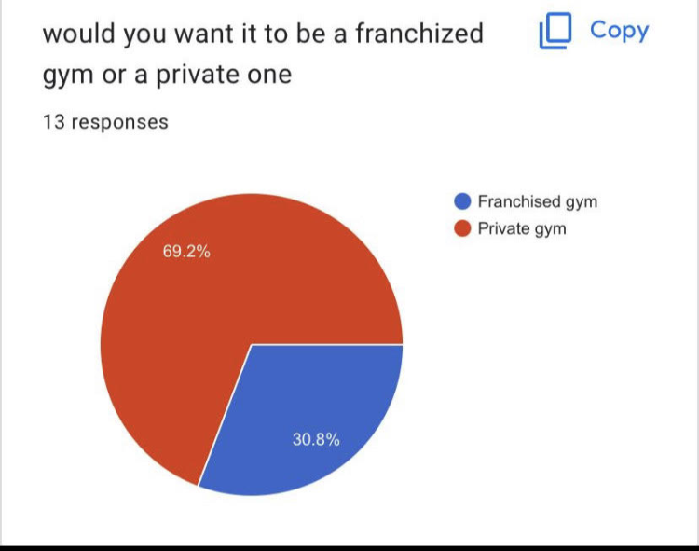
Causes for building gym at school
In 2023 students health is decreasing due to students spending most of their time indoors ,not having activities as a daily part of their life's.
A private gym as suggested by our survey that we did would motivate students to get their health back on track which would lead them back to a healthier lifestyle.

Slide 4
Consequence to building a gym .
Students in the NOS School would get more fit and into shape and would lead to the NOS School to get a grant from the government which could be used to maintain the gym and improve it.
And a gym would help NOS students have a better mental / physical health and help them to focus more when they are studying.
+

Slide 5
Finance
Since this would be an underground gym the construction plus the gym equipment, ventilation etc… it would roughly cost around 75,000 Jds and this could be paid for by the NOS, donation parties, concerts, movie nights and theater shows.

Slide 6
How would NOS students get a membership there.
There would be 2 ways of getting a membership at the gym, first would be that it would be added to your annual school fees, second would be to pay monthly at the accounting.

Slide 7
Safety
With safety being the most important part of building a gym, there would be 24/7 security to insure NOS’s students safety and coaches who would work from when the gym opens till it closes

Slide 8
Membership

