Slide 1
Selective breeding
By: Leen Ghosheh

Slide 2
Selective breeding:
Is when we choose which animals pass their genes to the next generation.
There are 3 steps:
1. Decide what you want, Choose parents that have some of these features then breed them together.
2. Select offspring closest to what you want to be the new parents.
3. Repeat the process over many generations.

Slide 3
Mutations:
A mutation is a change in a DNA sequence. Mutations can result from DNA copying mistakes made during cell division, exposure to radiation, exposure to chemicals. In applied genetics, it is usual to speak of mutations as either harmful or beneficial. A harmful mutation decreases the fitness of the organism. A beneficial mutation increases the fitness of the organism. A neutral mutation has no harmful or beneficial effect on the organism.

Slide 4
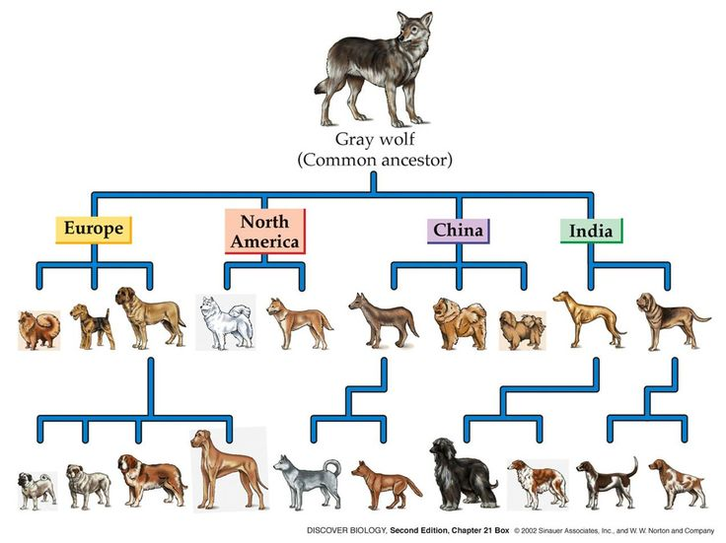
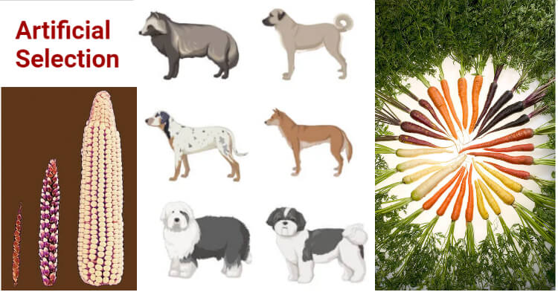
Examples:

Slide 5
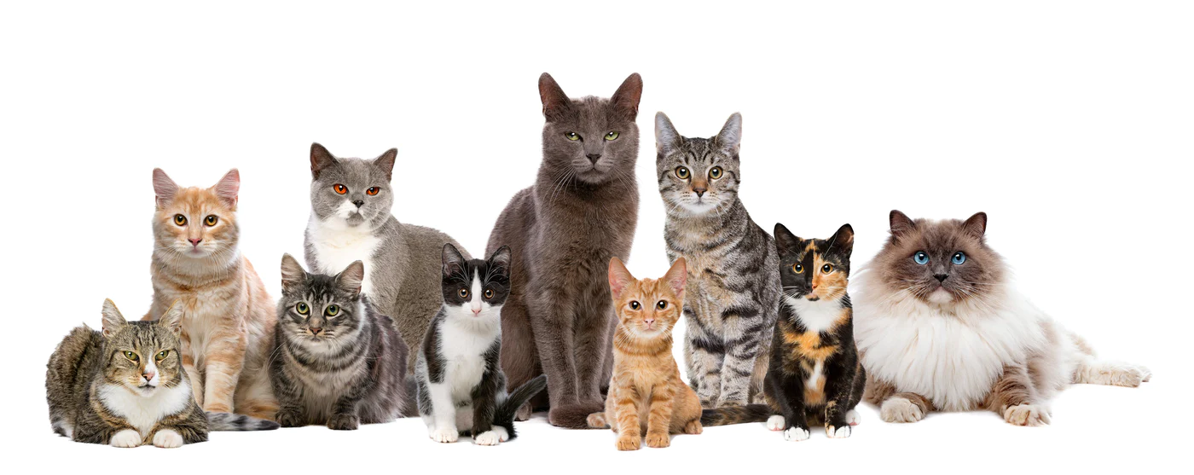
An example of variation
Wild cats show a lot of variation. Each cat inherits a unique combination of genes from its parents, so they all look different and behave differently.

Slide 6
Check your understanding
Question 1: List the steps involved in selective breeding.

Slide 7
1. Decide what you want, Choose parents that have some of these features then breed them together.
2. Select offspring closest to what you want to be the new parents.
3. Repeat the process over many generations.

Slide 8
Check your understanding
Question 2:
Give an example of an animal that has been selectively bred to be more useful to humans.

Slide 9
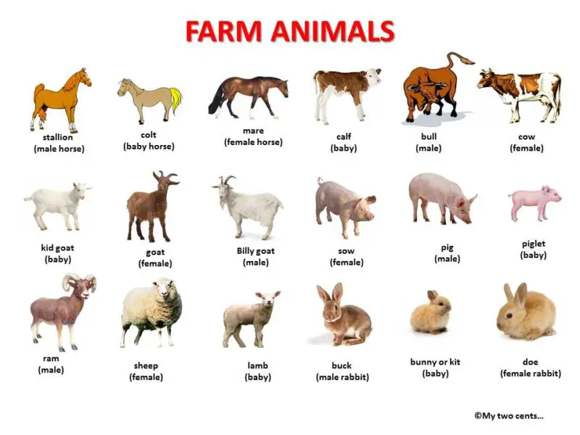
Chicken, cattle, sheep, and pigs

Slide 10
Thank you

