Slide 1
physics
Physics

Slide 2
Simple battery
A battery is a device that converts chemical energy contained within its active materials directly into electric energy by means of an electrochemical ...

Slide 3
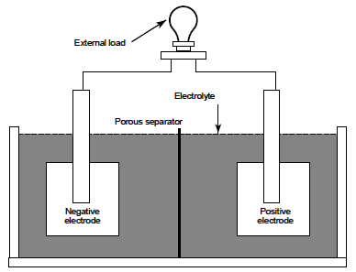
Simple battery components
There are four main components: The anode, the cathode, an electrolyte, and a separator.

Slide 4
An anode is an electrode of a polarized electrical device through which conventional current enters the device
A cathode is the electrode from which a conventional current leaves a polarized electrical device.

Slide 5
An electrolyte is the battery component that transfers ions — charge-carrying particles — back and forth between the battery's two electrodes, causing the battery to charge and discharge.
Battery separators provide a barrier between the anode (negative) and the cathode (positive) while enabling the exchange of lithium ions from one side to the other.

Slide 6
Lithium battery
Like remote controller battery
Or phone battery
The movement of the lithium ions creates free electrons in the anode which creates a charge at the positive current collector. The electrical current then flows from the current collector through a device being powered (cell phone, computer, etc.) to the negative current collector.

