Slide 1
Plants
By: Andre kakish Section: 8H

Slide 2
Lesson: Photosynthesis Process
Objectives:
Identify what a plant needs in order to make its own food through photosynthesis process.
Success criteria:
All students are able to write the word equation of photosynthesis process.

Slide 3
Introduction
You may know that a plant can make its own food, but:
Do you know how plants make their own food?

Slide 4
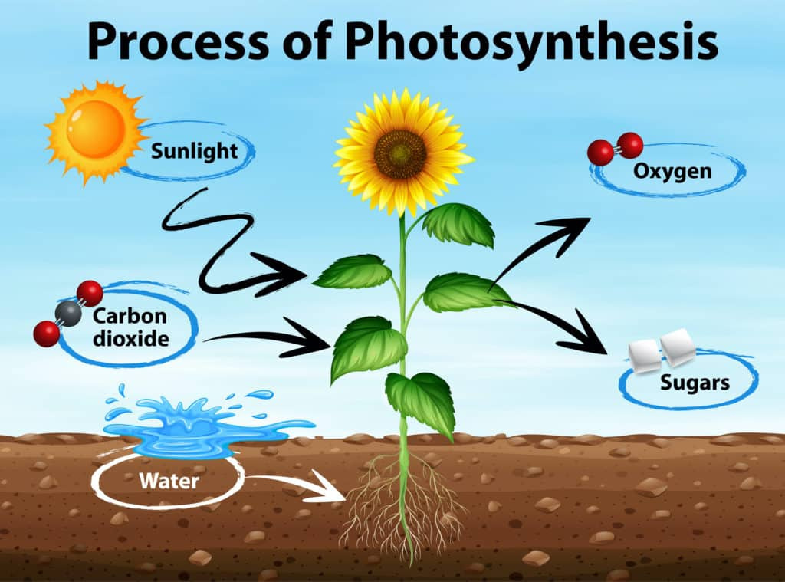
Photosynthesis process:
Plants are autotrophs. They make their own food through photosynthesis. They are capable of capturing energy via the green pigment (chlorophyll) inside the chloroplast found in plants leaves and stems.

Slide 5
Photosynthesis process:
Glucose is plants' primary source of nutrition and is the main requirement for their growth, but how would they get glucose?
By using Photosynthesis , Photosynthesis is the process by which plants use sunlight, water, and carbon dioxide to create oxygen and energy in the form of glucose.
To understand more, let’s watch this video:
https://www.youtube.com/watch?v=xEF8shaU_34

Slide 6
Photosynthesis process equation:

Slide 7
Questions
Question 1 :
Identify the reactants and the products in the photosynthesis reaction (word equation)?
Answer:
Carbon Dioxide + Water ➔ Glucose + oxygen

Slide 8
Questions
Question 2 :
What is the name of the pigment that captures energy in plants ?
Answer:
Chlorophyll, which is inside the chloroplast.

