Slide 1
Math
Constructing and Solving Linear Equations
By Jason and Michael

Slide 2
What is an equation?
An equation is a statement showing the equality of two expressions:
5𝑥 + 9 = 34
2𝑥 – 8 = 30
𝑦 x 6 = 18

Slide 3
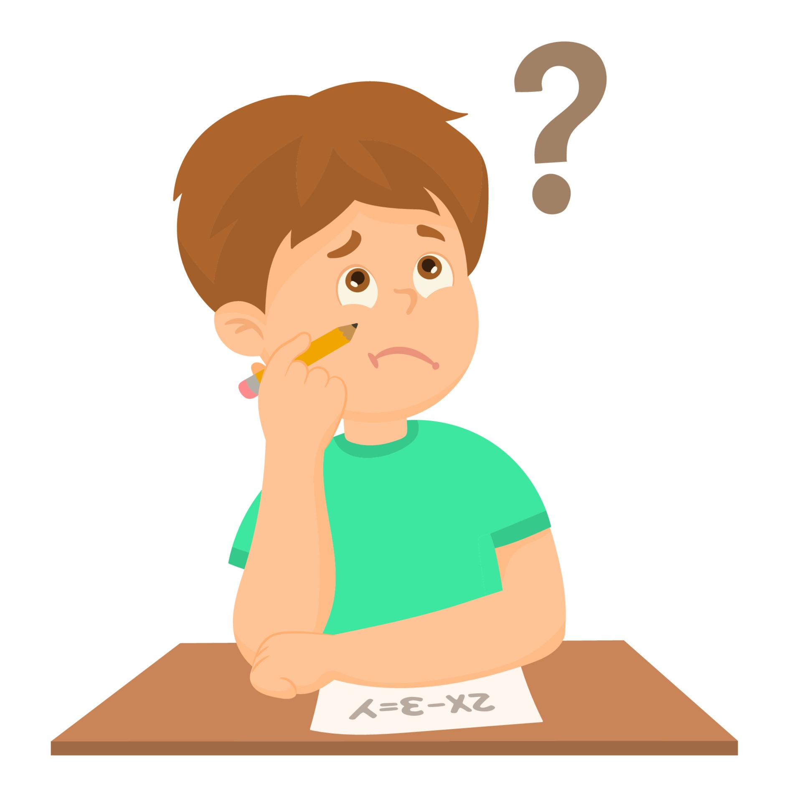
How do we solve them?
To solve the equations, we use the Balance method.
It means that what you do to one side of the equation, you have to do to the other for equality, here are some examples.
2 + 𝑥 = 5
To find the value of 𝑥, we get rid of any number or variable on it’s side of the equation.
In this example we need to get rid of the 2 in the equation
Simply, we just subtract the 2, but since we are using the balance method, we will
do so on both sides for equality
5 – 3 is 2, now we are left with 𝑥 = 3, and to make sure 2 + 3 is indeed 5.

Slide 4
Another example
Something more difficult would be:
𝑥/3 = 6
The first step is to get rid of the number on the 𝑥 side of the equation.
To get rid of 𝑥 getting divided 3, we can use inverse operation to get the 𝑥 on its own, here its division, the opposite is multiplication.
We multiply the other side too to balance the equation.
We are now left with 𝑥 = 6 x 3
Which is 𝑥 = 18, and to check, 18/3 is truly 6

Slide 5
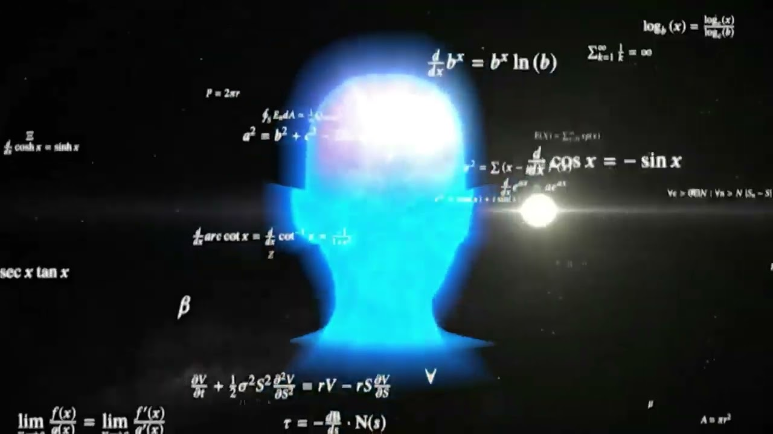
Difficult example
3𝑦 + 2 = 2𝑦 + 6
This one is tricky, to solve this, we get rid of the numbers on one side, since the 𝑦 is on both sides, it wont be possible to get rid of the numbers on both sides.
To get rid of the 2, we subtract on both sides.
3𝑦 = 2𝑦 + 4
Now since we have 𝑦 on both sides, we get rid of the one on the right, since getting rid of the one on the right leaves us with nothing but a 2𝑦 + 4, making no sense.
3𝑦 - 2𝑦 is 1𝑦 or just 𝑦, giving us the result: 𝑦 = 4

Slide 6
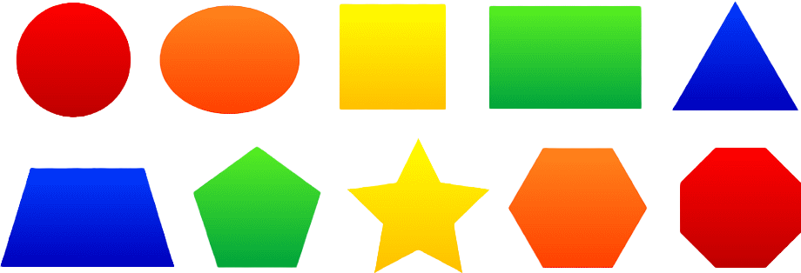
Geometry and expressions
𝑥 cm 𝑥 cm
8 cm
The parameter of this triangle is 32cm, find the value of 𝑥.
The equation for this is 2𝑥 + 8 = 32
This is very easy, all we do is subtract 8 on both sides, 32 – 8 = 26
Now our expression is 2𝑥 = 26, since 2𝑥 is like 2 multiplied by 𝑥, we use inverse operation and divide by 2 on both sides. 26/2 is 13, giving us 𝑥 = 13, and to check, 13 + 13 + 8 is indeed 32.

Slide 7
When the variable is in the denominator
12/𝑥 = 6
In this equation, we need to rewrite it in a different way, if 12 divided by 𝑥 is 6, it means that 6 multiplied by 𝑥 is 12, changing the equation to:
6𝑥 = 12
Using the balance method, we get rid of the six by dividing it on both sides, 12/6 is equal to 2, making it so the result is 𝑥=2
To check, 12/2 is indeed 6

Slide 8
More difficult equations
22/𝑥 + 4 = 2
First step is to rewrite the equation, making it:
2 x 𝑥 + 4 = 22 which can be simplified to 2𝑥 + 4 = 22
Now its easy, we get rid of the numbers on the variable’s side by subtracting 4 on both sides giving us 2𝑥 = 18
Do the same and divide by 2 on both sides to give us the result: 𝑥 = 9

Slide 9
What we learned
We learned what an equation is and how to solve it
How to solve an equation when the variable is on both sides of the equations
How to solve geometry and expressions
How to solve expressions when the variable is in the denominator

