Slide 1
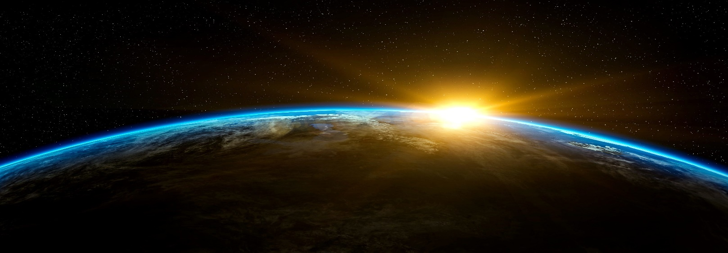
The solar system
by : zaina qursha and ameer aloudat

Slide 2
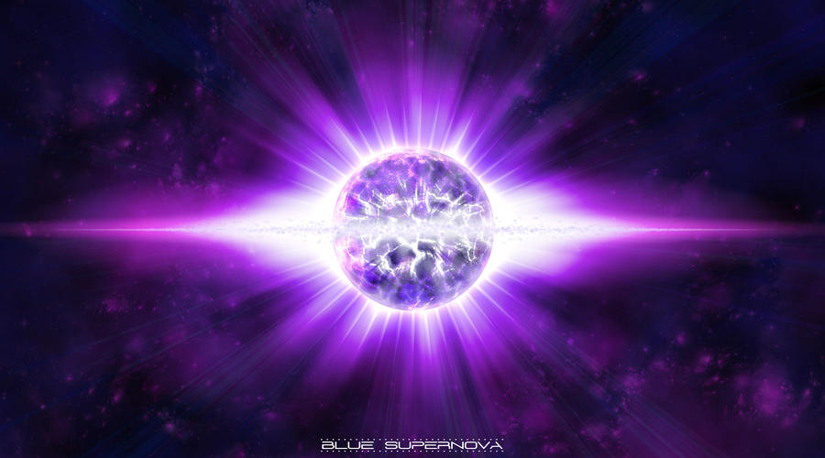
How was the our solar system formed?
Our solar system was formed by a dense cloud of interstellar gas and dust. The cloud collapsed, possibly due to the shockwave of a nearby exploding star, called a supernova about 4.5 billion years ago.

Slide 3
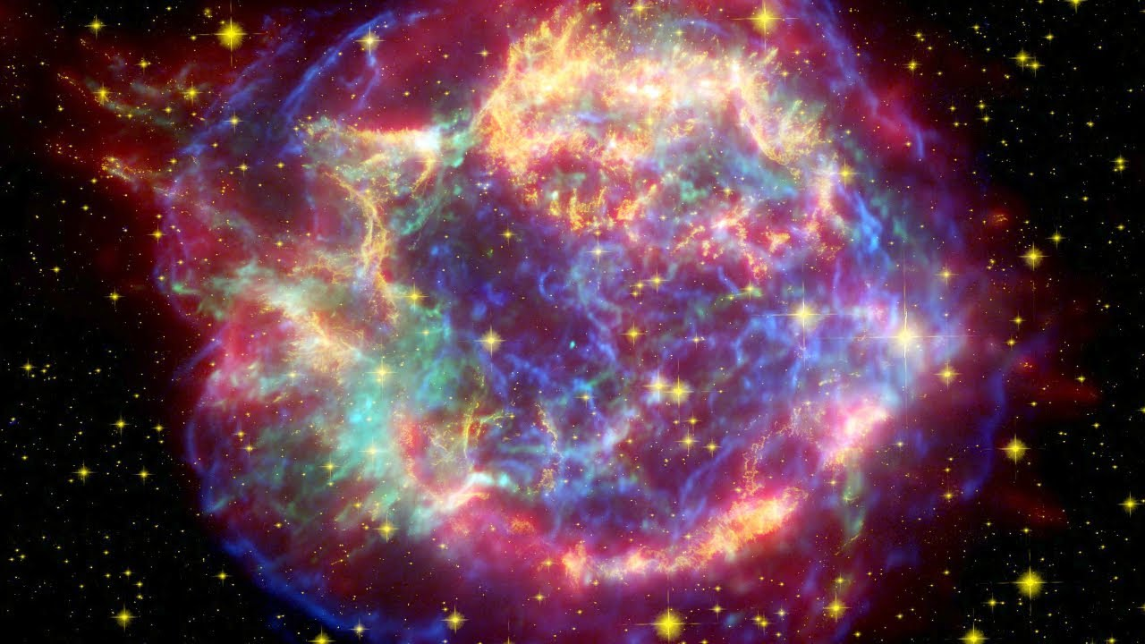
What is a super nova?
The super nova is the death of a star. When the pressure drops low enough in a massive star, gravity suddenly takes over and the star collapses in just seconds.

Slide 4
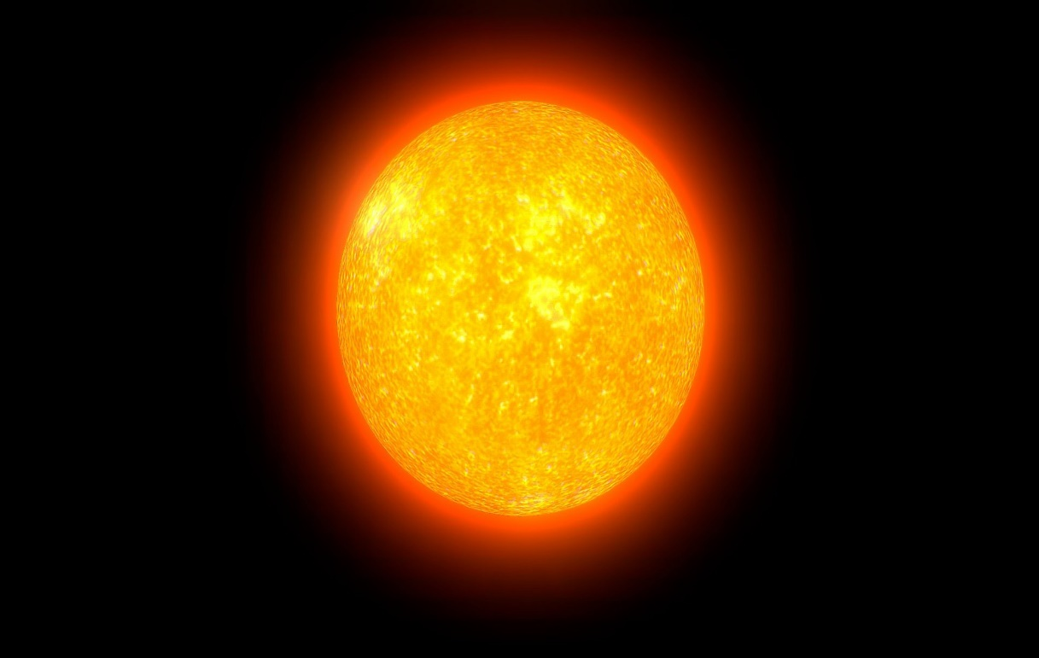
What is the sun?
The sun is a giant star that we orbit in our solar system. It is a nearly perfect ball of hot plasma, heated to incandescence by nuclear fusion reactions in its core. The Sun radiates this energy mainly as light, ultraviolet, and infrared radiation, and is the most important source of energy for life on Earth.

Slide 5
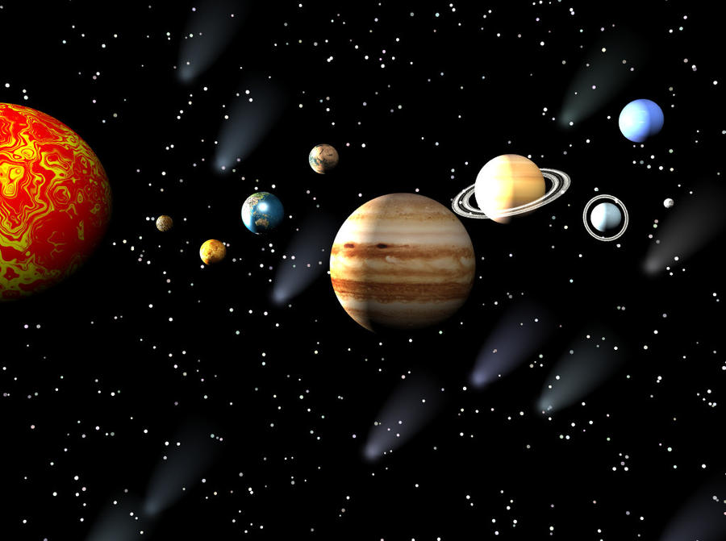
The planets
We have 7 plants in our solar system . Each planet has a unique features . The first planet is:
Mercury : This planet is the closer to our sun.
Venus : Is the hottest planet in our orbit.
Earth : Is our home planet and the only planet with perfect life conditions for livings organisms to live on.
Mars : Is known as the red planet for its rusty color.
Jupiter : Is the gas giant of our solar system.
Saturn : Is known for its beauty because of its rings.
Uranus : Is a blue planet before Neptune.
Neptune : Is the coldest planet in our solar system.

Slide 6
Thank you for listening

