Slide 1
ART
By: Angela Naber- Amie Derderian

Slide 2
Introduction
Drawing is a form of visual art in which an artist uses instruments to mark paper or other two-dimensional surface.

Slide 3

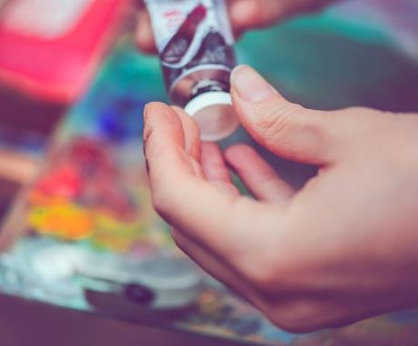

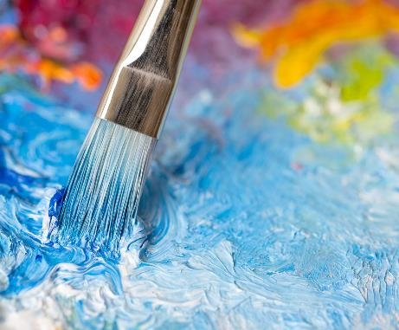
Types of Drawing
Realism
Painting
Sketching
Graffiti
Cartoon Drawing

Slide 4
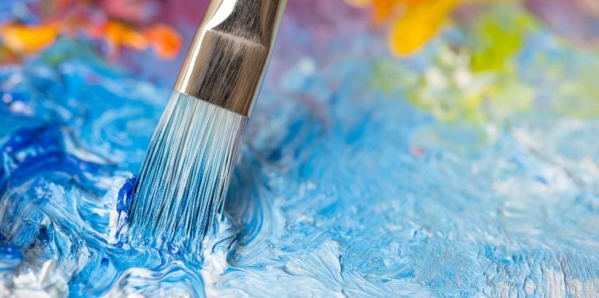

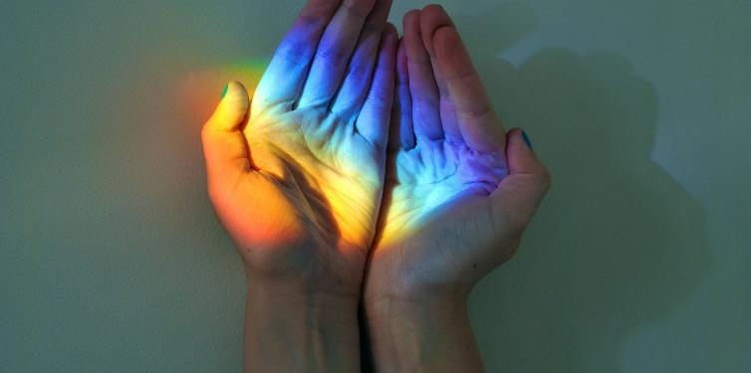
Realism
Realism in the arts is generally the attempt to represent subject matter truthfully, without artificiality and avoiding speculative and supernatural elements. The term is often used interchangeably with naturalism.

Slide 5


Painting
Painting is artwork that results from the application of paint onto a solid surface. The paint can be made of many materials, as long as it is pigmented liquid that can dry to a solid thin layer.

Slide 6
Sketching
sketch, traditionally a rough drawing or painting in which an artist notes down his preliminary ideas for a work that will eventually be realized with greater precision and detail.

Slide 7
Graffiti
Graffiti aims to be seen without being caught or to spread an important message. The end purpose of Graffiti, like other art is to tell a story or express oneself. Graffiti allows artists to express themselves.

Slide 8
Cartoon Drawing
A cartoon makes a brief, funny comment using illustrations and is often found on television, in a newspaper or in a magazine. The Simpsons and Snoopy? Both cartoons. A cartoon can be a satirical or humorous drawing, a series of illustrations (also called a comic strip), or an animated film.

Slide 9
Famous Artists and thereTimeline
Van Gogh
Pablo Picasso
Goya
Leonardo Da Vinci
Van Gogh's art became astoundingly popular after his death, especially in the late 20th century
The painter Pablo Picasso started to make a name for himself when he settled permanently in Paris in 1904
Goya began his career as court painter in 1786, under Charles III. Later, he established himself as a favorite of Charles IV, becoming First Court Painter to the king in 1799
Leonardo da Vinci was an artist and engineer who is best known for his paintings, notably the Mona Lisa (1503–19) and the Last Supper (1495–98).

Slide 10

Why is Drawing Benifitial
Drawing is a great way to improve your creative skills and start thinking in a different way. Art shows you that there is normally more than one way to solve a problem. Art encourages open ended thinking and creativity. These can be really helpful for personal development and solving problems

Slide 11
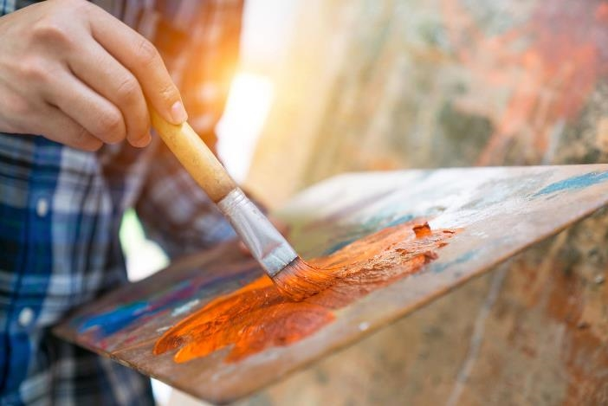
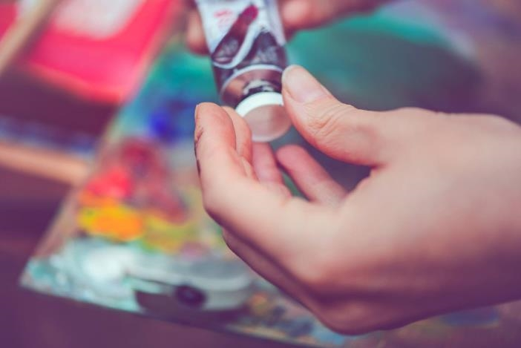
Summary
Drawing is a very beautiful type of art and it is very helpful to many peoples mental health and creativity. Drawing summarizes the beauty in nature and the inner mind and thoughts.

Slide 12
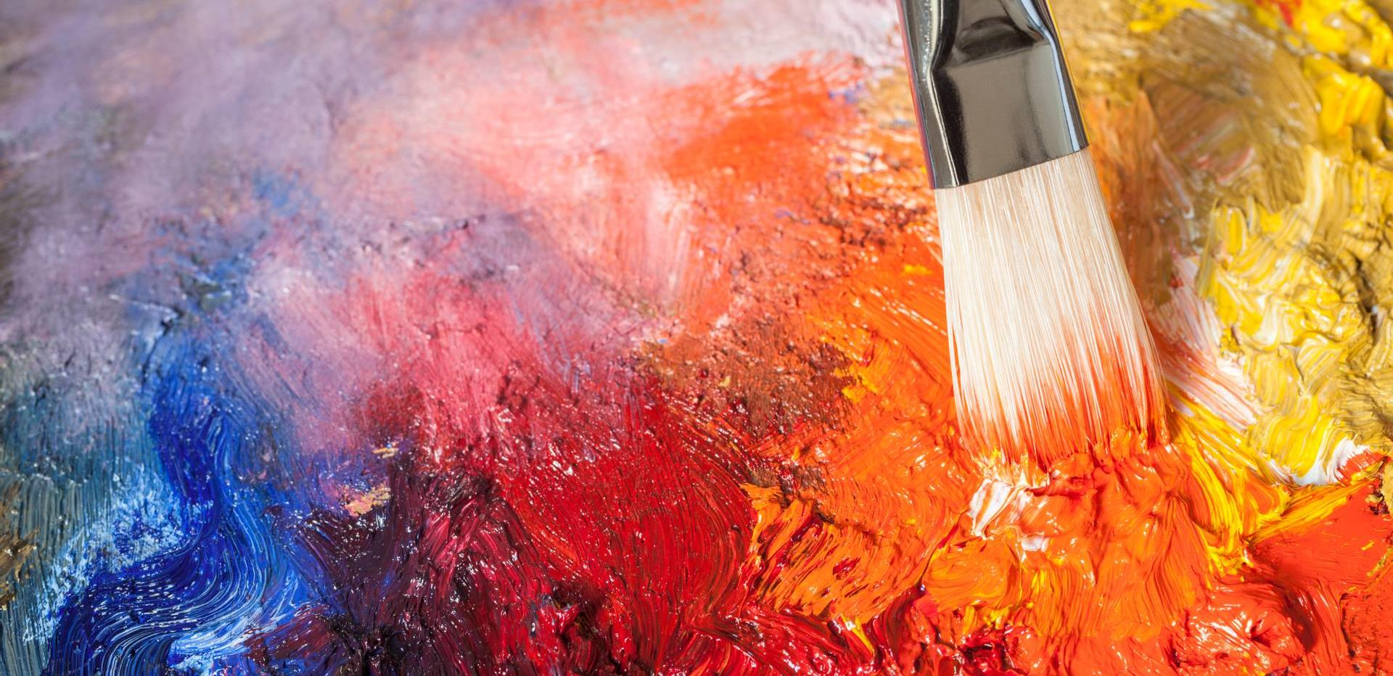
Thank You for Listening.

