Slide 1
Electric circuits
Made by: saif fashho and sami abbasi

Slide 2
What is a circuit?
A circuit is a complete path around which electricity can flow. It must include a source of electricity, such as a battery. Materials that allow electric current to pass through them easily, called conductors, can be used to link the positive and negative ends of a battery, creating a circuit.

Slide 3
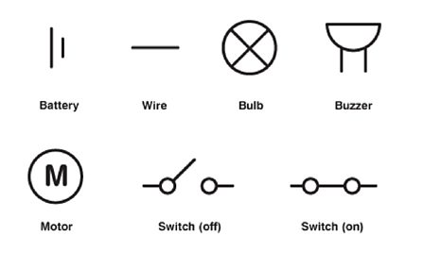
What is a circuit made up of?
A circuit is made up of a wire, a cell ,a battery ,a lamp, a switch, a buzzer and a motor.

