Slide 1
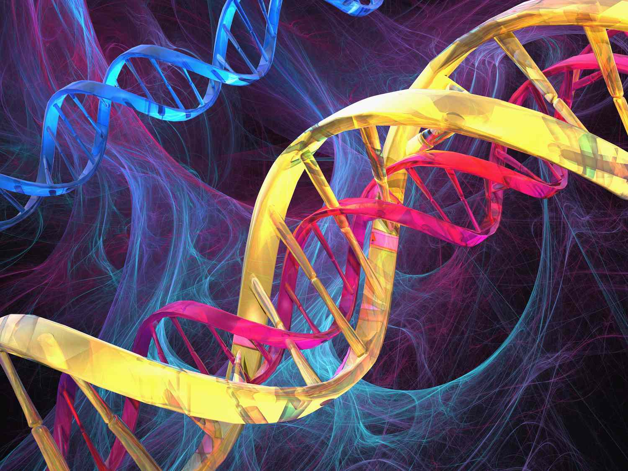
Chromosomes, genes and DNA
By: Tala Dababneh

Slide 2
Lesson overview
In this lesson we will understand that organisms inherit
characteristics from their parents through genetic
material that is carried in cell nuclei

Slide 3
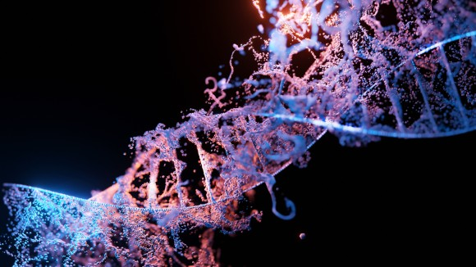
What are genes?
Genes are set of instructions contained in the nucleus cell
some genes are the same in everyone so we all have similar bodies , other genes help to make us all slightly different
Your genes determine your traits, such as eye color and blood type
DNA
DNA is a molecule that carries all the genetic information (A short section of a DNA is a gene)

Slide 4
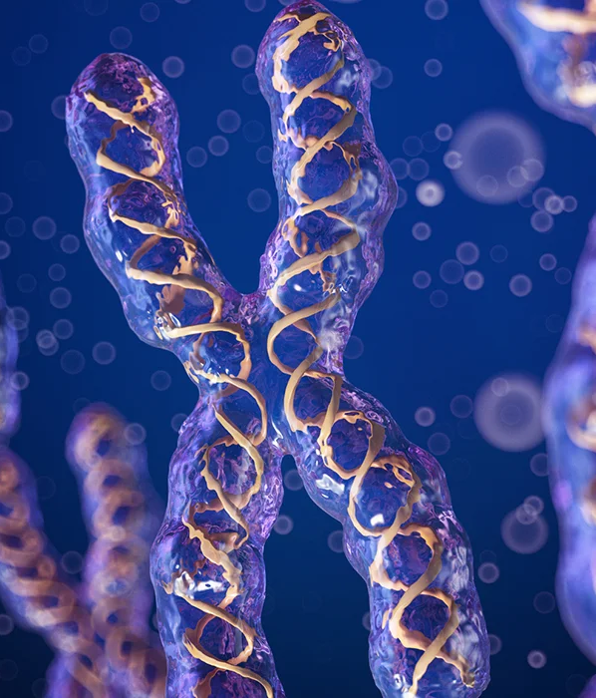
Chromosomes
A chromosome is a long thin thread that is made up of proteins and DNA
(deoxyribonucleic acid) . Each cell normally contains 46
chromosomes arranged in 23 pairs .

Slide 5
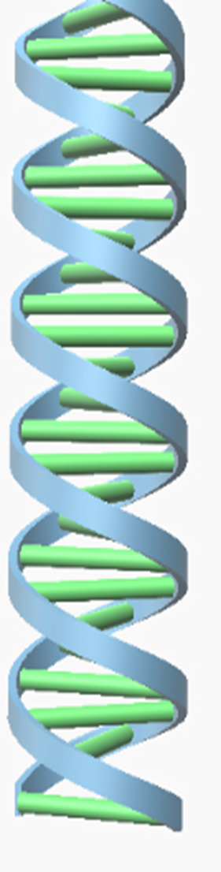

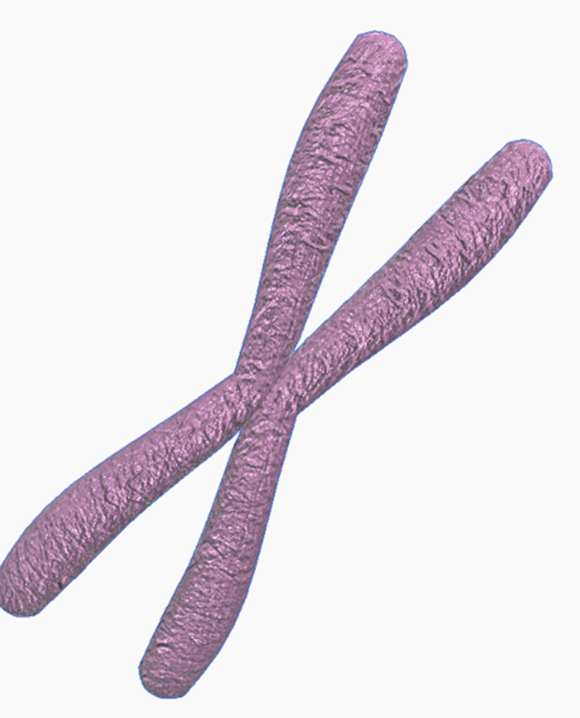
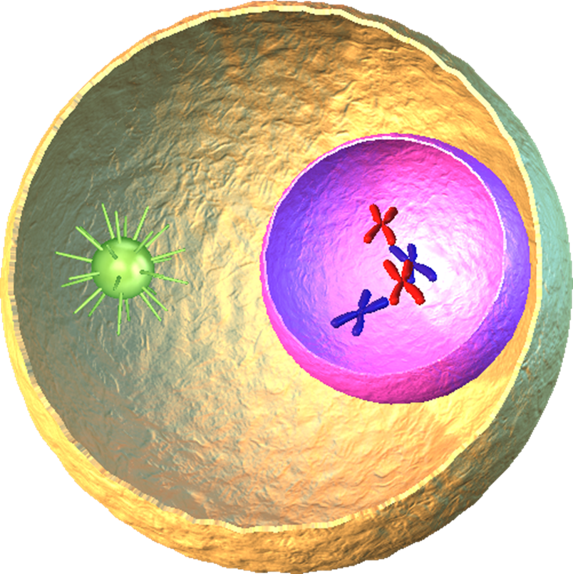
How are chromosomes, genes and DNA all linked to each other ?
The long thin threads in the cell nuclei are the chromosomes. They are made from a giant molecule which is the DNA scattered along each chromosome are special section of DNA are the genes
DNA
cell
Chromosome
Gene

Slide 6
Characteristics
A human cells have 23 pairs because we inherit 23 chromosomes from each parent so we inherit half of each parent’s genes and two copies of each gene and also take different characteristics that are transmitted from parents to offspring
Characteristics controlled by genes
Characteristics controlled by the environment
Blood group
Body mass
Height
Intelligence
Language and accent spoken
Body mass
Height
Intelligence

Slide 7
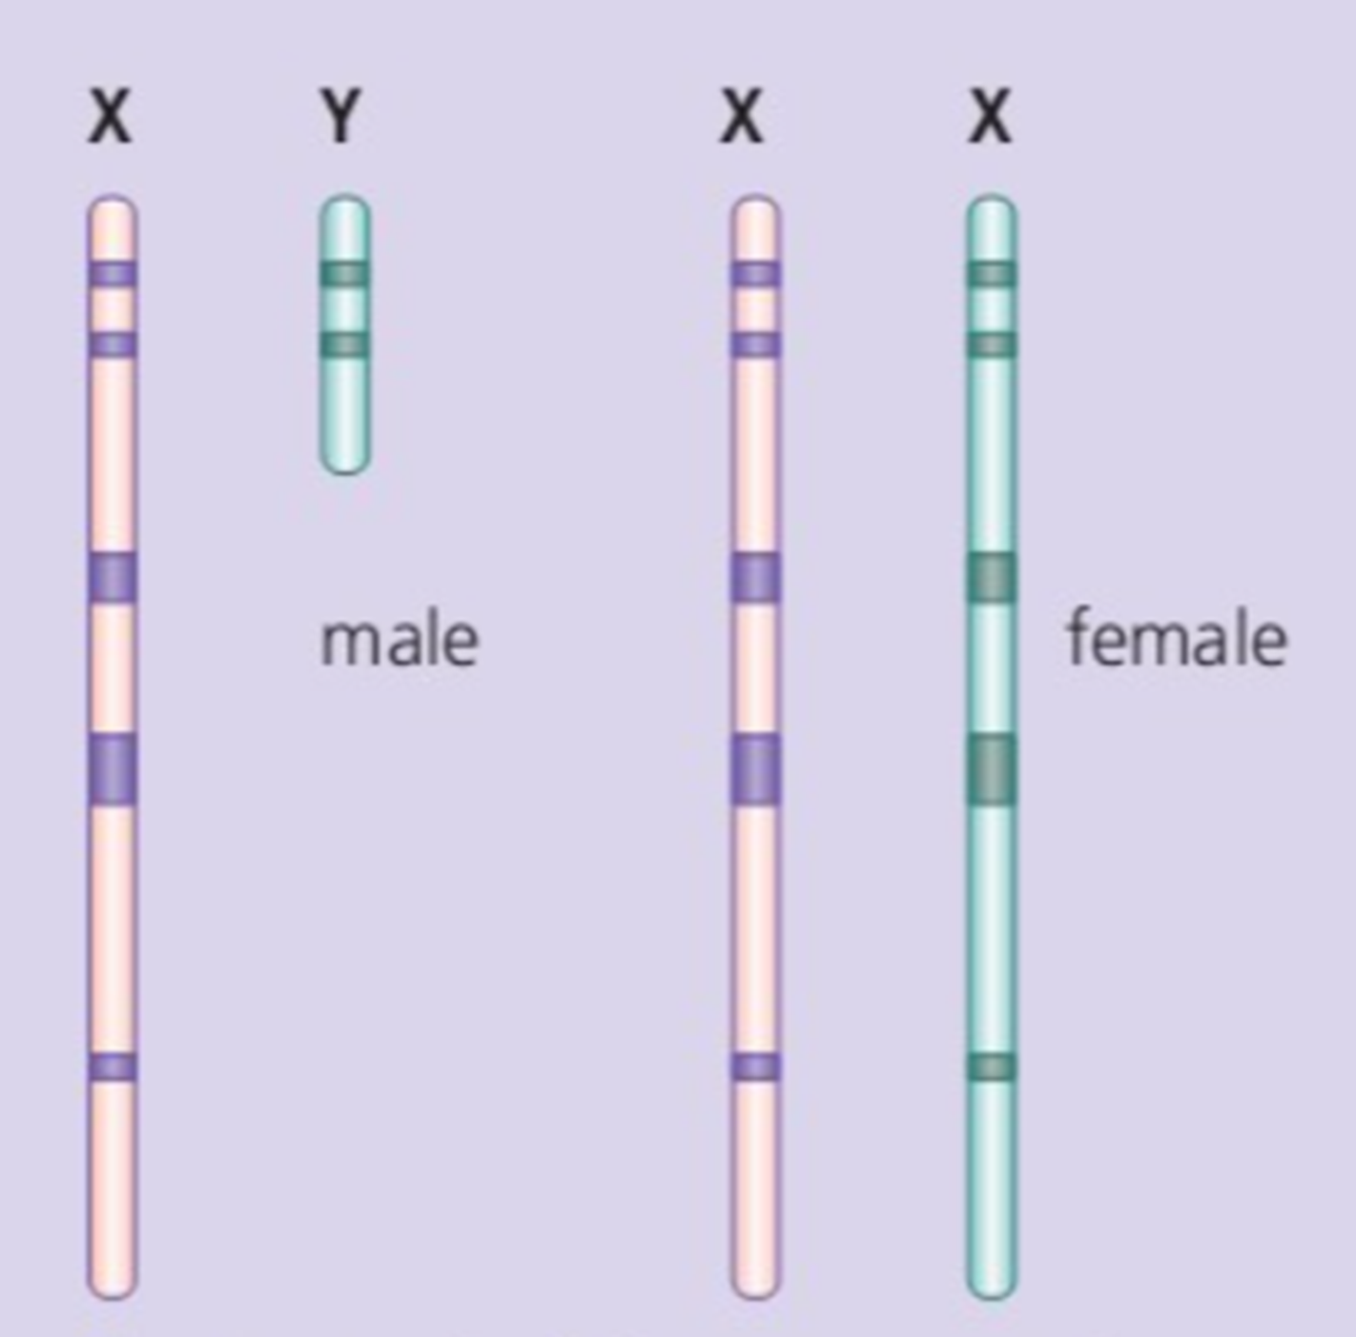
Sex chromosomes
every human has two forms of chromosomes called X and Y
Sex chromosome carry the genes that decide whether you are a female or male. Females have two X chromosomes and males have an X and Y chromosome.

Slide 8
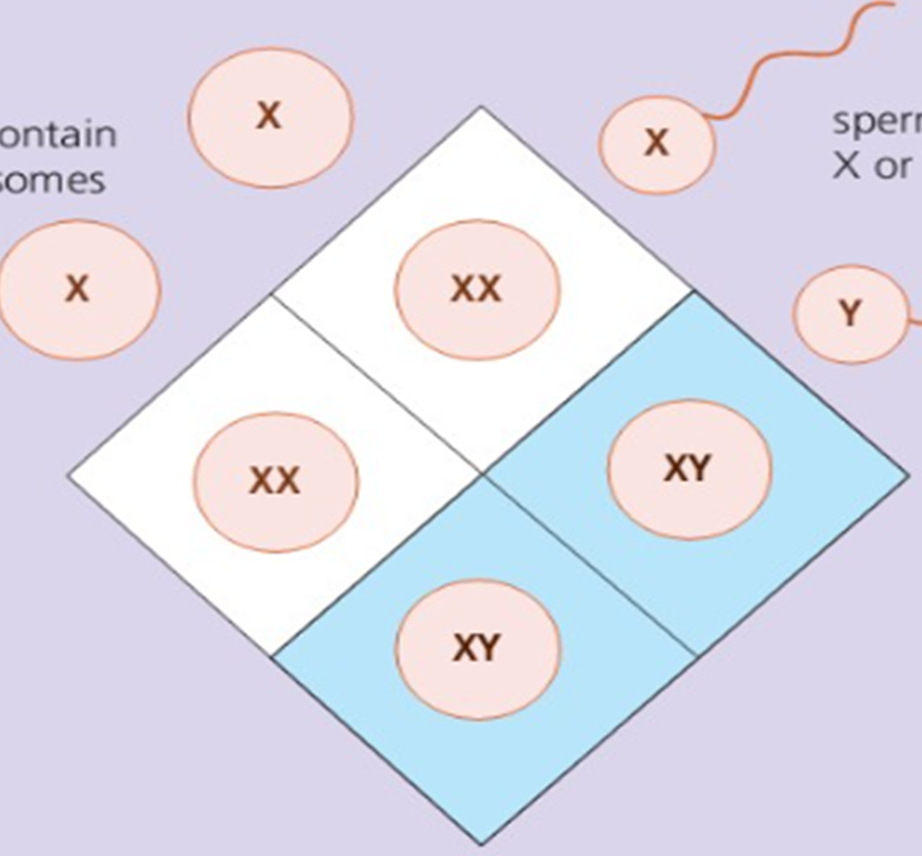
Why do parents are equally likely to have a boy or girl ?
A fertilized egg cell could get two X chromosomes and produce a girl, or get an X and a Y chromosome and produce a boy. The diagram shows that the chances of producing a boy is a 50% chance and a chance to get a girl is also a 50% chance

Slide 9

What decides the gender the fertilized egg grows into?
Males can make two sorts of sex cells. On average, half a mans sperm carry X chromosomes and have carry Y chromosomes, so the sperm cell decides the gender.

Slide 10
Dominant and recessive genes
The terms dominant and recessive describe the inheritance patterns of certain traits. That is, they describe how likely it is for a certain phenotype to pass from parent offspring.
Dominant genes
Recessive genes
A gene that always affects an organism even when only one copy of the dominant gene is present
A gene that has no affect when only on copy of the recessive gene is present
Phenotype
Genotype
The set of observable characteristics of an individual resulting from the interaction of its genotype with the environment.
an organism's complete set of genes. It is the heritery information ex. BB or Bb

Slide 11

Q1. T/F The nucleus of every cell contains 23 chromosome
False, they contain 46 chromosomes

Slide 12
Q2 Explain why you have two copies of every gene
The genes on paired chromosomes do the same jobs as each other, so we inherit two copies of each gene one from each parent

Slide 13

Q3 What is the genotype of a person with two dominant alleles for long eye lashes
LL

Slide 14
Thank You

