Slide 1
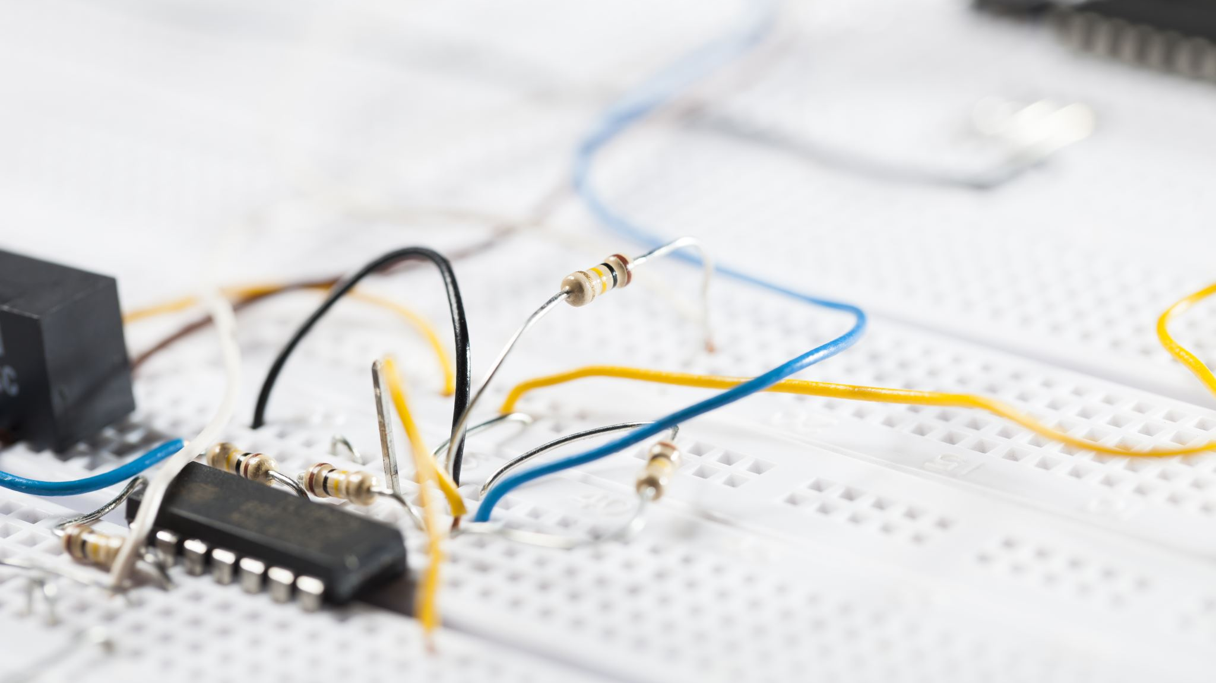
Physics:Electric circuits
Made by: Sinan Shawareb, Fayez al Uzaizi and amir al momaiz

Slide 2
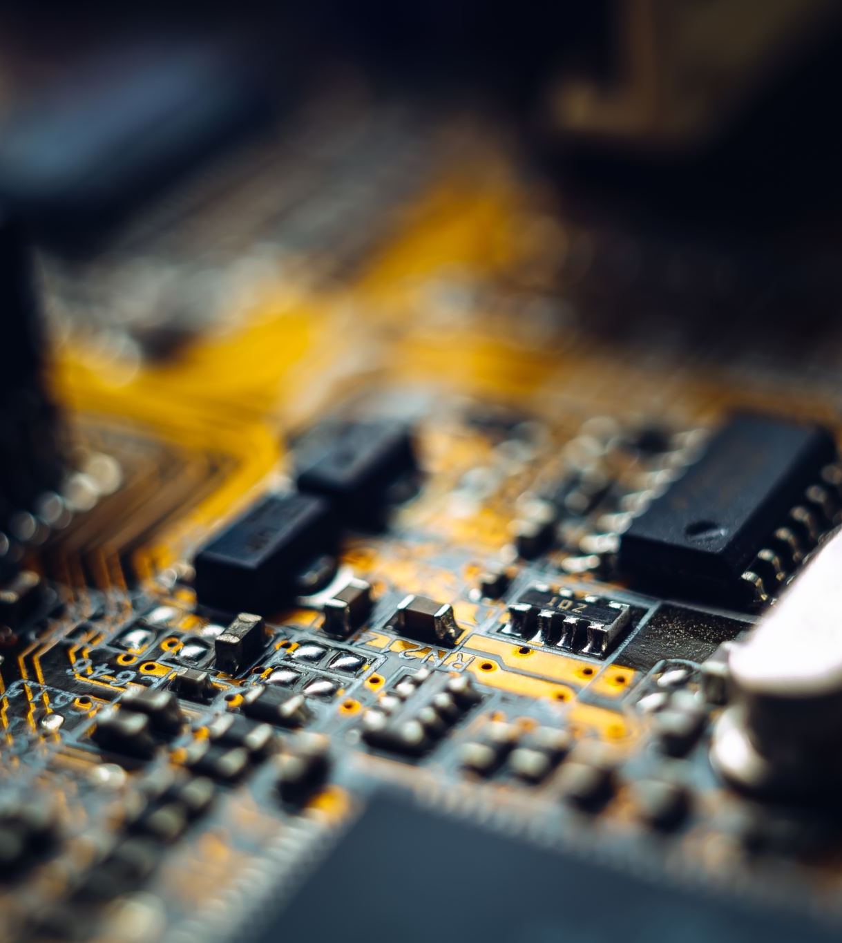
What is an electric circuit?
An electric circuit connects a source of current, A lamp
and a switch.

Slide 3
Examples of electric circuits.
Televsions.
Movie projectors.
Loudspeakers.
Many other devices that are used for entertainment.

Slide 4
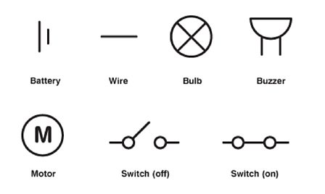
Circuit Symbols
This figure shows the components of an electric circuit and its symbols.
We can use circuit symbols for each of the components instead of a complicated and long drawings.

Slide 5
What is an electric current?
Its the flow of charge, which is caused by the movement of electrons.
The current is the number of electrons flowing per second.

Slide 6
Q1 What symbol is used for a buzzer?

Slide 7
Q2 What is an electric circuit?
its the flow of protons per seconds
it’s the flow of electrons per second

Slide 8
Q3 What are some examples of electric circuits?
Televsions and movie projectors
solar heater and fuel engine

Slide 9
Yes you got it correct
go to question 2
go to question 3

Slide 10
No you got it wrong
click on the question number to see the answer
❶❷❸

Slide 11
The end
Thank you for listening
This Photo by Unknown Author is licensed under CC BY

