Slide 1
.
About sports
By: yasmeen,selena

Slide 2
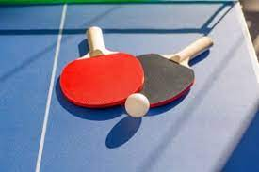
.
Table tennis (ping pong)
Table tennis, also known as ping-pong and whiff-whaff is a racket sport derived from tennis but distinguished by its playing surface being atop a stationary table, rather than the court on which players stand, the Ping-Pong table is divided into 2 equal courts by a net fixed across its width at the middle.
The time taken to complete a table tennis match is 1h 45m

Slide 3
.
Table tennis rules
Games are played to 11 points.
Alternate serves every 2 points
Toss the ball straight up when serving
The serve can land anywhere in singles
Double serves must go right go right court to right court
A serve that touches the net on the way over is a “let”
Touching the ball with your paddle hand is allowed
Team members in Ping-Pong are either singles or doubles
Ping-Pong was first played in the 19th century in England,UK
If your hit bounces back over the net by itself then its your point

Slide 4
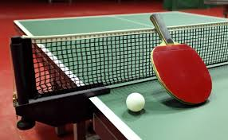
,
How is table tennis played?
The object is to hit the ball so that it goes over the net and bounces on the opponent's half of the table in such a way that the opponent cannot reach it or return it correctly

Slide 5
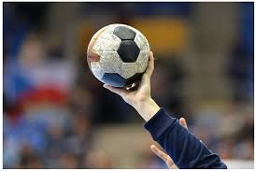
.
Handball
It is a team sport that consists of 2 teams of 7 players, they pass a ball using their hands with the aim of throwing it to the goal of the opposing team.
Handball is a standard match that consists of 2 periods of 3 periods of 30 minutes, and it was first on the 2nd of December 1917, in Berlin, Germany

Slide 6
,
Handball rules
In handball; a goal is scored when the ball passes between the goalpost and travels fully across the goal lin. However, a goal is not awarded until the referee has signaled that it is in and is confident the no rules were broken.

Slide 7
.
Handball rules (points)
A competitive game consists of equal 30 minutes halves with a 10-15 minute break
A team cannot keep possession of the ball without attempting to attack
A goal can be scored from any type of throw
A player can run with the ball for 3 steps maximum
A player can hold the ball for 3 seconds maximum
The players are permitted to dribble the ball for maximum one time
A player cant hit/punch the ball out of a opponents hands
Players cannot make contact with the ball below their knees
Players are only allowed to hold the ball for only 5 seconds without moving when guarded by a close defender

Slide 8
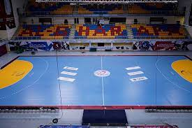
.
Handball court
The playing court is 40m long and 20m wide, with 2 goal areas and a playing area. The longest boundary lines are called side lines, and the shorter ones are called goal lines or outer goal lines

