Slide 1
Dominant and recessive genes
By Sanad Madanat

Slide 2
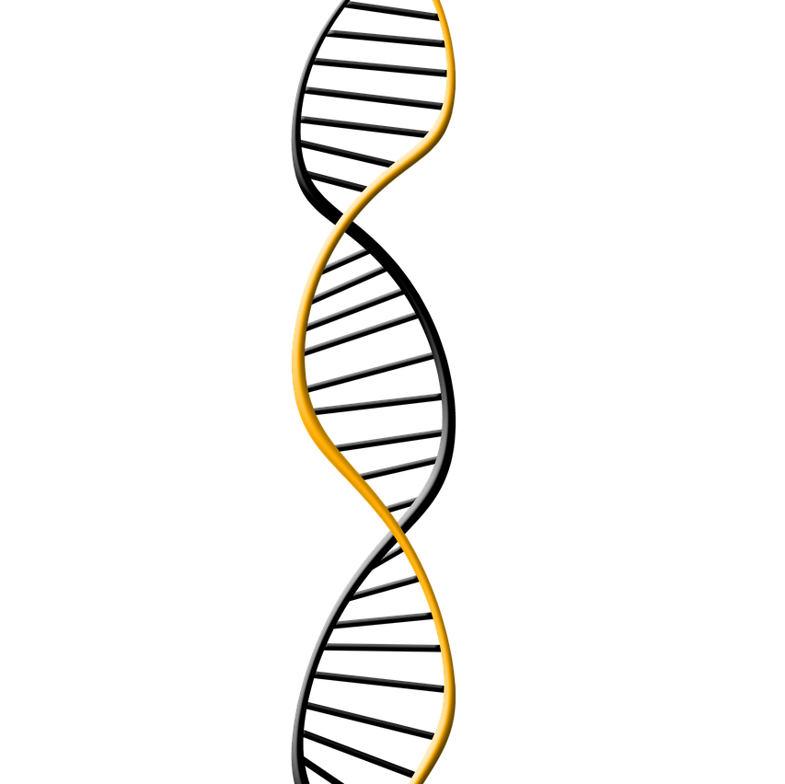
What are they
Dominant refers to the relationmship between two versions of a gene.
Individuals receive two versions of each gene,known as alleles,from each parent.
If the alleles of a gene are different, one allele will be expressed ;it is dominant gene. The effect of the other allele, called ressesive,is marked.

Slide 3
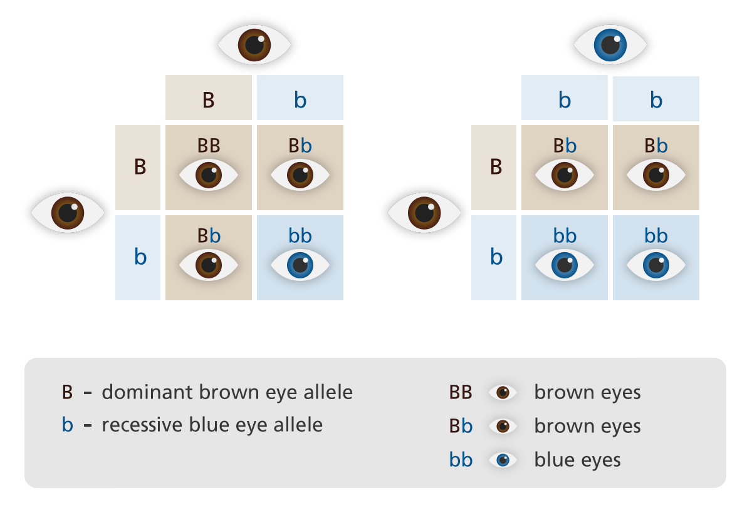
Example:
In this photo here it shows the prosses of dominant and recessive genes.

Slide 4
Dominant and recessive in plants
Dominant and recessive genes can also be found in plants for example if you have a plant with T for the color purple and t for the color white the color of the next plant will be purple but if you had tt it would be white.

Slide 5
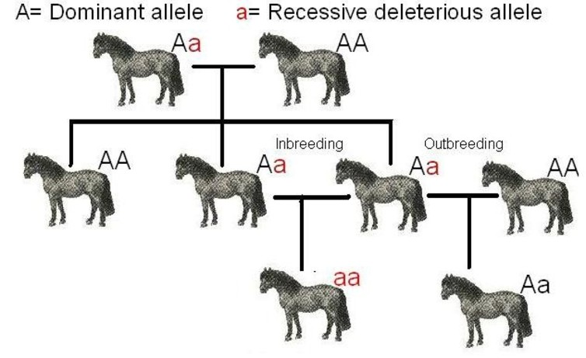
Dominant and recessive in animals
For example, if u wanted to know how the next generation of horses will look like or if u wanted. To know the eye color u, need to know the dominant and recessive gene and you can do this table, so you know the answer.

