Slide 1
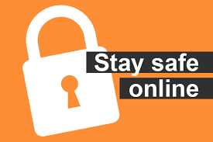
Staying safe online
By Adam Abdullah

Slide 2
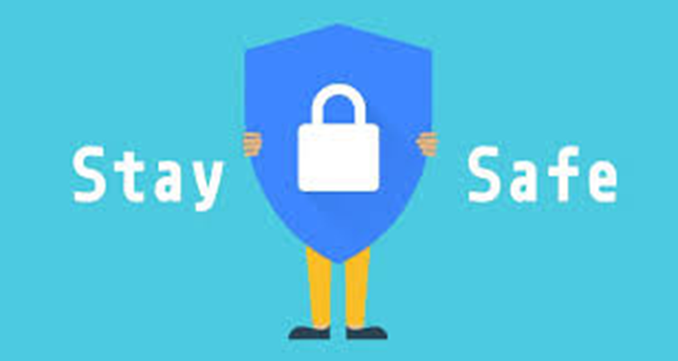
What is online safety?
Understanding the kind of risks you could face when using the Internet for activities is referred to as online safety.

Slide 3
Why is staying safe online important?
Being safe online entails defending oneself and others from dangers and threats that could compromise their personal data, result in dangerous contacts, or even have an adverse effect on their mental health and welfare.

Slide 4
how to stay safe online
Use unique strong passwords
Keep you software up to date
Don’t click on links from people you don’t know
Download from secure sources
Never share your password

