Slide 1
Factors Affecting the Rate of Reaction
By: Nabeel Zureiqat, Jad Halase, Noor Dweiri

Slide 2
What is a Chemical Reaction?
A chemical reaction involves a chemical change that happens when 1 or more reactant(s) react/decompose to form 1 or more new product(s) which have different properties than the original reactants, and are usually hard to revert back to the original.
For Example:
Hydrochloric acid + Magnesium → Magnesium Chloride + Hydrogen
HCl + Mg → MgCl₂ + H₂
For a chemical reaction to take place it needs 2 things:
Activation Energy
It is the minimum amount of energy required for a particle to react
Collisions/Orientation
For particles to react they must collide, but not all collisions result in a reaction, they must be in the right orientation. For example, 2 iron particles colliding won’t result in a chemical reaction, but if a hydrochloric acid particle and a magnesium particle collide they will react to make, magnesium chloride and hydrogen

Slide 3
What is the Rate of Reaction
The rate of reaction is the speed at which a chemical reaction takes place.
If the collisions increase or get stronger and/or if the activation energy needed is lowered the rate of reaction will increase.

Slide 4
What are the Factors that Affect the Rate of Reaction
There are 4 factors that affect the rate of reaction:
Temperature
Surface Area
Concentration
Catalyst

Slide 5
Temperature
As the temperature increases in a chemical reaction, particles will gain more kinetic energy, therefore they will have stronger and more frequent collisions.
As a result, the rate of reaction will increase.

Slide 6
When the Particles Have a Low Amount of Heat

Slide 7
When the Particles Have a High Amount of Heat

Slide 8
Surface Area / Particle Size
As the surface area increases (particle size decreases) in a chemical reaction particles will be more exposed, therefore they will have more collisions.
As a result, the rate of reaction will increase.

Slide 9
When the Particles Have Low Surface Area (Ex. Cube)

Slide 10
When the Particles Have High Surface Area (Ex. Powder)

Slide 11
Concentration
As the concentration increases in a chemical reaction there will be more particles in a small area, therefore they will have more collisions.
As a result, the rate of reaction will increase.

Slide 12
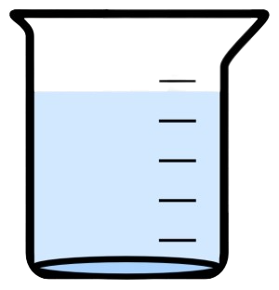
When the Particles Have Low Concentration

Slide 13
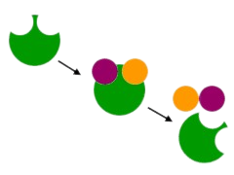
When the Particles Have High Concentration
Release of products and moving on for another reaction
Catalyst
Catalyst bonding to reactants

Slide 14
Catalyst
A catalyst is a substance that speeds up a reaction without being used up and is used in small amounts.
Catalysts attract and bond to the particles (a process known as adsorption). Then they move around and lower the activation energy required to make the particles more likely to react.
Thus increasing the rate of reaction.
Different reactions usually require different catalysts.
Catalyst
Catalyst bonding to reactants
Release of products and moving on for another reaction

Slide 15
Watch this Video to Understand More!
Release of products and moving on for another reaction
Catalyst
Catalyst bonding to reactants

Slide 16
Thanks For Listening!

