Slide 1
Selective breeding
By: Sanad Mraybeh and Abdullah Zaatar

Slide 2
What is Selective breeding?
Selective breeding is the process by which humans manage the breeding of organisms to either express or eliminate a particular characteristic.

Slide 3
Why do breeders use Selective breeding?
Selective breeding is a process of selecting parents from plants or animals that have desirable characteristics. The hope is that the offspring will inherit these desirable characteristics, allowing future generations to benefit from the chosen changes.

Slide 4
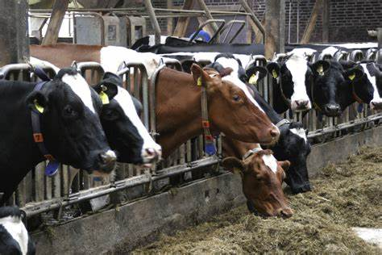
Advantages and disadvantages of selective breeding
Advantages: new varieties may be economically important by producing more or better quality food.
example: farmers selectively breed different types of cows with highly desirable characteristics in order to produce the best meat and dairy so they can make the most profit.
Disadvantages: it can lead to a reduced gene pool, making it more difficult to produce new varieties in the future.

Slide 5
What are the 3 steps of selective breeding?
Choose what you want, Choose parents who already have some of the desired characteristics, and then breed them together.
Select offspring that are the most similar to what you want to be the new parents.
Repeat the process over many generations.

Slide 6
Now that we have finished explaining Selective breeding, let’s see what you have learnt.
which one of these is the definition of selective breeding?
the process by which humans manage the breeding of organisms.
the process where organisms are better adapted to their environment.

Slide 7
The answer is #1

Slide 8
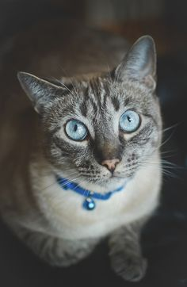
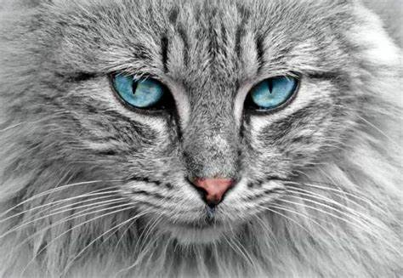
If u want a big cat with blue eyes which cats would you mate?
a small female cat with a small male cat with green eyes.
a big female cat with a big male cat with blue eyes.

Slide 9
The answer is #2

Slide 10
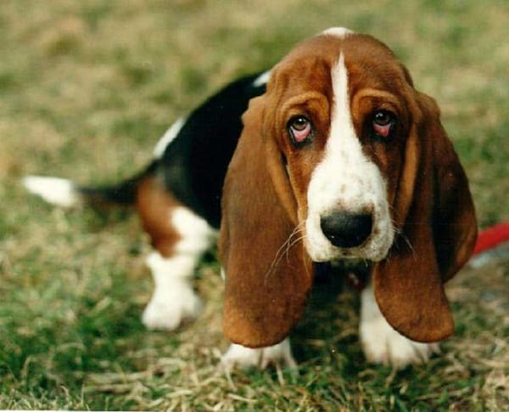
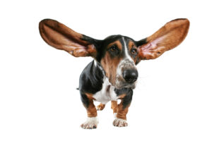
If you want a small dog with big ears which dogs would u mate?
a big female dog with a big male dog with big ears.
a small female dog with a small male dog with big ears

Slide 11
The answer is #2

