Slide 1
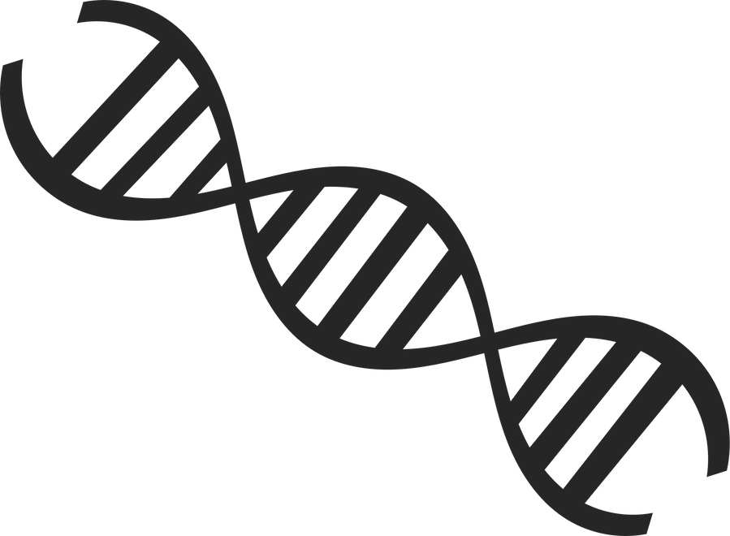
Chromosome, DNA & genes
By: Christina & Carol

Slide 2
introduction
chromosomes
DNA
genes
A chromosome is a structure found inside the nucleus of a cell. A chromosome is made up of proteins and DNA organized into genes. Each cell contains 46 chromosomes split into 23 pairs, 23 pairs from the father and 23 pairs from the mother.
DNA is made of two connected strands that wind around each other to resemble a twisted ladder, which is known as a double helix. A short section of the Dna is a gene.
The nucleus of every cell contains a set of instructions called genes, some genes are the same in everyone so we all have similar bodies , other genes help to make us all slightly different. Your genes determine your traits, such as eye color and blood type.

Slide 3
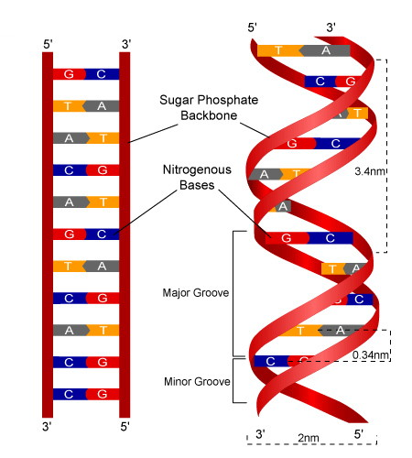
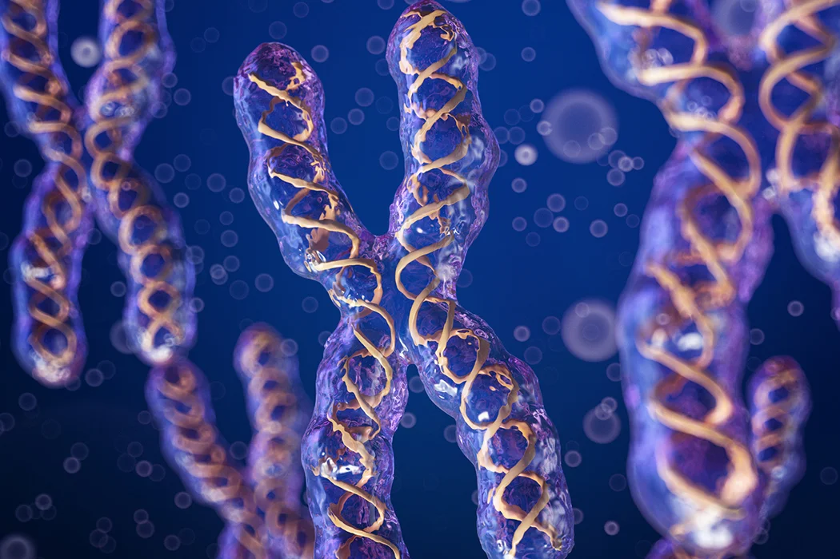
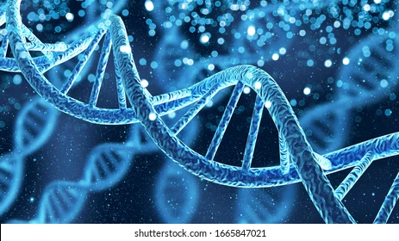
What they're useful for:
1
2
3
Chromosomes: they carry long pieces of Dna, which helps the Dna strands by containing enough protein for the Dna to exist in its proper form.
Dna: it helps an organism develop, survive and reproduce in humans, animals and plants. It can also produce a bit of protein.
Genes: They carry instructions that tell your cells how to work and grow. They contain information for making specific molecules and proteins that allow human cells to function and that control how the body grows and operates.

Slide 4
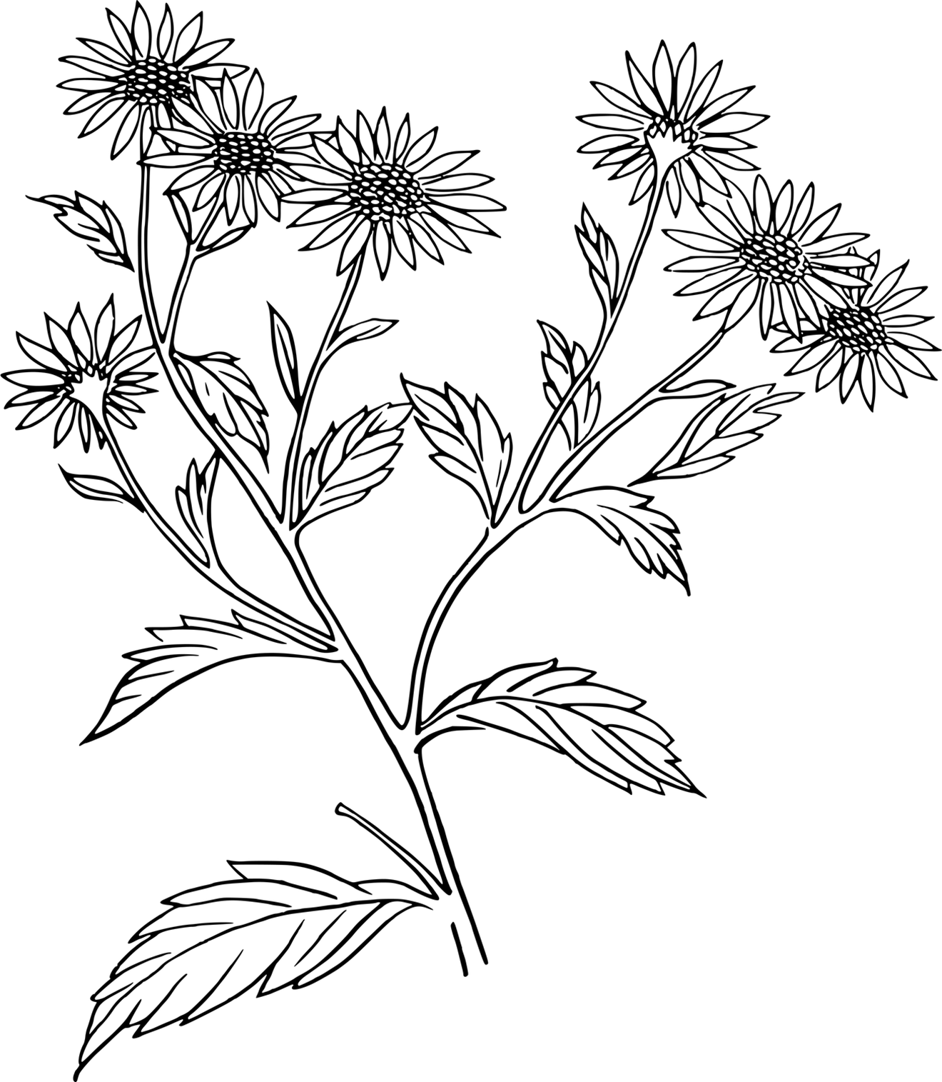
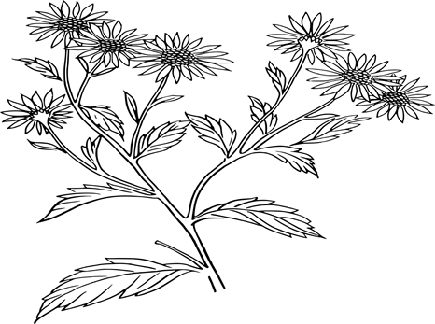
Genetic basics

Slide 5
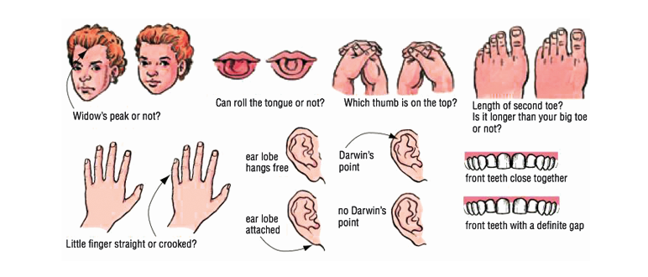
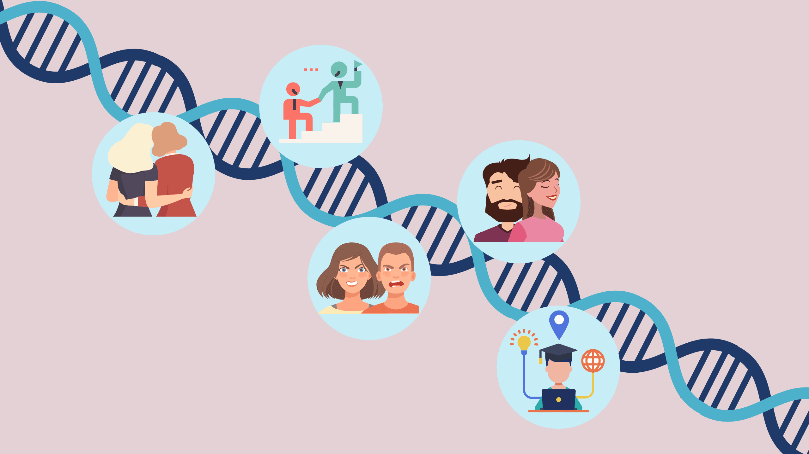
Genetics is the inheritance of traits(characteristics), traits can be determined by genes, environmental factors or both. Traits can be qualitative(such as height or blood pressure).genetic variation alter gene activity or protein function can introduce different traits in an organism. If the trait is adventurous and helps individuals survive, its more likely to be passed on to the next generation.

Slide 6
Blood group
Body mass
Height
Language spoken
intelligence
By genes
By genes and environmental factors
By genes and environmental factors
By environmental factors
By genes and environmental factors

Slide 7
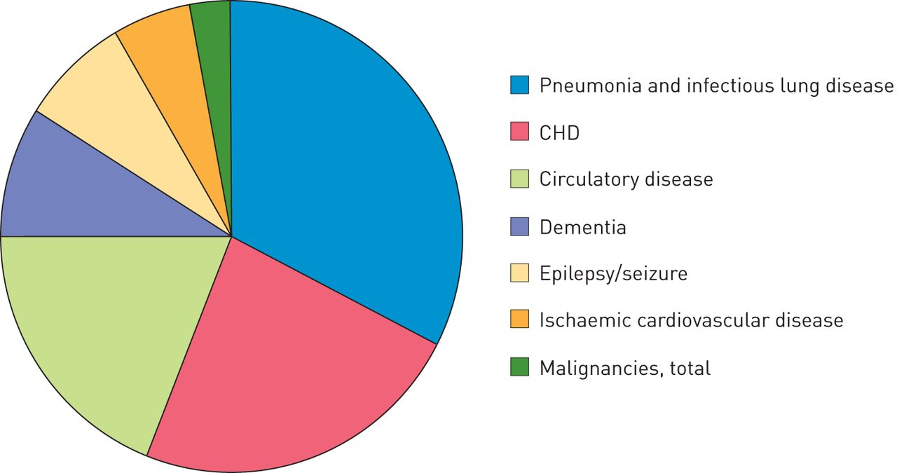
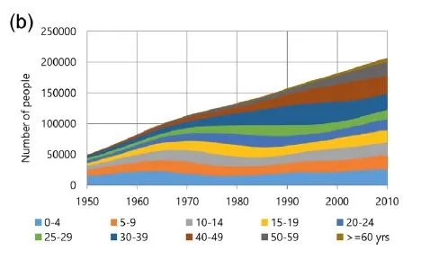
Down syndrome
Down syndrome occurs when the total number of chromosomes is 47, whereas there's meant to be 46. the reason for this occurrence is when babies have an extra copy of a chromosome.

Slide 8
Questions!
Q1-
What are genes useful for?
Q2-
How many chromosomes does a human body contain?
Q3-
How is a down syndrome caused?

Slide 9
Answers :
Q1-They carry instructions that tell your cells how to work and grow.
Q2- 46 chromosomes into 23 pairs.
Q3-Its caused when babies have an extra copy of a chromosome.

Slide 10
THANK YOU!

