Slide 1
Immune System
By: Bassam.M. Sweis

Slide 2
Contents:
Introduction.
What is the immune system?
Parts of immune system.
The role does the immune system play in Keeping us alive and well.
The food that boost our immune system.
Why these food ,that I presented in the previous slide, boost the immune system?
What would happen if you had a very week immune system or no immune system at all ?
Does being happy boost your immune system?
Recourses.

Slide 3
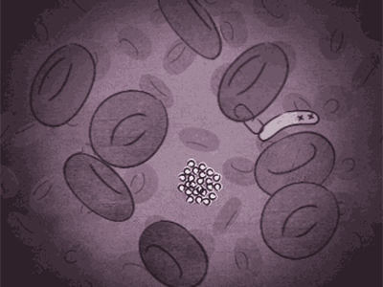
Introduction:
Every second of your life you are under attack. Bacteria, viruses, spores and more living stuff wants to enter your body and use its resources for itself. The immune system is a powerful army of cells that fights like a T-Rex on speed and sacrifices itself for your survival. Without it you would die in no time. This sounds simple but the reality is complex, beautiful and just awesome. An animation of the immune system.

Slide 4
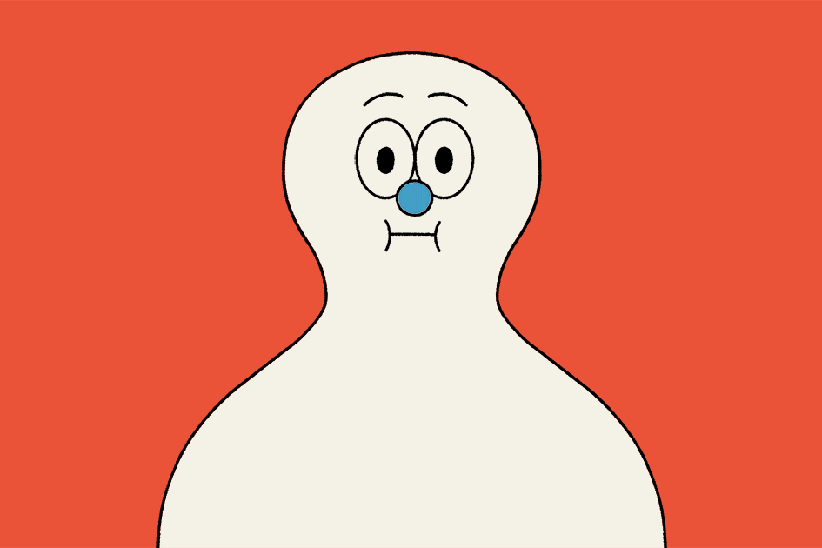
What is the immune system?!
The immune system is one of our great organ systems, it is a complex network of cells and proteins that defends the body against infection. It helps to protect us against diseases caused by tiny attackers
Called Microorganisms( bacteria and parasites) and viruses. The immune system is made up of specialized organs, cells, and tissues that all work together to destroy these attackers.

Slide 5
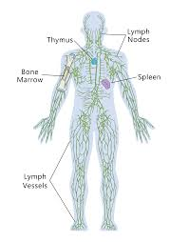
Parts Of Immune System:
White blood cells, they are the key players in your immune system and they are made in your bone marrow.
Antibodies, they help the body to fight microbes or the toxins (poisons) they produce.
Complement system, the complement system is made up of proteins whose actions complement the work done by antibodies.
Lymphatic system, it is a network of delicate tubes throughout the body.
Spleen, it is a blood-filtering organ that removes microbes and destroys old or damaged red blood cells.
Bone marrow, it is the spongy tissue that produces the red blood cells, the white blood cells and the platelets.
Thymus, it filters and monitors your blood content.

Slide 6
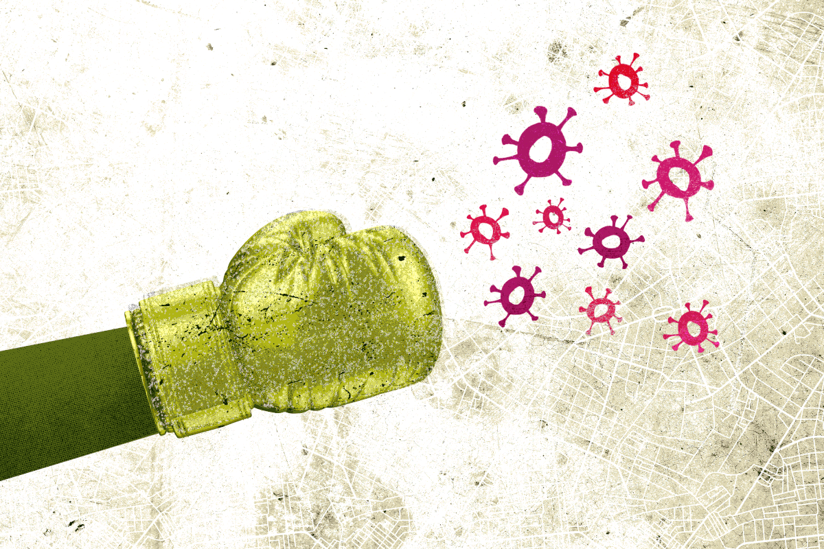
The role does the immune system play in Keeping us alive and well!!
Your immune system works hard to keep you healthy. Its job is to keep germs out of your body or to destroy them or limit the extent of their harm if they get in. When your immune system is working properly, it can tell which cells are yours and which substances are foreign to your body.
When the body senses foreign substances (called antigens), the immune system works to recognize the antigens and get rid of them.
Examples of antigens include the proteins on the surfaces of bacteria, fungi and viruses. When these antigens attach to special receptors on the immune cells (immune system cells), a whole series of processes are triggered in the body. Once the body has come into contact with a disease-causing germ for the first time,( it usually stores information about the germ and how to fight it. Then, if it comes into contact with the germ again, it recognizes the germ straight away and can start fighting it faster)*.
* This amazing system has memory then, that is really awesome .

Slide 7
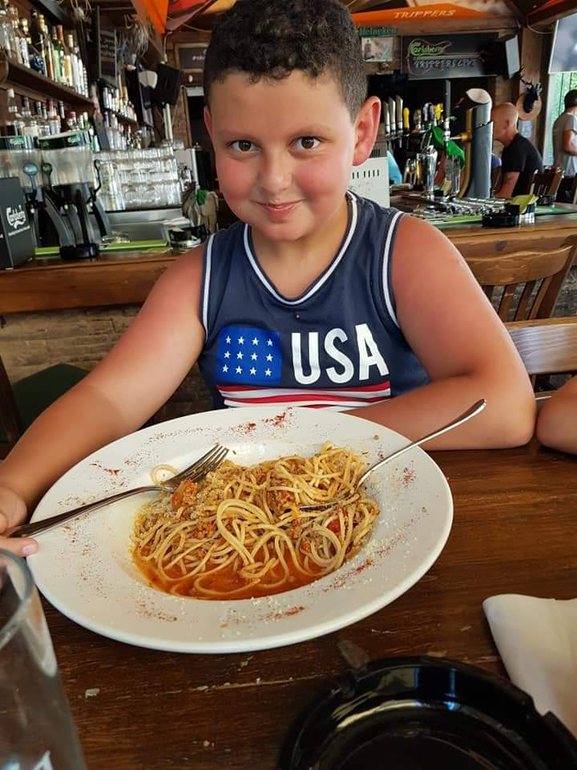
The food that boost our immune system:
Citrus fruits such as: lemon, orange, easy peeler, grapefruit and lime.
Red bell pepper.
Garlic.
Broccoli.
Ginger.
Green leaves, lettuce and spinach.
Dairy such as milk and yogurt.
Dry almonds.
Sunflowers seeds.
Turmeric.
Green tea.
Papaya.
Kiwi.
Fish and the fish oil.

Slide 8
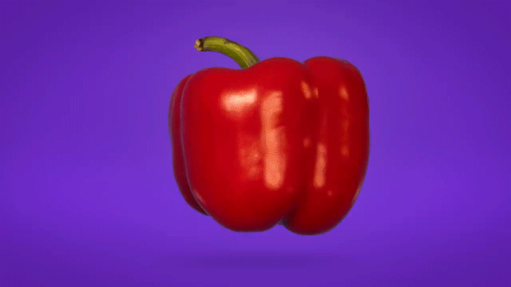
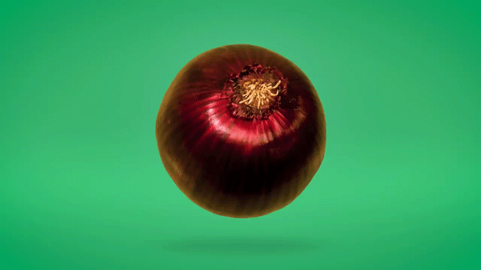
Why these food ,that I presented in the previous slide, boost the immune system?
Because all the food I presented have vitamin, protein and beta-carotena which could boost the immune system.
Beta-Carotene: Beta-carotene is a powerful antioxidant that can reduce inflammation and boost immune function by increasing disease-fighting cells in the body.
Vitamins C and E: They are antioxidants that help to destroy free radicals and support the body’s natural immune response.
Vitamin D: Research shows vitamin D supplementation may reduce the risk for viral infections, including respiratory tract infections.

Slide 9
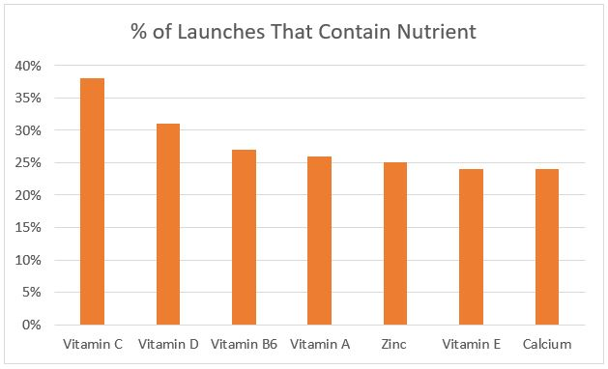
Vitamin C, vitamin D, and vitamin B6 were the leading nutrients found in new product launches with immune system claims during the period defined above. Vitamin C was by far the most popular with 38% of new product launches in the immune category containing vitamin C. The chart below shows the percentage of new product launches containing each of the top seven nutrients

Slide 10
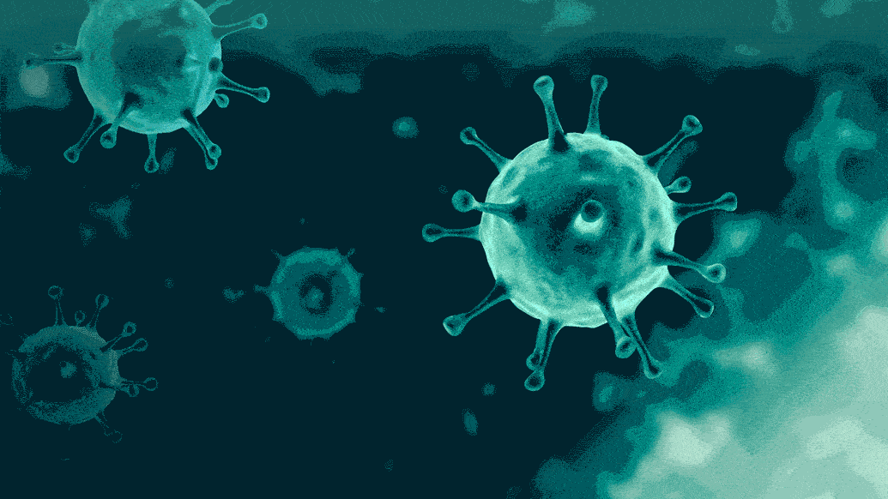
What would happen if you had a very week immune system or no immune system at all ???
Without an immune system, we would have no way to fight harmful things that enter our body from the outside or harmful changes that occur inside our body.
The main tasks of the body’s immune system are:
1.To fight disease-causing germs (pathogens).
2.To recognize and neutralize harmful substances from the environment.
3.To fight disease-causing changes in the body, such as cancer cells.

Slide 11
Does being happy boost your immune system?
Scientific studies have begun to reveal a host of physical health benefits surrounding happiness including a stronger immune system, stronger resilience in the face of stress, a stronger heart and less risk of cardiovascular disease, alongside quicker recovery times when overcoming illness or surgery.
So smile and don’t worry be happy.

Slide 12
Thank you miss Eva, you are the best (;

Slide 13
Resources:
https://www.hopkinsmedicine.org/health/conditions-and-diseases/the-immune-system
https://www.betterhealth.vic.gov.au/health/conditionsandtreatments/immune-system
https://www.healthline.com/health/food-nutrition/foods-that-boost-the-immune-system#shellfish
https://www.betterhealth.vic.gov.au/health/conditionsandtreatments/immune-system#:~:text=The%20immune%20system%20is%20a,it%20enters%20the%20body%20again.
https://www.youtube.com/watch?v=zQGOcOUBi6s
www.ducksters.com/science/biology/immune_system.php
https://www.pcrm.org/news/blog/foods-boost-immune-system
https://www.ncbi.nlm.nih.gov/books/NBK279364/

