Slide 1
Food choices and their impact on your immunity system
by : Naya al Shami andnd maya atawi

Slide 2
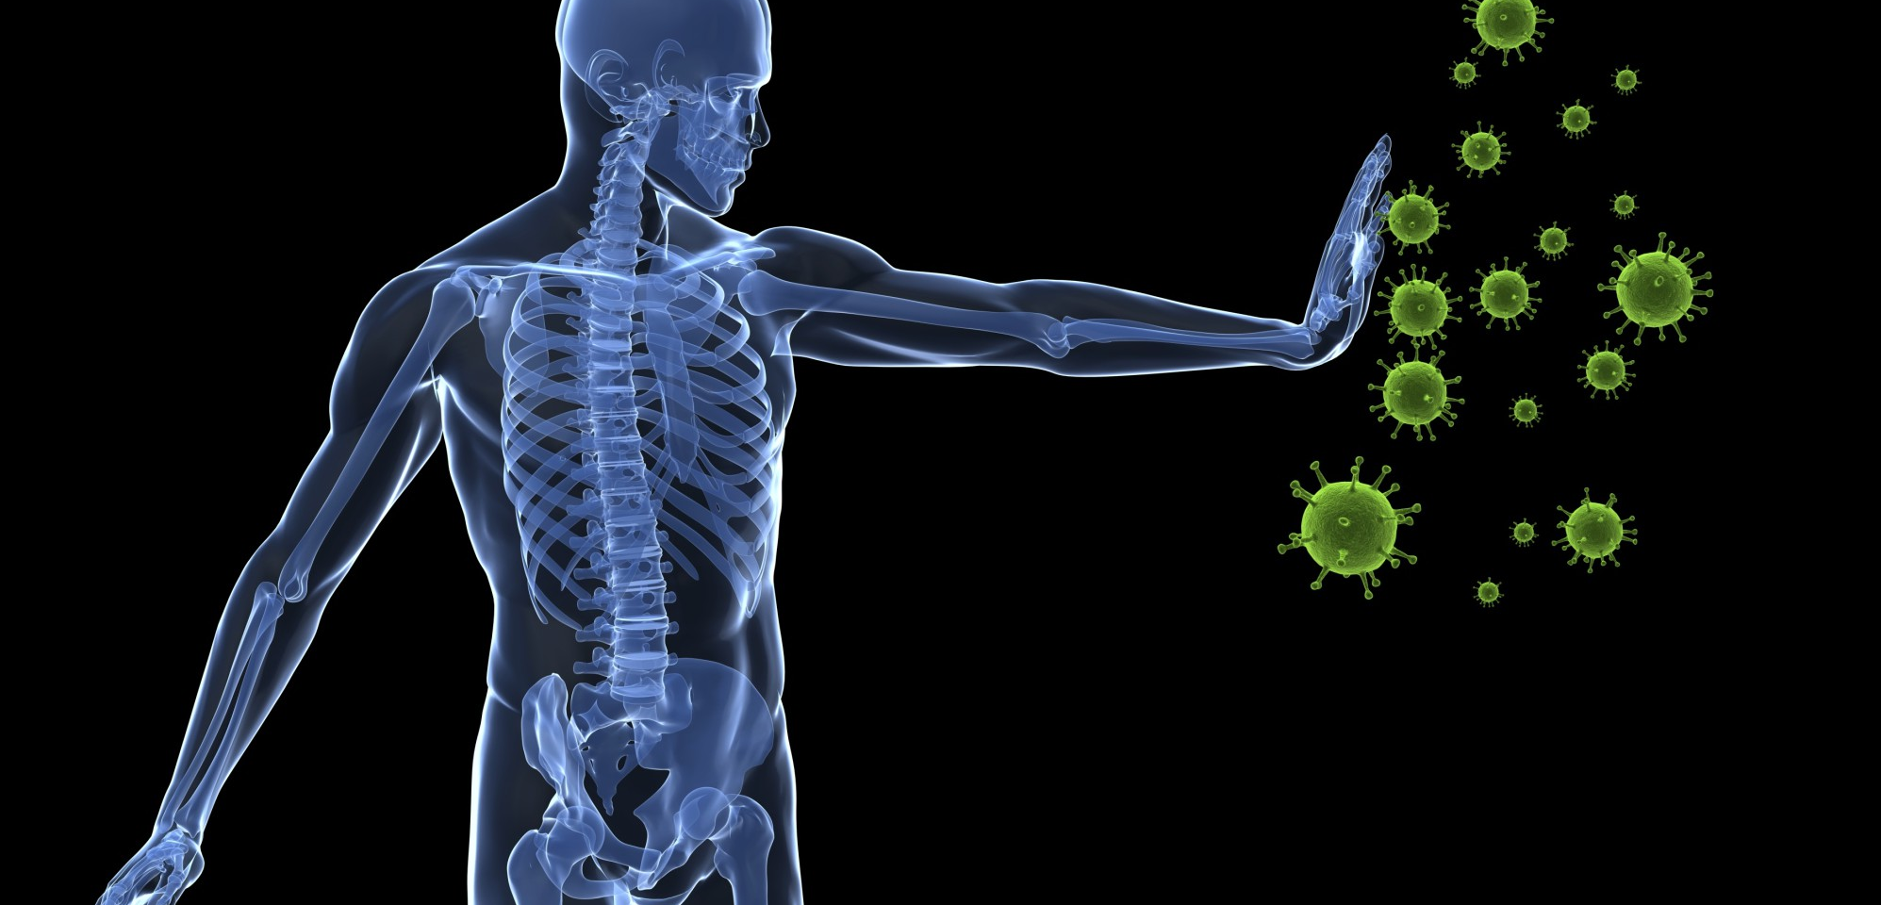
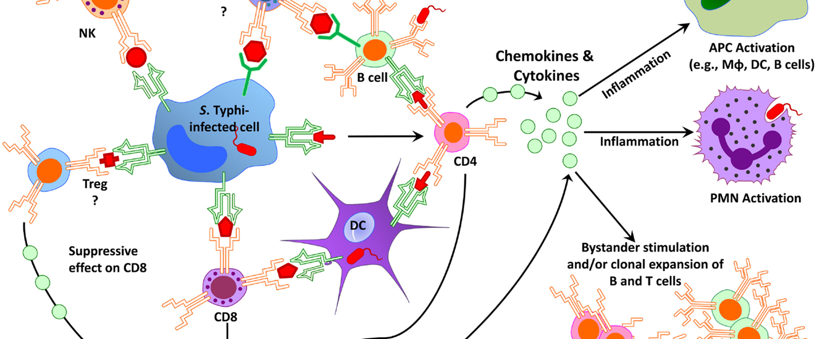
What is the immunity system?
This Photo by Unknown Author is licensed under CC BY-NC-ND
The immunity system is a complex network of cells and proteins that defends the body against infections . The immunity system keeps record of every germ (microbic)it has ever defeated so I can recognize and destroy the microbe quickly if it enters the body again
This Photo by Unknown Author is licensed under CC BY

Slide 3
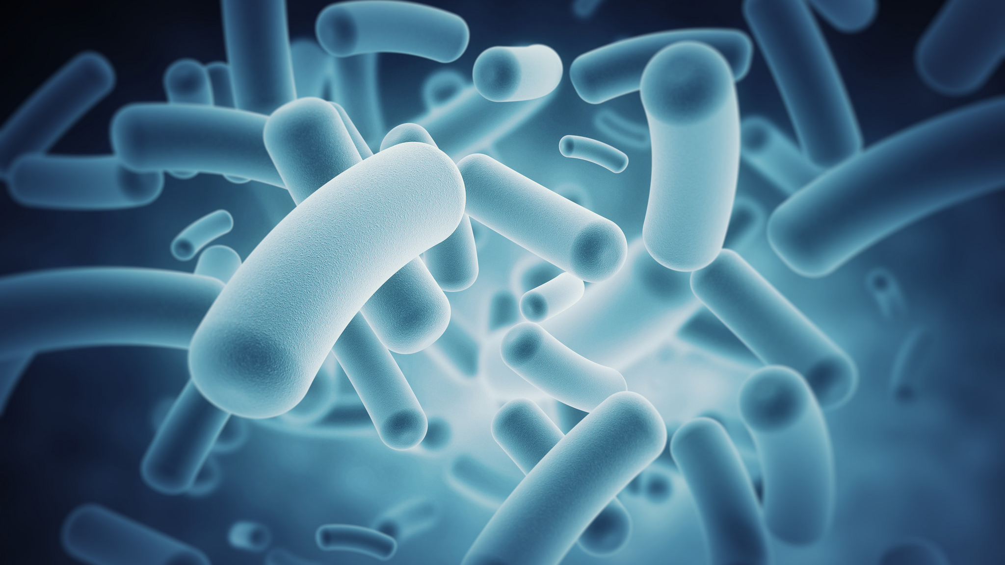
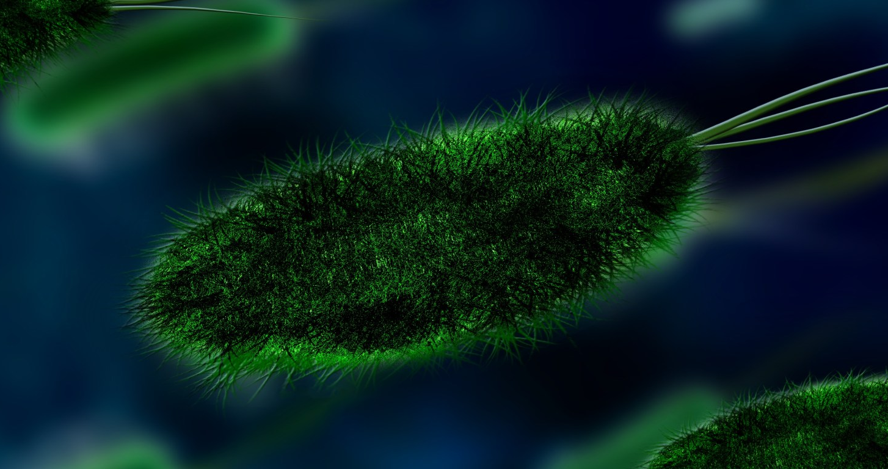
What role does the immune system play in keeping us alive and well?
This Photo by Unknown Author is licensed under CC BY-SA-NC
fights off infections (bacterial, viral)
Fights diseases like cancer
Produce antibodies
produce memory cells that keep a record of pathogens and how to kill them
This Photo by Unknown Author is licensed under CC BY

Slide 4
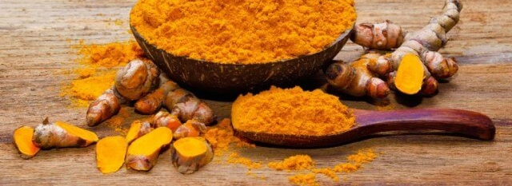
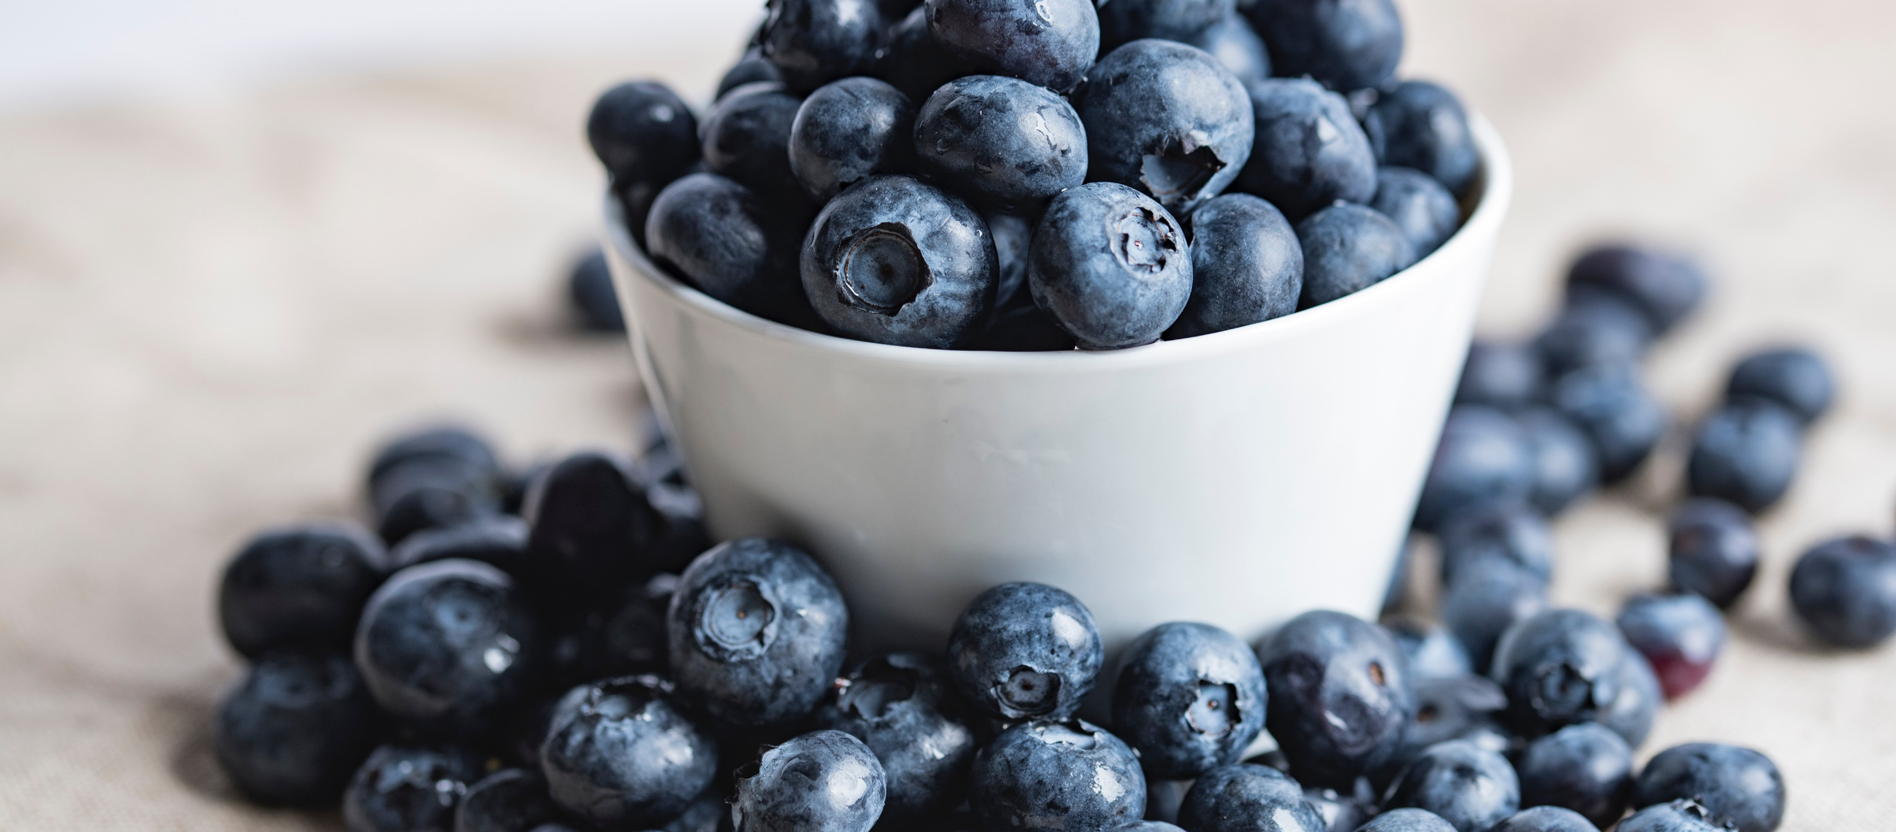
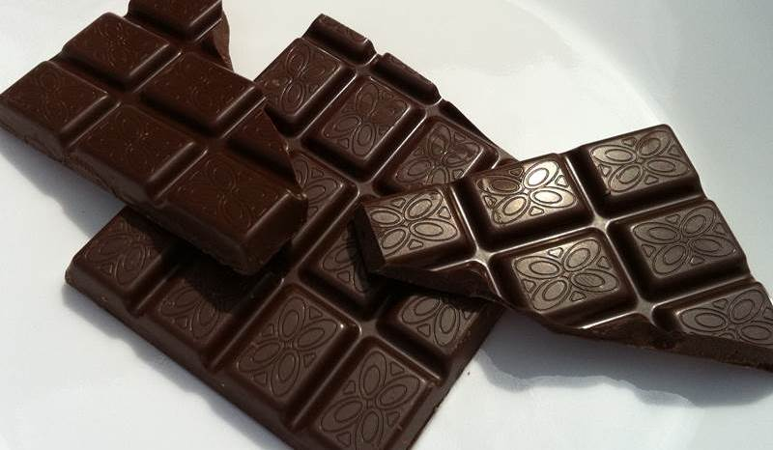
Which foods boost the immune system?
1)Dark chocolate contains an antioxidant called theobromine, which may help to boost the immune system by protecting the body’s cells from free radicals.
2) Blueberries contain a type of flavonoid called anthocyanin, which has antioxidant properties that can help boost a person’s immune system. A 2016 study noted that flavonoids play an essential role in the respiratory tract’s immune defense system.
3) Turmeric is a yellow spice that many people use in cooking. It is also present in some alternative medicines. Consuming turmeric may improve a person’s immune response. This is due to the qualities of curcumin, a compound in turmeric.
This Photo by Unknown Author is licensed under CC BY
This Photo by Unknown Author is licensed under CC BY-SA-NC

Slide 5
How does the immunity system work?
Your immune system protects your body from infectious germs. Through highly complex and adaptive processes, a healthy immune system is always at work, protecting you from infections by identifying and destroying harmful microorganisms. Your immune system also helps you build immunity so that when you encounter certain invading germs again, you can fight them faster the next time around, often without even getting sick at all.

Slide 6
What is the function of the immunity system ?
There's a mantra in organized sports that says, defense is king! In today's world, with germs lurking around every corner, it pays to have a strong defense. The immune system is the body's natural defense mechanism. The function of this system is to prevent or reduce the occurrence of infection. This is accomplished through the coordinated function of the body's immune cells.
Cells of the immune system, known as white blood cells, are found in our bone marrow, lymph nodes, spleen, thymus, tonsils, and in the liver of embryos. When microorganisms, such as bacteria or viruses invade the body, non-specific defense mechanisms provide the first line of defense.

Slide 7
Are immune systems good at any age?
But fear not -- at least not much. “Compared to many other bodily functions, most people’s immune systems actually do really great at any age,” Glatt says. Most of our immune systems work well enough that our risk for infection and illness isn’t much higher than normal. Even better?
What happens to your immune system as you get older?
As you get older, your immune system ages with you. There's even a medical term for it – immunosenescence – the gradual decrease in immune function that comes with age. Similar to your walking or running speed, your body's ability to fight off infection inevitably slows.

Slide 8
https://www.bing.com/search?q=does+the+immunity+system+effect+age&cvid=afcbf50b3cb8450cb697b6308e88b84f&pglt=427&FORM=ANNTA1&DAF1=1&PC=HCTS https://www.bing.com/search?q=how+does+the+immunity+system+work&cvid=f3a70bf7fbad42a7930787b66899503c&pglt=43&FORM=ANNTA1&DAF1=1&PC=HCTS
https://www.bing.com/search?q=%E2%80%A2+Which+food+can+boost+our+immune+system%3F&cvid=4de1d2647a0c4bf7aa244b7e6173c7ec&pglt=43&FORM=ANNTA1&DAF1=1&PC=HCTS
https://www.bing.com/search?q=immunity+system+&go=Search&qs=ds&form=QBRE
https://www.bing.com/search?q=what+is+the+immunity+system&cvid=2aa9a261e36e48a88c53d76e7b9ec061&pglt=43&F ORM=ANNTA1&DAF1=1&PC=HCTS

Slide 9
Thank you for watching my presentation
By Naya al shami and Maya atawi

