Slide 1
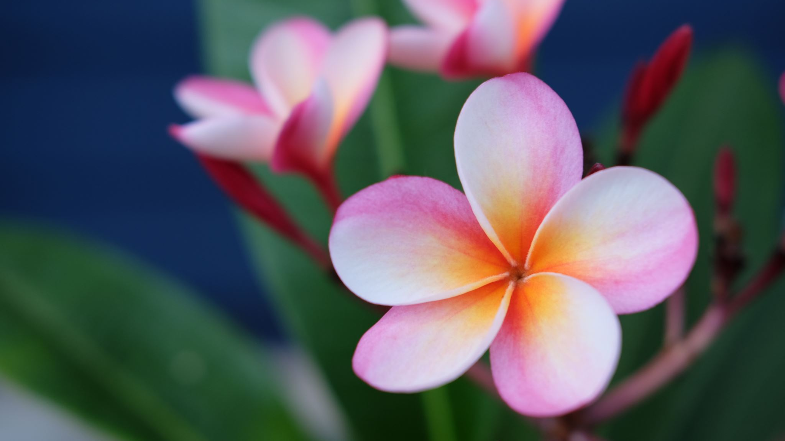
Biology (Intensive Farming and Pesticides)
By : Pilar Habash and Sulaf Al-Ayyoub 8F CS

Slide 2
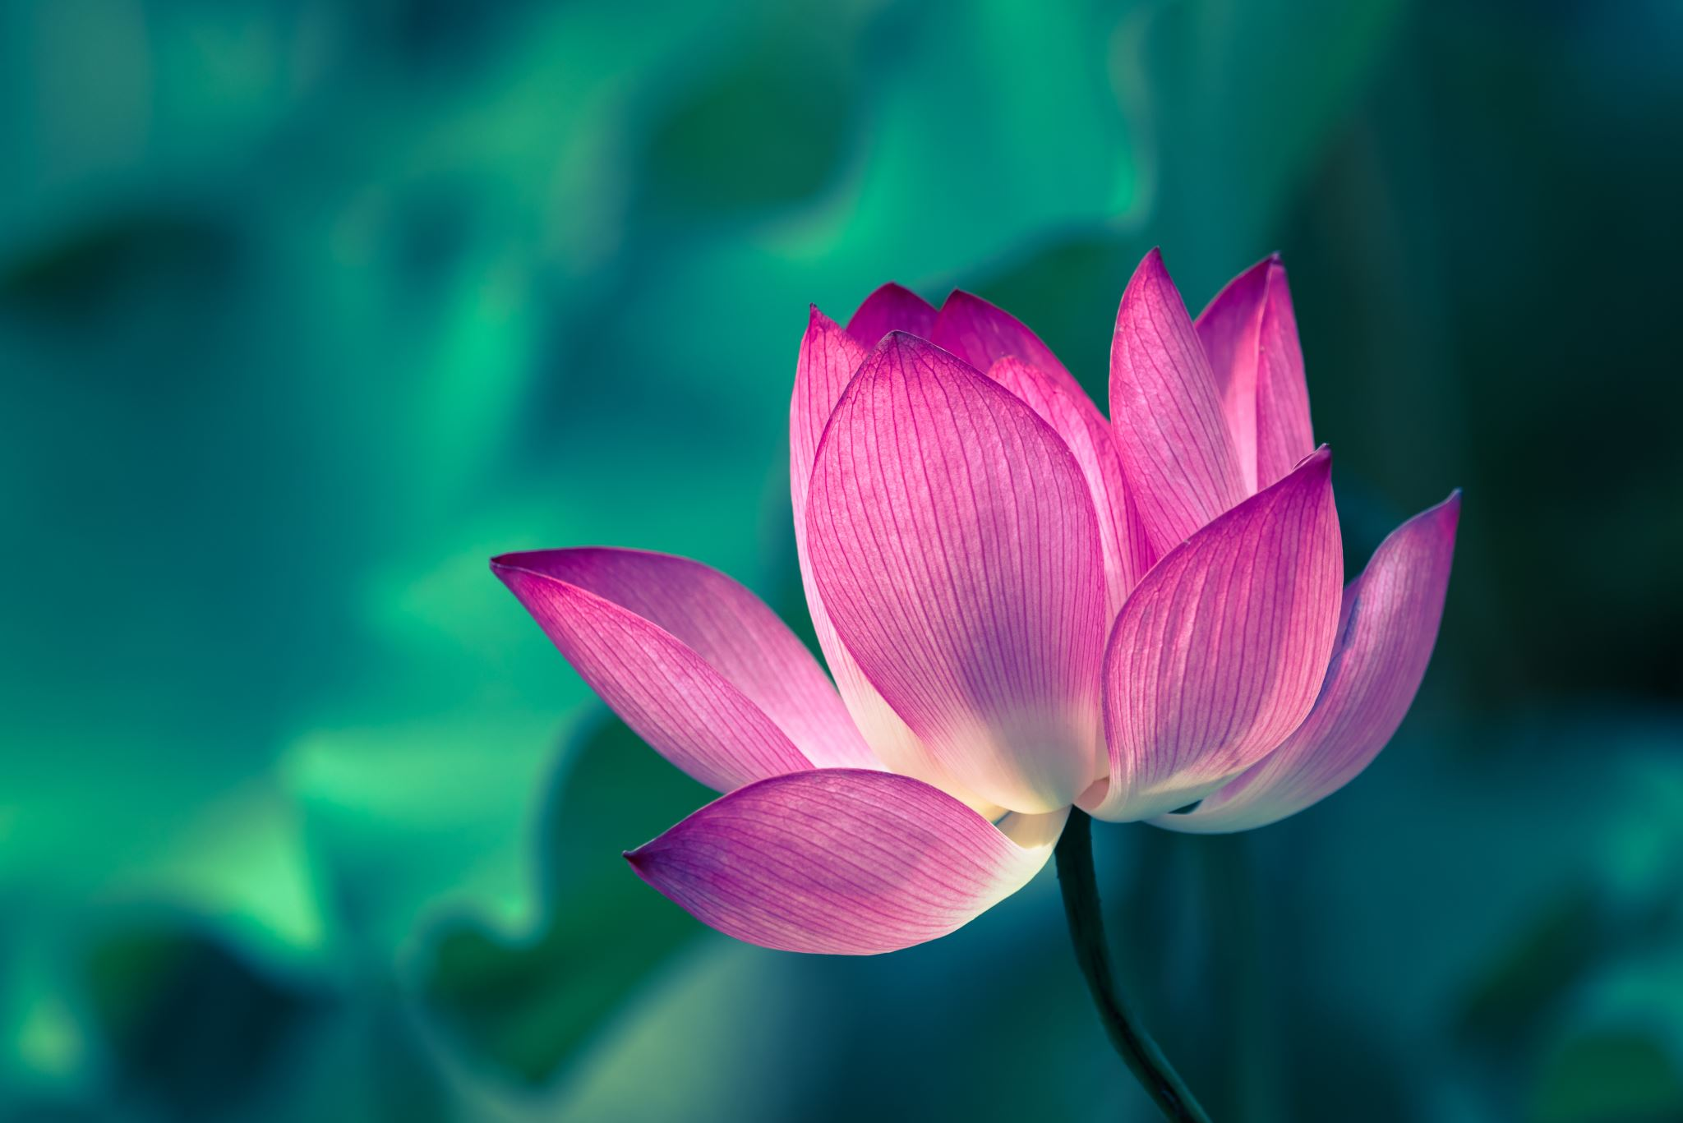
What is Intensive Farming
Intensive farming includes using Fertilizers and Pesticides in order to increase the amount and quality of crops.

Slide 3
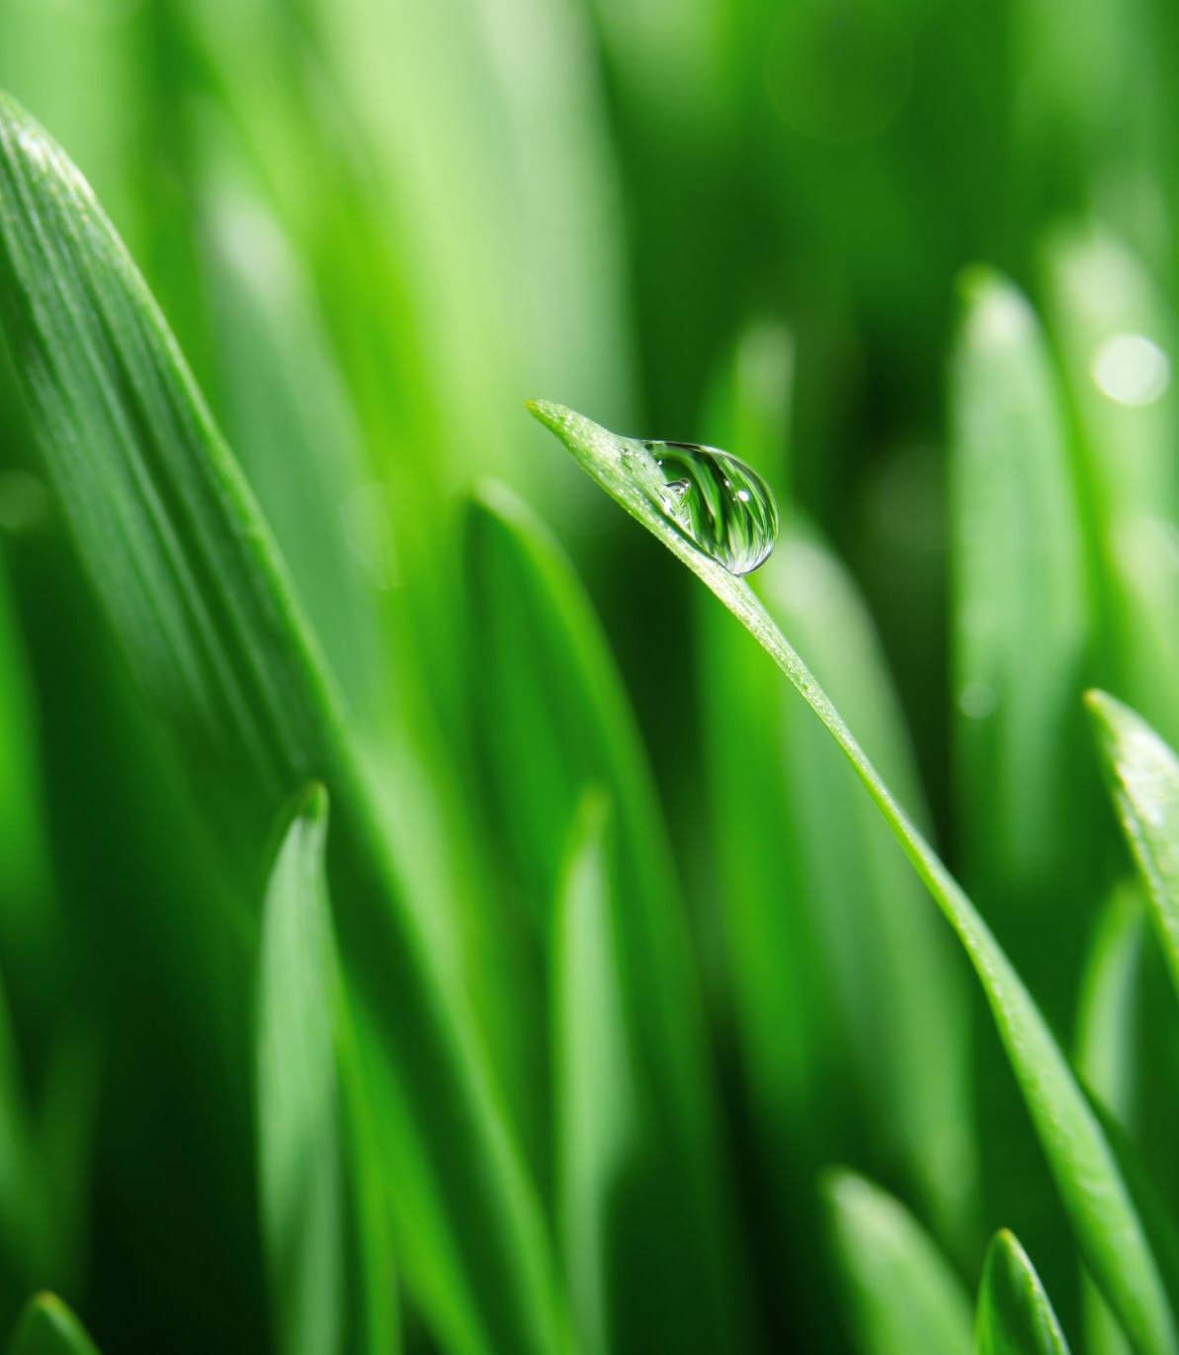
Fertilisers
They are needed for the quality and growth of the plants and to replace the minerals (Nitrogen/ Potassium/ Phosphorus ) that have been taken away (consumed) in the crop
Moreover, If too much is added, the plant will not use all the minerals so they will cause soil and water pollution.

Slide 4
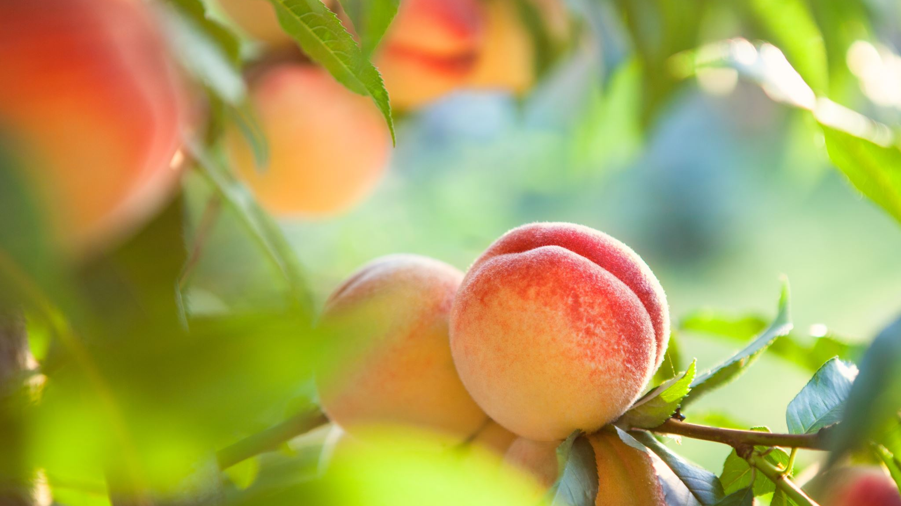
What is the Difference Between Organic and In-Organic Fertilisers?
Organic Fertilisers Differ from In-Organic Fertilisers in weight and when and how the fertiliser is needed for the plant and properties and the the material that they are made of also differ in many ways .

Slide 5
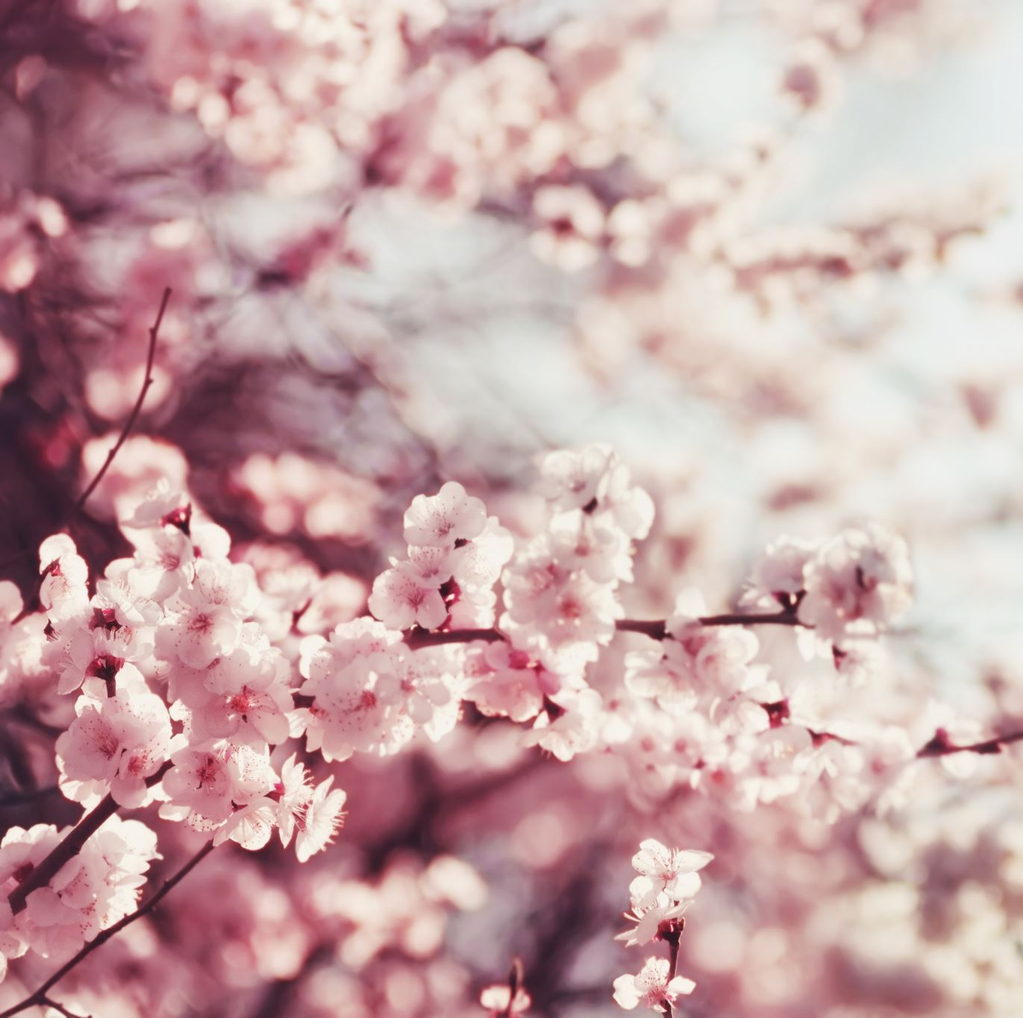
Organic
Organic:
Made of : Wastes of farm animals and sewage
Properties: It takes a long time for the minerals to be released and Too heavy
How to be added? : Must be spread from a trailer attached to a tractor
When to be added? : Before Crop is Sown

Slide 6
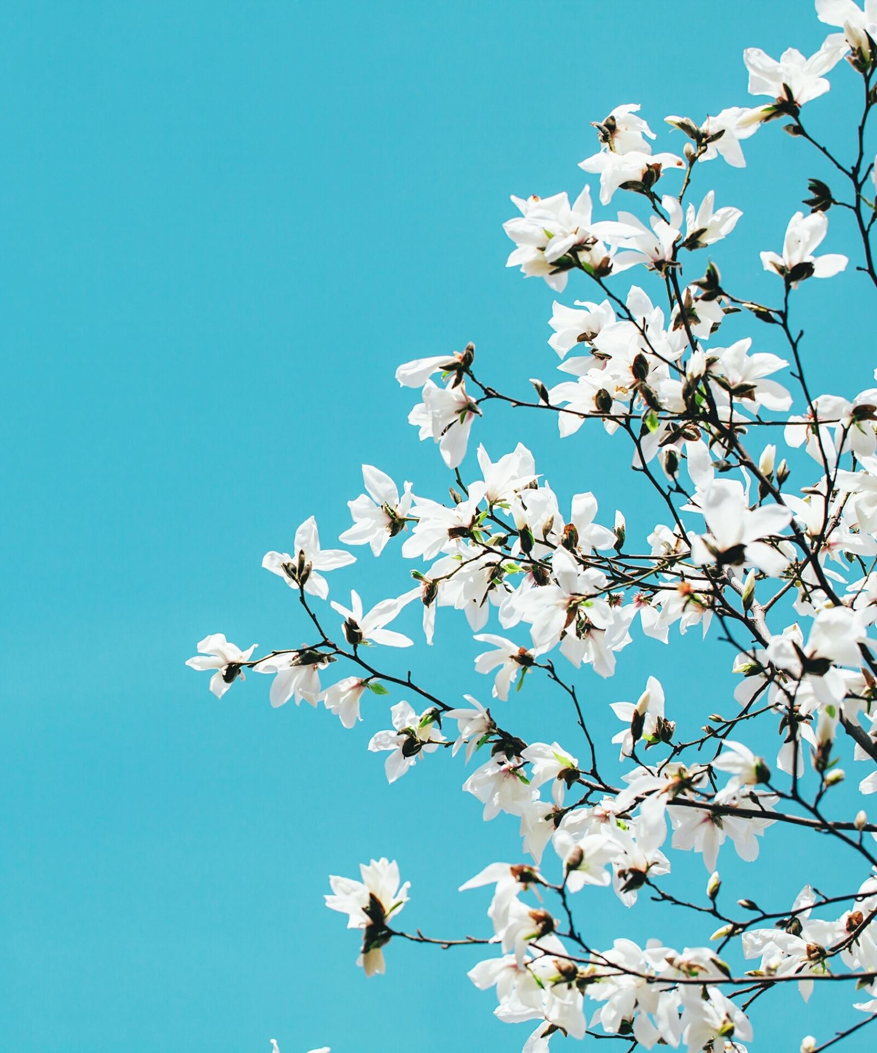
In-Organic
In-Organic:
Made of : Manufactured chemicals such as ammonium nitrate ammonium phosphate and potassium chloride
Properties : Give an instant supply of minerals, Plus they are Light in weight
How to be added?: Can be spread from airplanes and helicopter
When to be added?: Can be added any time without damaging the crop.

Slide 7
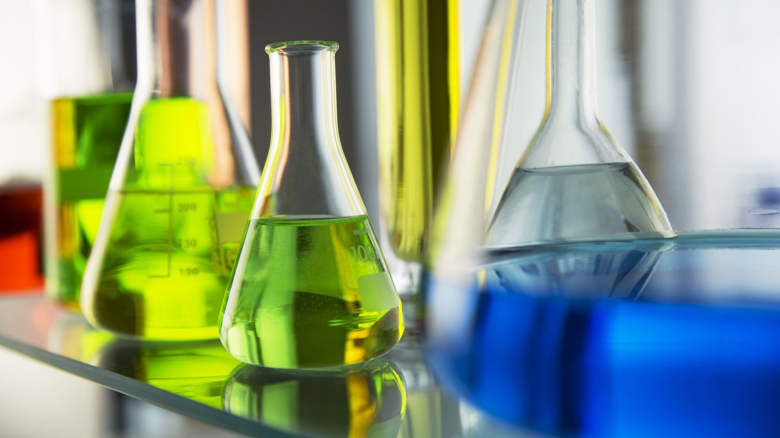
Pesticides
What is the Difference Between:
Herbicides: To kill unwanted weeds that compete with the crop on water, sun light and soil.
Fungicides: To kill fungus that may attack the roots.
Insecticides: They are used to kill the unwanted insects that may affect the plants.

Slide 8
Seed Dispersal
Coconut palms, Water lilies, and Water mint are plants that are
dispersed by water.
Coconut palms especially grow close to water so they can easily roll
there.

Slide 9
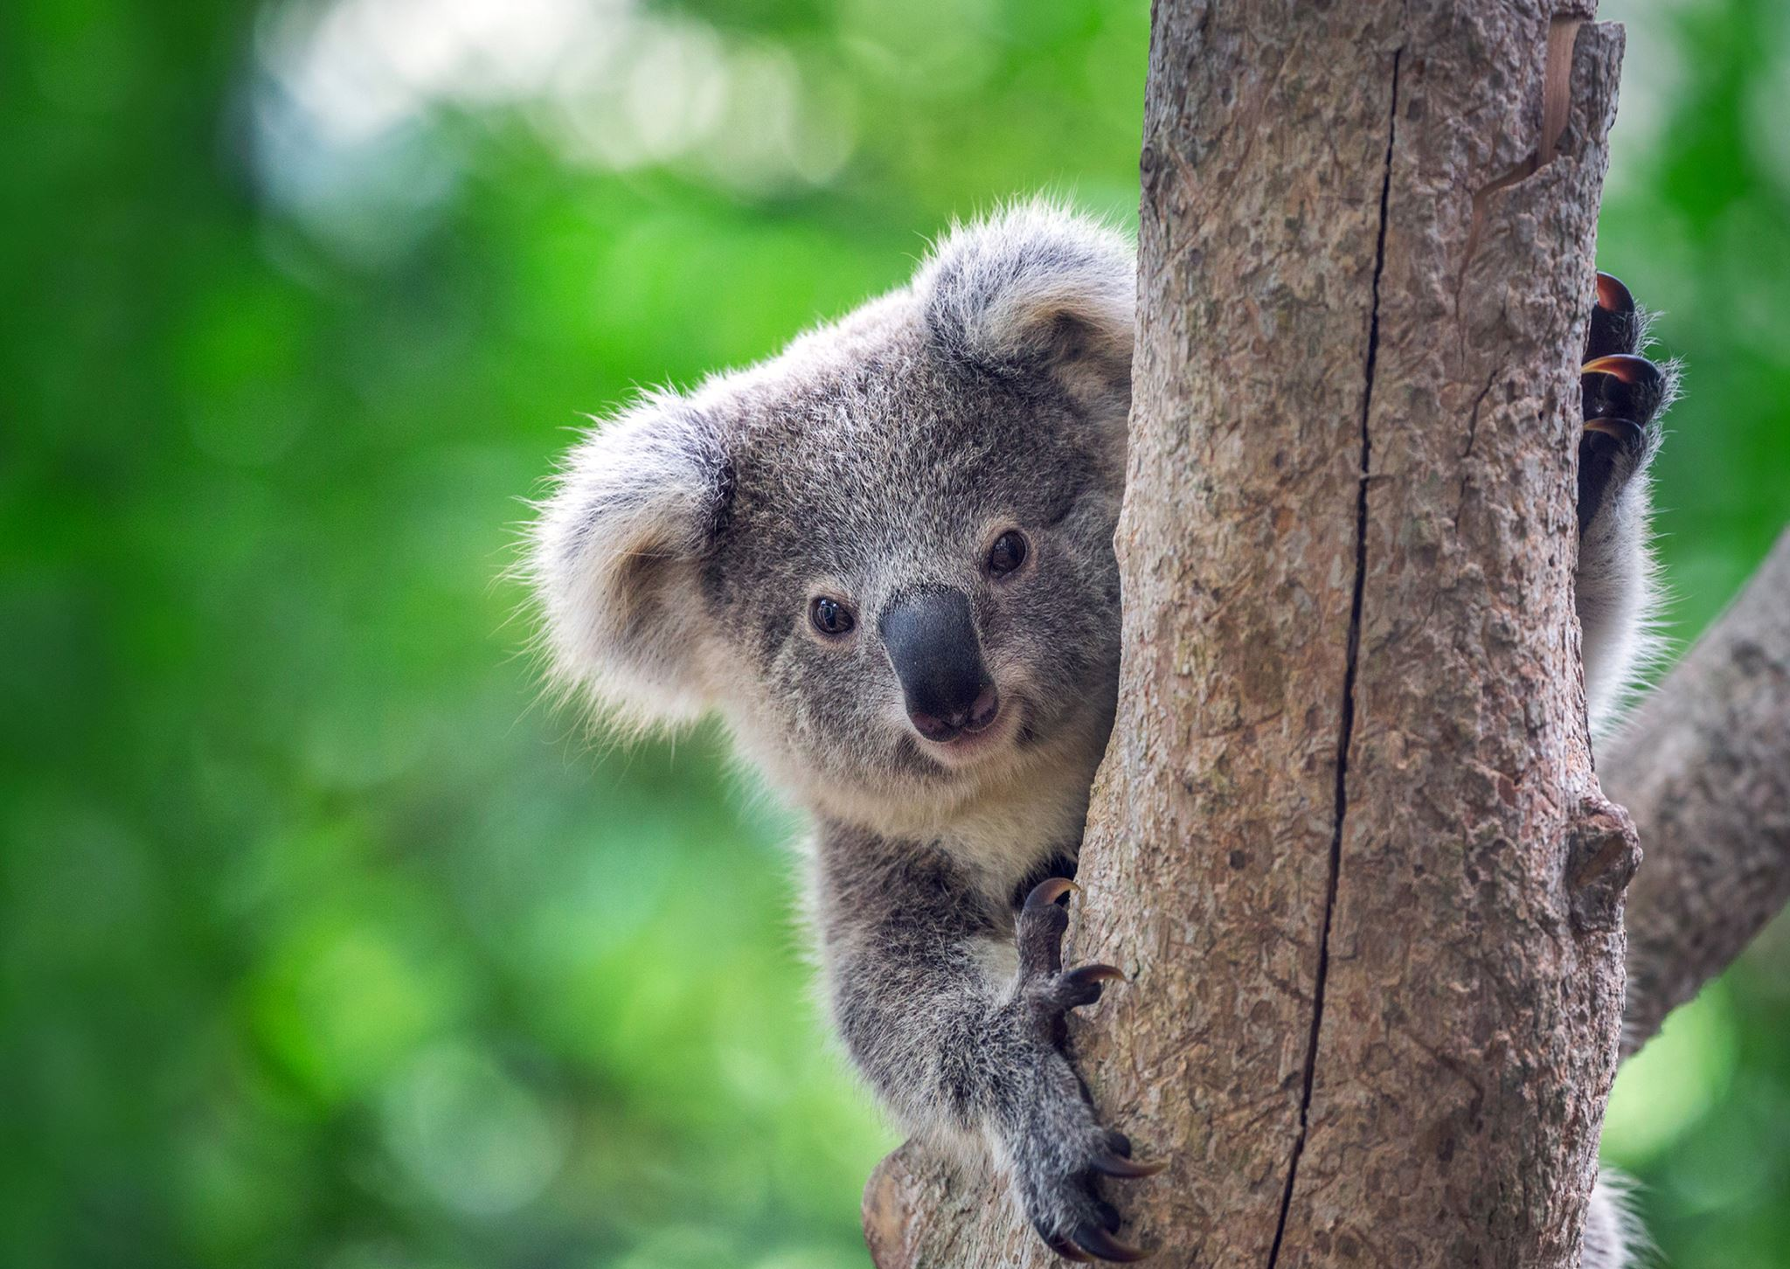
Animal
Fruit seeds can stick under animals' feet/fur, and they can travel to
different areas taking the seeds with them.
Insects Collect seeds and store them and some may forget about the
food.
Animals consume seeds and deposit it after.

Slide 10
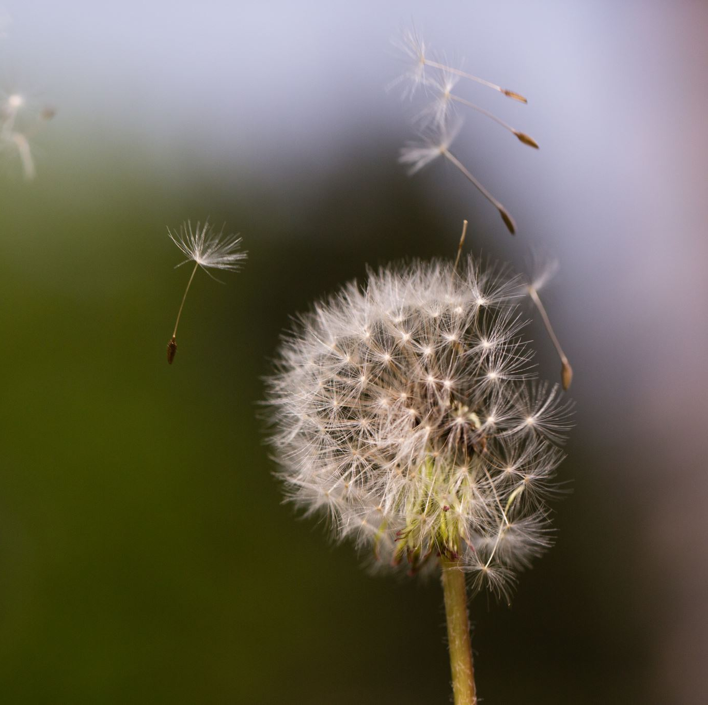
Wind
lightweight seeds can get easily transported by wind. Some may
include having wings.
Examples: Orchids
Cotton
Dandelions
Oleander

Slide 11
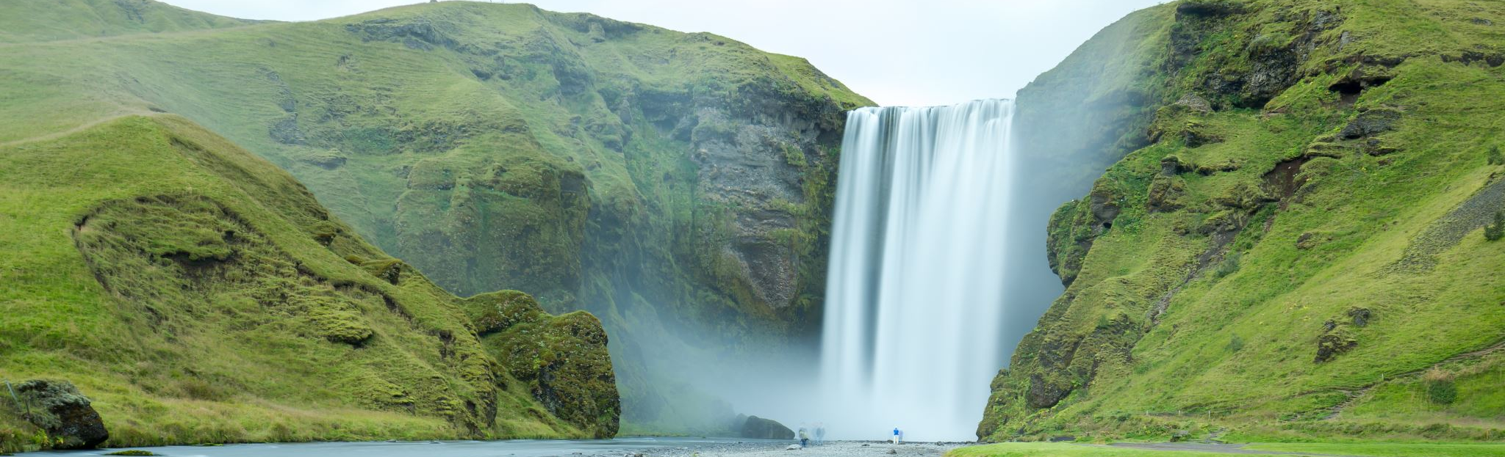
Water
Coconut palms, Water lilies, and Water mint are plants that are
dispersed by water.
Coconut palms especially grow close to water so they can easily roll
there.

Slide 12
THANK YOU FOR WATCHING !!!

