Slide 1
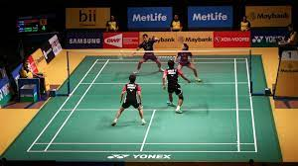
Badminton
Badminton was originated in China over 2,000 years ago. It was brought to England in 1870 and was played somewhat like tennis.

Slide 2

Badminton
Its the objective of the quick-paced racket sport of badminton, which can be played in singles or doubles (2 players), is to hit a shuttle over a net and onto the court of the opposite team.
-A badminton net that is 1.55m high at the ends and drops to 1.52m in the middle divides the court's two halves, each measuring 6.7m.

Slide 3

The Positions of Badminton
There are stances for badminton, such as:-
Attacking Stance
Defensive Stance
Net Stance

Slide 4

Attacking Stance
Attacking stance: is when you turn your body to face the court's side. Put your non-racket leg in front and your racket leg behind. Legs should be separated by shoulder-width. Your non-racket arm should also be raised.

Slide 5

Defense stance
Defensive stance: it enables the player to be prepared to block an opponent's smash shot. In badminton, you must face your body toward the front of the court while holding your racket in front of you at around waist height and leaning slightly forward.

Slide 6
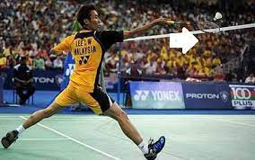
Net stance
Net stance: when you put your racket foot forward and your other foot behind you. Put your racket in front of you at a height just above your waist. For balance, raise the arm not holding the racket

Slide 7

Check Your Understanding
1) What are the three stances of badminton?
Attacking stance, Defense stance and Net stance
2) What sport was badminton alike in England in 1870?
Tennis

