Slide 1

Electrical circuits
Electric Circuits
By Adeeb alamat grade 8f
By : Adeeb Alamat

Slide 2
Disclosure:
What is an electric circuit?
Parts of a circuit.
Types of circuits.
Circuit diagrams.
Conductors and insulators.
Real-world applications.

Slide 3
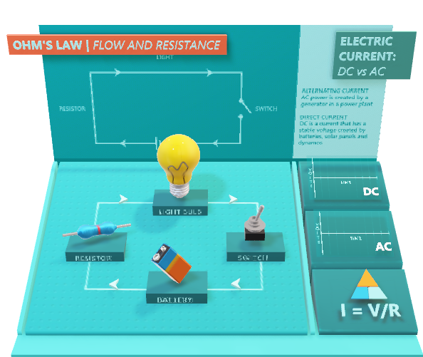
What is an electric circuit?
An electric circuit is a path that electric current follows.
It’s made up of components that work together to allow electric current to flow in a certain way.

Slide 4
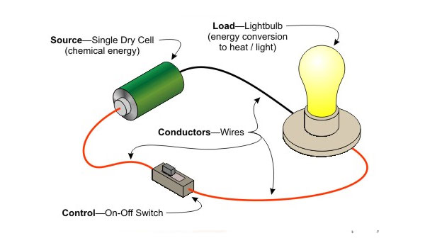
Parts of a circuit
There are three main parts of a circuit: the power source, the wires, and the components.
Power Source: provides energy to the circuit and the components.
The Wires: carry the electric current.
The Components: control the flow of current.

Slide 5
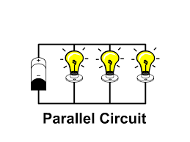
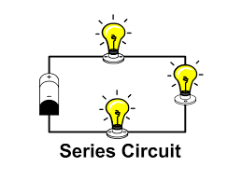
basic Types of circuits
There are two main circuit types, each with its use.
Parallel circuits have two or more loops.
Series circuits have one loop.
If any component is removed any component from a series circuit it will become an open circuit.
If you remove any components from a parallel circuit it will stay on(power sources are exceptions)

Slide 6
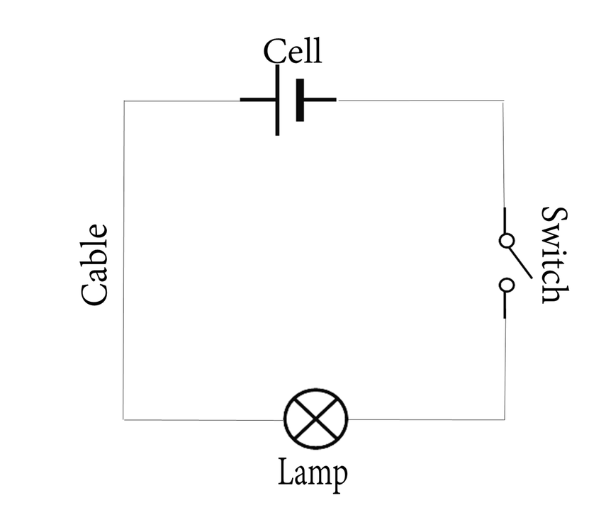
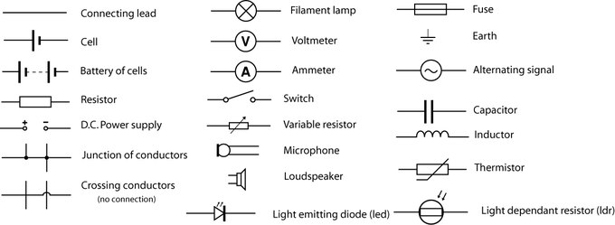
Circuit diagrams
A circuit diagram is a representation of an electrical circuit. It uses simple symbols to represent parts of a circuit.
This Photo by Unknown Author is licensed under CC BY-SA

Slide 7
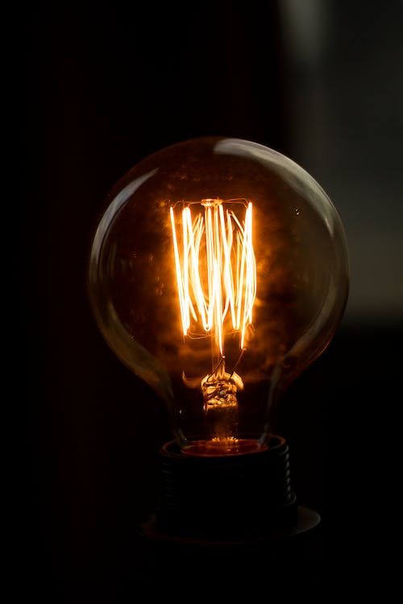
Ohm’s law
Current is the rate at which electrons flow past a point in a complete electrical circuit.
Current is measured in Amps(A)/Milliamps(mA).
Current can flow from the positive to the negative terminal (Conventional Current).
Current can also flow from the negative to the positive terminal (electron flow).
V=I*R

Slide 8
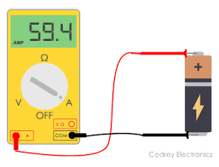
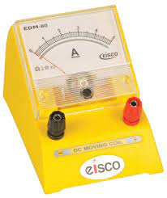
ammeter
Ammeter is a device that is used to measure electric current.
There are 2 types of ammeters(Analogue/Digital)
Digital ammeters can measure volts and ohms (AVO) and they’re called multimeters.

Slide 9
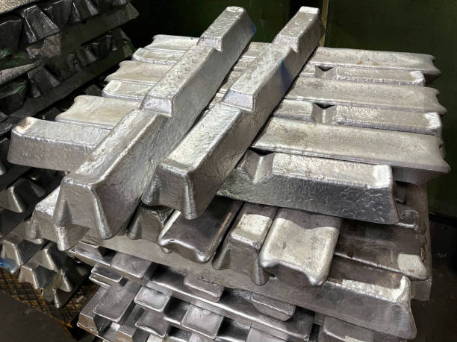

Conductors and insulators
Conductors: these are those substances that electricity can flow through.
Insulators: are those substances that electricity cannot flow through.
All metals are conductors.
The only non-metal that is a conductor is (graphite/carbon).

Slide 10
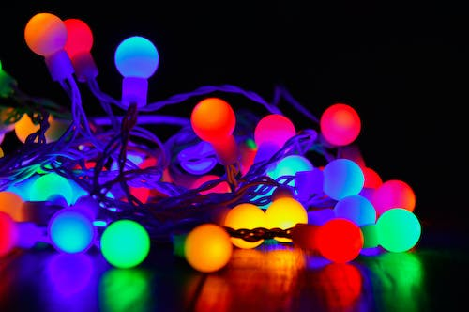
Real-world examples of electrical circuits
Christmas lights (old ones are series circuits).
Lamps or bulbs in a house.
Freezers.
Refrigerators.
Heaters.
TVs/Radios.

Slide 11
conclusion
Electric circuits are used in our day-to-day life.
Basic operation of D.C circuits was explained including their types and uses.
In Addition, Circuit diagrams represent electric circuits using symbols.

Slide 12

Question time
Q1.Why do we use copper wires?
Q2.Why do we use circuit diagrams?
Why do we use copper wires?
Why do we use circuit diagrams?
This Photo by Unknown Author is licensed under CC BY

Slide 13


Slide 14
recourses
Electronic circuit - Wikipedia
Wikipediahttps://en.wikipedia.org › wiki › Electronic_circuit
Electric circuit | Diagrams & Examples | Britannica
Encyclopedia Britannicahttps://www.britannica.com › technology › electric-cir...
Complete physics for Cambridge Secondary 1

