Slide 1
Mutations
Done by Christina Al-Sharqawi
8H

Slide 2
What is Mutations?
A mutation is a change in a DNA
Sequence
In applied genetics, it is usual to speak
of mutations as either harmful or beneficial.

Slide 3
Beneficial mutation
A beneficial mutation increases the fitness of the organism, it has a positive effect on an organism

Slide 4
Harmful mutations
A harmful mutation decreases the fitness of the organism it also can result in a genetic disorder

Slide 5
How mutations can result?
Mutations can result from DNA
copying mistakes made during cell division.

Slide 6
Examples on mutations

Slide 7
Questions
What is mutations?
A mutation is a change in a DNA
Sequence

Slide 8
Questions
What does harmful mutation do?
A harmful mutation decreases the fitness of the organism it also can result in a genetic disorder

Slide 9
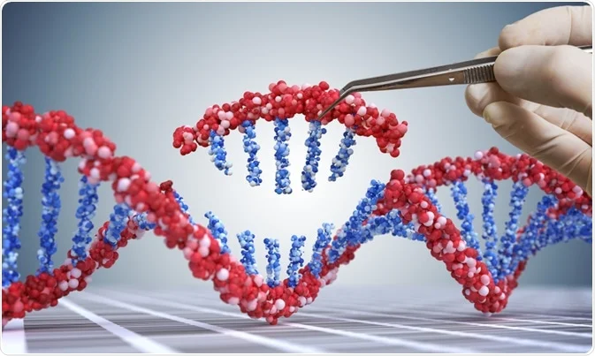
Thank you

