Slide 1
Making football field bigger
Done by: Saif Jumaian, Jad Gammoh

Slide 2
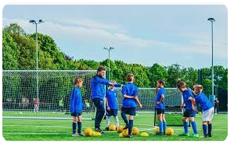
Many people enjoy playing football during physical education class, but occasionally there isn't enough space for everyone to play because it is too small, so Making the football field bigger could help the school in many ways, benefiting everyone and a lot of other things that we will be discussing in the following slides. saif
introduction

Slide 3
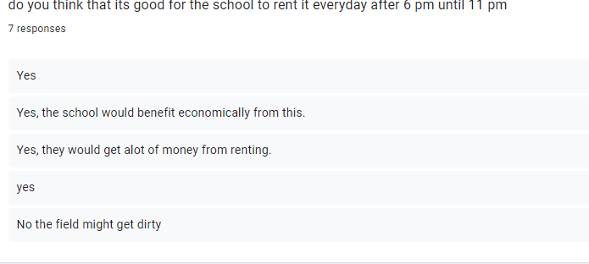
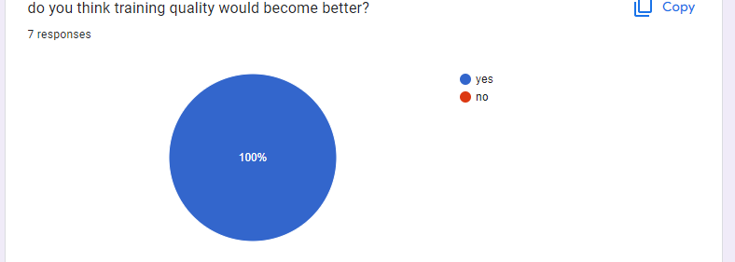
we made a survey asking boys about how this would help the school and most of the results were people saying this would help the school economically in many ways such as making the money back by renting it from 6 until 11 pm. jad A lot of people also said that this would improve training because if we make the field bigger it could lead to bigger chances of making the football team bigger and also hosting school tournaments in the field jad
Peoples opinions on the project

Slide 4
how the school could profit
hosting tournaments
renting it out

Slide 5
hosting tournaments
hosting tournaments could be a good idea for profit since also of people are interested in football, a ticket for the cost of 3 JDS could make the profit back.

Slide 6
Renting it out
Renting the football field out from 6 until 11 pm everyday could be a very good idea for the school to make the money back, a survey has proof of this.
1 hour:35 jds
2 hours:55 jds
3 hours: 80 jds

Slide 7
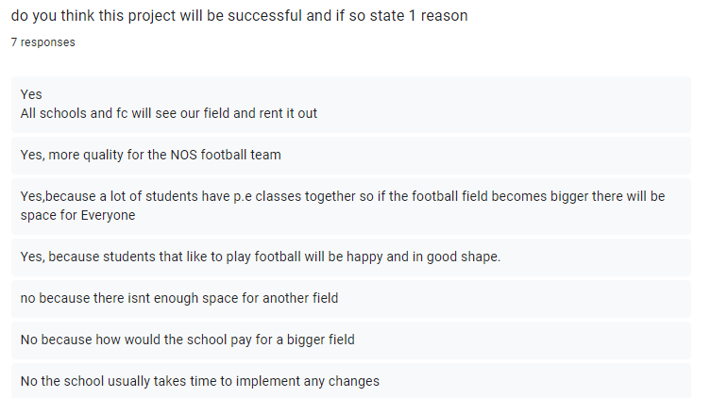
Advantages:
More people can play in pe
Can be rented out
Could be profitable in the long run
Better training
jad
Disadvantages:
Renting it out could make it dirtier
May not be able to be expanded
May not be profitable
saif

