Slide 1
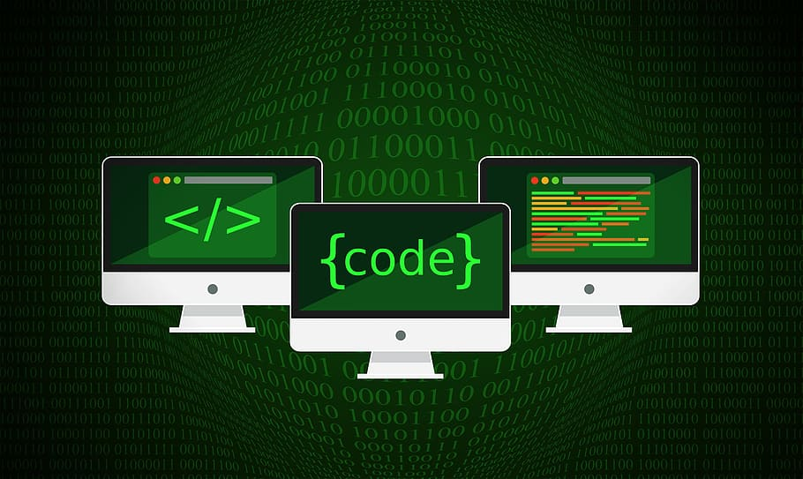
Computer Science: Programming and Coding
By: Karam Samara

Slide 2
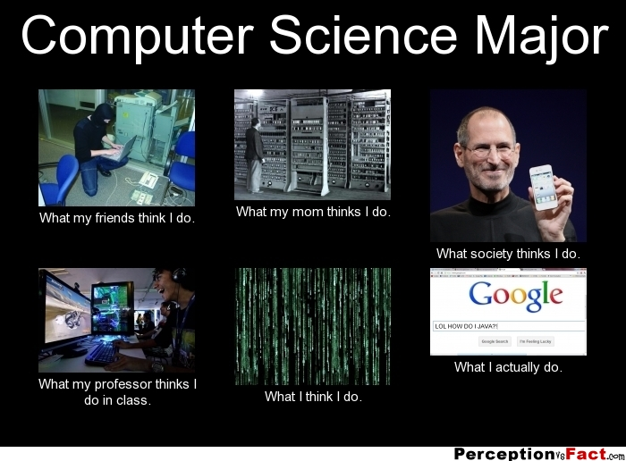
Introduction
We will talk about:
What is the computer science?
How to program and codE?
Advantages and disadvantages of Programing and coding
And we will do a quiz at the end
This Photo by Unknown Author is licensed under CC BY-SA

Slide 3
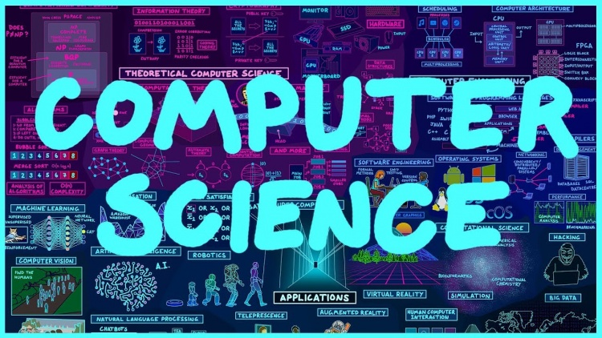
WHAT IS THE Computer Science?
Computer science is a field of study that deals with the theoretical and practical aspects of computing and information technology. It involves the design, development, and analysis of computer software and hardware, as well as the use of computational processes to solve problems and create new solutions.
Computer science includes various subfields such as algorithms, programming languages, artificial intelligence, computer graphics, databases, networking, computer architecture, and software engineering. Computer science also involves the study of the social and ethical implications of computing technology, as well as its impact on society and the world at large.
This Photo by Unknown Author is licensed under CC BY-NC-ND

Slide 4
How to program and code?
Programming and coding involve writing instructions that a computer can understand and execute. Here are the basic steps involved in programming and coding:
Choose a programming language: There are many programming languages to choose from, such as Python, Java, C++, and JavaScript. Each language has its own syntax and features, so it's important to choose one that suits your needs.
Plan your program: Before you start coding, it's important to have a clear plan of what you want your program to do. This involves breaking down the problem into smaller parts and determining the best way to solve each part.
Write your code: Once you have a plan, you can start writing your code. This involves using the syntax of your chosen programming language to write instructions that the computer can understand.
This Photo by Unknown Author is licensed under CC BY-SA

Slide 5
How to do program and code?
4.Test your program: After writing your code, it's important to test it to make sure it works as expected. This involves running your program and checking the output to see if it matches what you were expecting.
5.Debug your program: If your program isn't working as expected, you'll need to debug it by identifying and fixing any errors in your code.
6.Refine your program: Once your program is working correctly, you can refine it by improving its efficiency, adding new features, or making it more user-friendly.
7.Deploy your program: Finally, you can deploy your program by making it available for others to use, either by distributing it as a standalone application or by hosting it on a website or server.

Slide 6
Advantages and disadvantages of programing and coding
Advantages
Ability to create customized solutions: Programming and coding give individuals and businesses the ability to create customized software and applications that meet their specific needs.
Automation of tasks: Programming and coding can automate tasks, making processes more efficient and saving time and resources.
High demand for programmers: There is a high demand for skilled programmers and coders in the job market, with many career opportunities and good salaries available.
Disadvantages
Steep learning curve: Programming and coding can be difficult to learn, with a steep learning curve that may discourage some individuals from pursuing it.
Time-consuming: Programming and coding can be time-consuming, requiring many hours of work to create even basic applications.
Errors and bugs: Even experienced programmers and coders can make mistakes, and errors and bugs can be difficult to identify and fix.
This Photo by Unknown Author is licensed under CC BY

Slide 7
Before we start the quiz I have a video to present
https://www.youtube.com/watch?v=CIRGjwYgdT4

Slide 8
Quiz game link
Https://www.dkfindout.com/us/quiz/computer-coding/quiz-yourself-on-coding/

Slide 9
Bonus thing: what is the difference between programing and coding
Programming and coding are often used interchangeably, but they actually refer to different aspects of software development.
Coding refers to the process of writing code using a programming language. It involves translating ideas and algorithms into a language that a computer can understand and execute. Coding typically involves writing instructions, functions, and scripts in a text editor or integrated development environment (IDE) that can be compiled into executable code.
Programming, on the other hand, encompasses a broader set of activities that include coding but also involves the design, analysis, and implementation of software solutions. Programming involves understanding the requirements of a problem and developing a solution using a variety of tools and techniques, which may include coding.

Slide 10
This Photo by Unknown Author is licensed under CC BY-NC-ND

