Slide 1
Indoor
tennis
court
By: Jana Tarazi, Zain Attiyat

Slide 2
introduction
In this power point we will be telling you about , advantages ,
Disadvantages and consequences of adding an
indoor tennis court .
How is the school gonna afford it.
Where will the court be
Which grades are aloud to play .
And why we think adding an indoor tennis court would benefit
The NOS school and the students.

Slide 3
Why do we want to add an
Indoor tennis court?
We want to add an indoor
Tennis court for students to
have More actives rather
than football, Basket ball
,volley ball and badminton.
Students might be interested
In learning a new sport.
It would be really helpful for
Students physical health and
Will be able to relief stress
Hormones.

Slide 4
advantages | disadvantages
Health improvement | Finding other players
A great way to meet people and spend times with friends | Motivations might be a problem
Suitable for all ages and skill levels | injuries
Helpful to reduce stress | Pressure can be high
dependent on youth strength | You may simplify not like playing tennis
you can unplug | Talent is a big factor

Slide 5
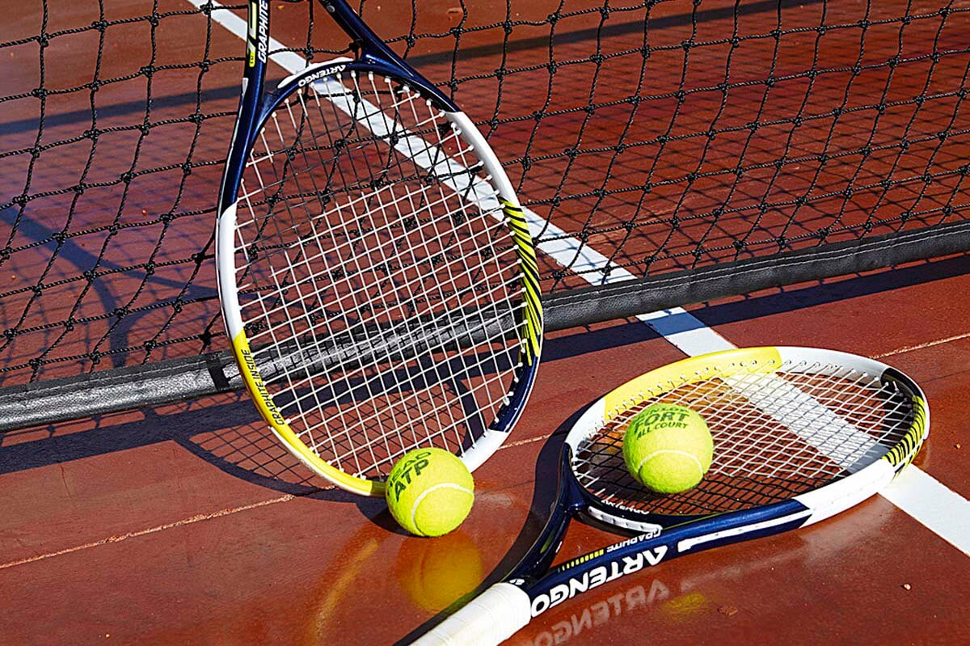
Tennis is a sport for all ages, genders, sizes and expertise levels, with benefits including maintaining healthy body composition, bone health, muscle strength and balance. “Sport is a preserver of health.”
(according to the ancient Greek physician Hippocrates)
Playing tennis on a regular basis leads to stronger, healthier bones.
benefits

Slide 6
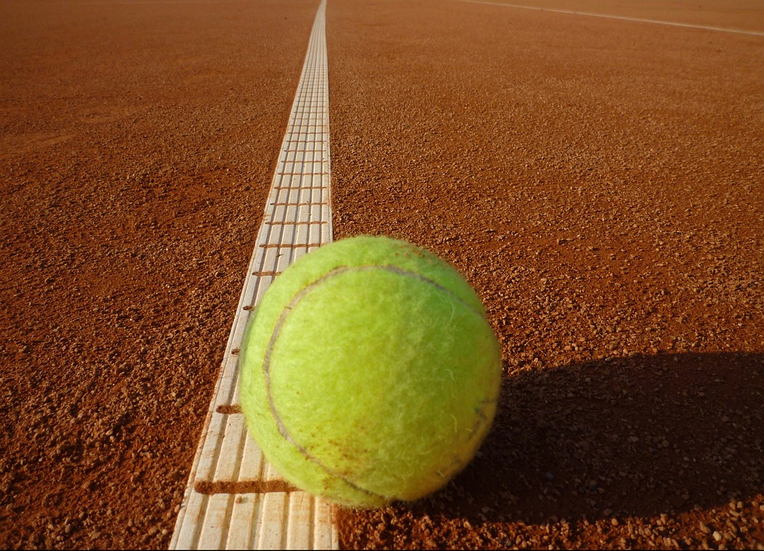
cost
It will be at bit expensive
as we are going to do a whole
new floor above the
gymnasium, so we will rent it
for people in and outside
the school.
Rent:
Students from the school | people outside the school
20 jds | 40 jds

Slide 7
Ages
students of ages 12-18(grades 6-12)
will only be able to participate in this activity
since the all share the same outside area and to
have children from grades 1-5 will be
unpractical because they will have to go up
and down each time they play

Slide 8
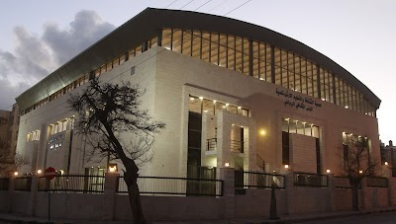
where
We will change the hall
To a indoor
tennis court.
All the tennis classes
Will Be held there.

