Slide 1
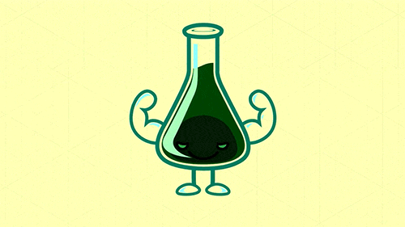
Acids & Alkalis
By: Laya Nowwara,
Dareen Al-Farah,
Sama Kaawach 8G

Slide 2
Comparisons
ACIDS
ALKALIS
Contains Hydrogen ions
Extremely Corrosive
Sour
Changes litmus paper to red
Conducts electricity
0-6 Ph
Contains Hydroxide/ Oxide
Corrosive
Bitter
Changes litmus paper to blue
Soapy/Slimy
8-14 Ph

Slide 3
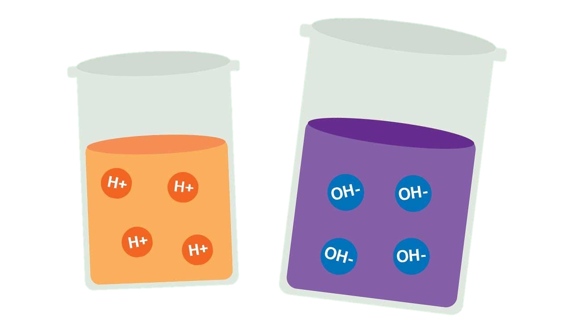
Indicators
Litmus Indicator (paper): Blue litmus paper turns red under acid conditions, and red litmus paper turns blue under alkaline conditions.
Universal Indicator: An indicator is a substance that changes its color when it comes in contact with an acid or a base.
Phenolphthalein (Phph): An indicator that stays colorless when in contact with acids, and turns into a pink solution when in contact with alkalis.

Slide 4
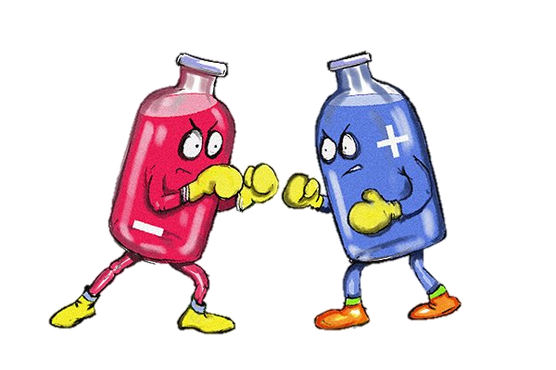
Mixing acids & alkalis: Neutralization
Strong Acid + Strong Alkali Salt + Water (Neutralization)
Strong Acid + Weak Alkali Weak Acid
Weak Acid + Strong Alkali Weak Alkali
Weak Acid + Weak Alkali Salt + Water (Neutralization)
To neutralize an acid, you need to add the correct volume of alkali.
The volume depends on how dilute or concentrated the solutions are.
The pH of a neutral solution is 7.

Slide 5
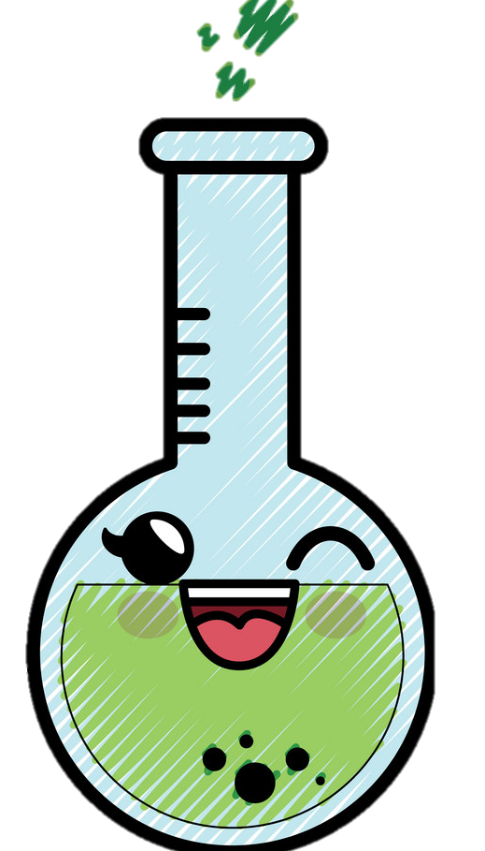
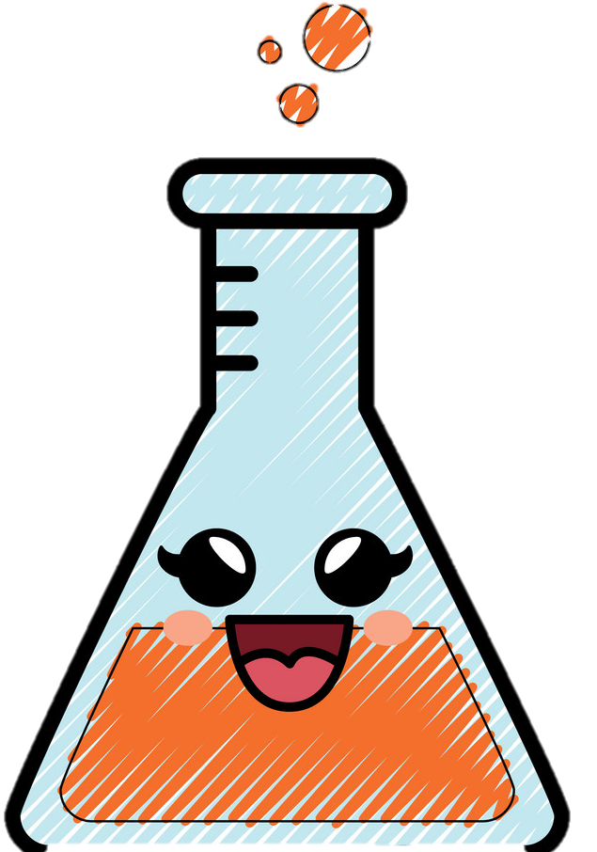
Activities
Lab visits that contain:
Litmus Paper experiments.
Neutralization experiments.
Full visual and theoretical comparison between acids and alkalis; using indicators.

Slide 6
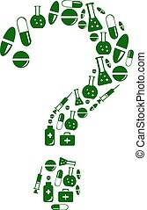
questions
Q1: A solution turns red using litmus paper, is it acid or alkaline?
Acid
Q2: True or False
a) The more acidic a solution the higher its ph.
False
b) There is only one type of indicator.
False
c) Alkalis contain hydroxide.
True

Slide 7
CITATIONS
https://www.vedantu.com/question-answer/a-what-is-a-universal-indicator-for-what-purpose-class-11-chemistry-cbse-5fec0d67952f7054f8824142
https://languages.oup.com/google-dictionary-en/
https://chem.libretexts.org/Bookshelves/Introductory_Chemistry/Introductory_Chemistry_(CK-12)/21%3A_Acids_and_Bases/21.01%3A_Properties_of_Acids
Complete Chemistry for Cambridge Secondary 1

