Slide 1
E-learning,by karam haddadin 8B
Multimedia

Slide 2
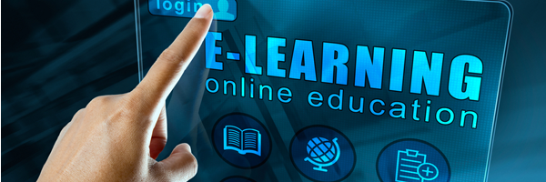
E-learning
E-learning (sometimes called web-based training) is anywhere, any-time instruction delivered over the internet or a corporate Intranet to browser-equipped learners. Contrary to traditional learning methods, e-learning allows students, employees in training and casual learners to participate in an organized learning experience regardless of their physical location.

Slide 3
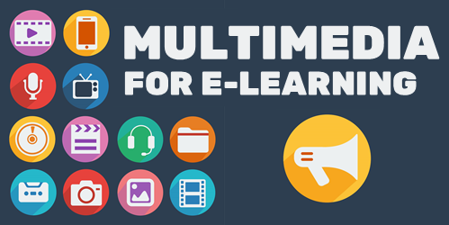

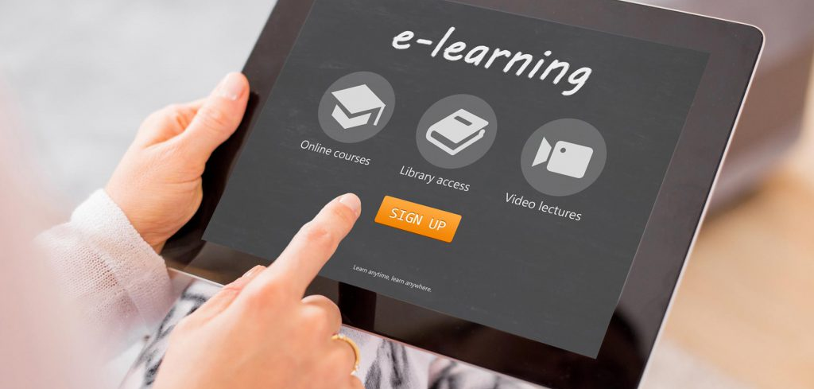
E-learning+MEDIA.
Definition
TYPES
INtroduction
Definition. Multimedia combines five basic types of media into the learning environment: text, video, sound, graphics and animation, thus providing a powerful new tool for education.
The world in which we live is changing rapidly and the field of education is experiencing these changes in particular as it applies to Media Services. The old days of an educational institution having an isolated audio-visual department are long gone! The growth in use of multimedia within the education sector has accelerated in recent years
5 types videos sound graphics text animation can be used in multiple different websites to help students and teachers learn and improve in modern easy and fast ways

Slide 4
E-learning+Multimediea
teachers
help
Students
The teacher could help more than one student at a time and not wasting any time and making sure all of them learn and improve without any mistakes
Many online learning solutions account for self-paced learning and allow students and teachers to work together to meet scheduled targets.
maximize the potential for individual learning curves and styles within the classroom

Slide 5
E-LEARNING-HELP STUDANTS
time
Help
overall mental health improvement
Students can wake up comfortably without the stress of going out meaning they can get on classes on time and be stress free to improve the learning
With the click of a few buttons students can create paragraphs detailed information add pictures to make a detailed writing or project making stress levels and fear of exams go down by a lot
Less stress while waking up lower fear levels on exams less tiring not having to tire our body while writing whole paragraphs with your fingers and pencil

Slide 6
E-learning+multimedia
Our future

