Slide 1
Staying safe on the internet
by;: Jad Alkurdi 8C

Slide 2
Introduction
Lately most people In the world are using the internet and having accounts in the social media, some people might have public accounts and private accounts.
Public accounts increase the percentage of getting texted by a random strangers which might ask you for your password where do you live and for your personal info and they might threaten you with death threats.
Private accounts reduce the risk of being texted by random strangers and your photos and videos will be only visible for your followers (the people you know).

Slide 3
Staying safe from the internet
Staying safe from the internet doesn't mean that we aren’t allowed to use the internet it is meant by hiding your personal info and create a private account that is only visible to you and your friends.

Slide 4
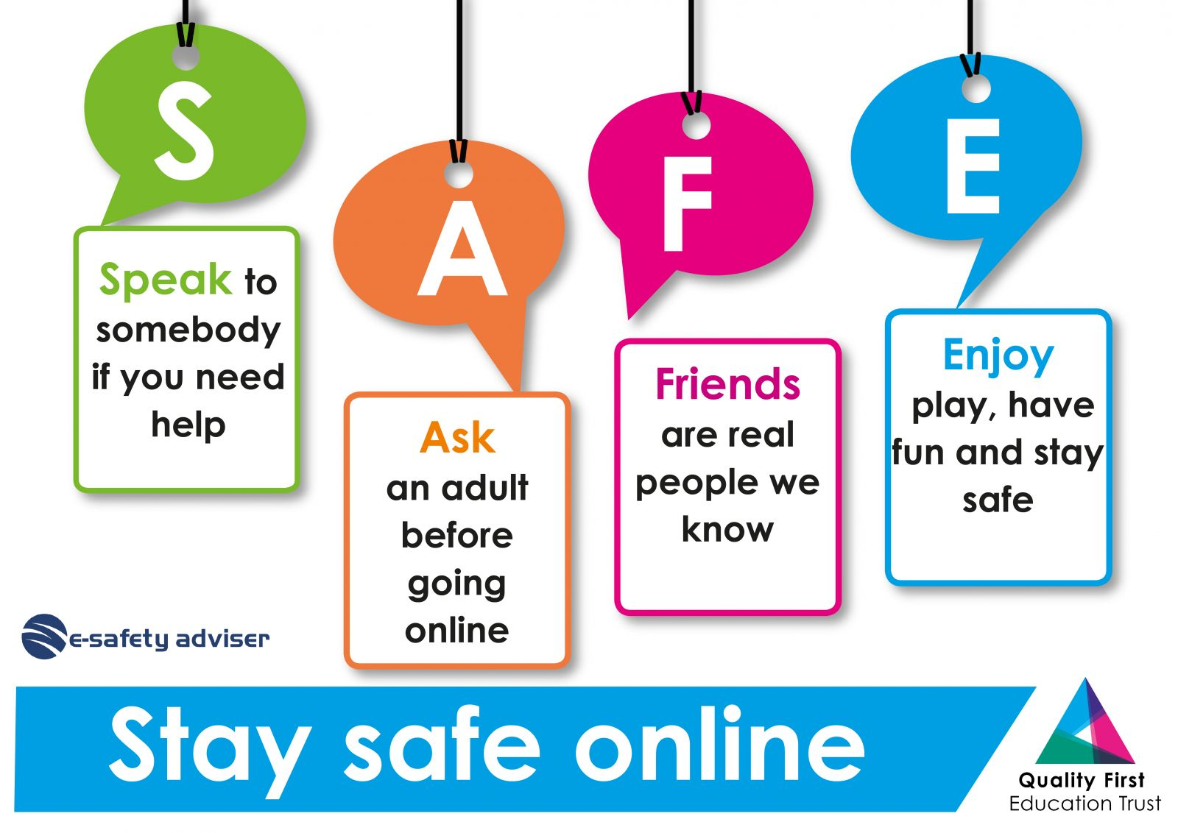
How to stay safe?
How to stay safe
How to be unsafe
Never share your password with a friend or strangers
Block accounts that are making you feel uncomfortable
Don’t text random people
Sharing your personal info
Following dangerous accounts
Sending inappropriate pictures

Slide 5
Why staying safe is the better option
Staying safe will lead nothing but happiness and feeling comfortable with the people that are viewing your content.
Not being responsible can lead to many dangerous things.
Texting random people and sharing your personal info with them can make them break in to your house or to send pictures of you or to leak all your personal info.

Slide 6
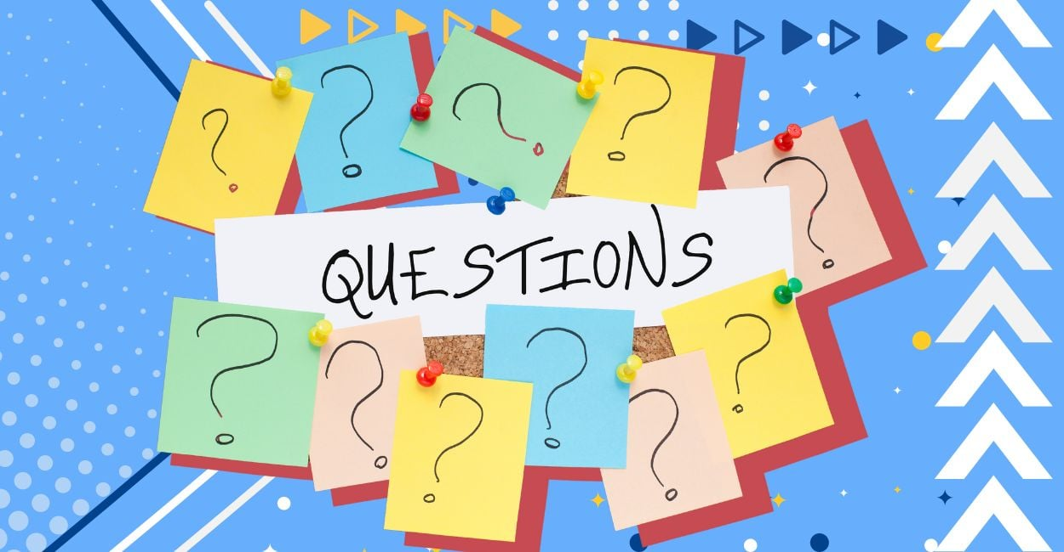
Questions!!!

Slide 7
What are the ways to stay safe
Leaking your password
Blocking dangerous accounts
Texting random strangers

Slide 8
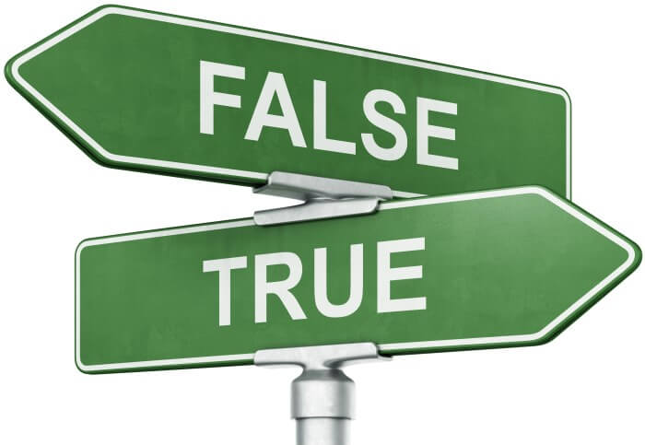
True or false
Sharing your personal info to random strangers or friends is one of the ways of staying safe on the internet TRUE FALSE
People nowadays are using the social media to create dangerous accounts and to leak other innocent peoples personal info TRUE FALSE
Having a private account reduce the risk of being threatened by random strangers TRUE FALSE
Sending personal info will lead to success and happiness TRUE FALSE

Slide 9
GOBACK

Slide 10
GO BACK

Slide 11
Thank you for your time

