Slide 1
By: Carla Seleme
8D

Slide 2
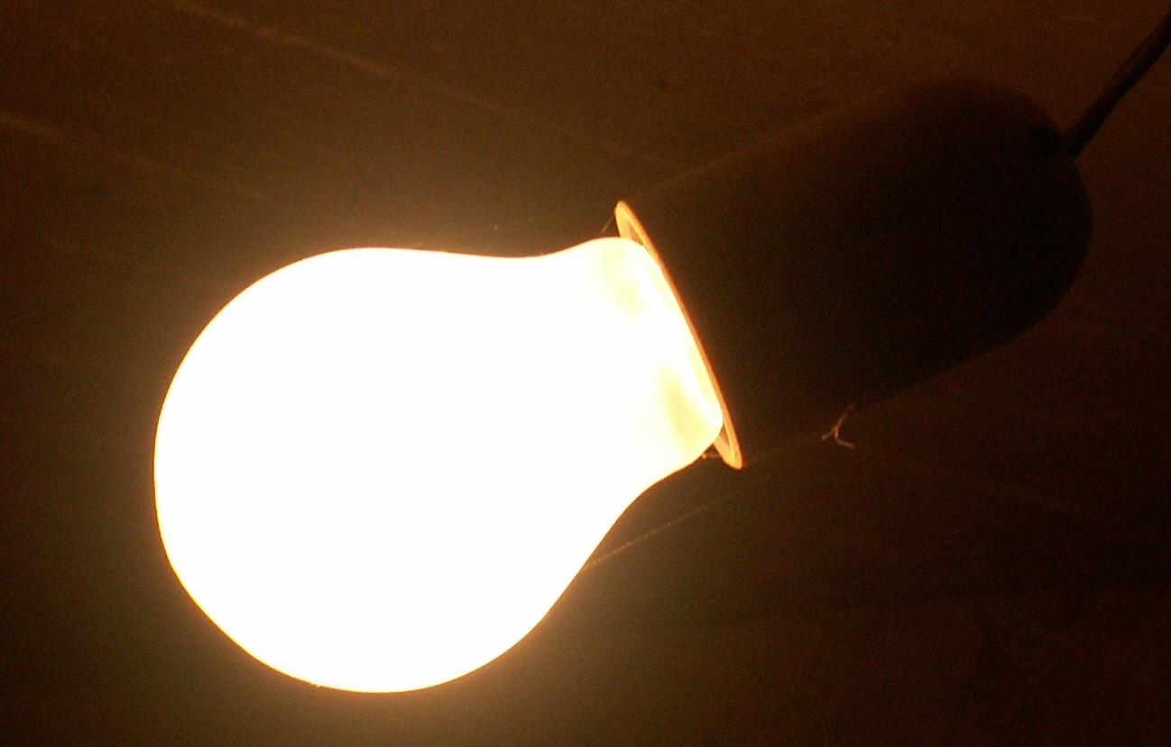
In physics we have many topics to talk about, but from all of them we chose to talk about light today
Light:
Light is electromagnetic radiation that can be perceived by the human eye. Visible light is usually defined as having wavelengths in the range of 400–700 nanometres, corresponding to frequencies of 750–420 terahertz, between the infrared and the ultraviolet.

Slide 3
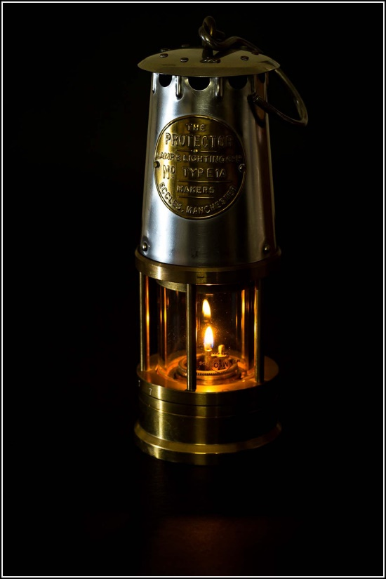
Who invented light?
In 1802, Humphry Davy invented the first electric light. He experimented with electricity and invented an electric battery. When he connected wires to his battery and a piece of carbon, the carbon glowed, producing light. His invention was known as the Electric Arc lamp.

Slide 4
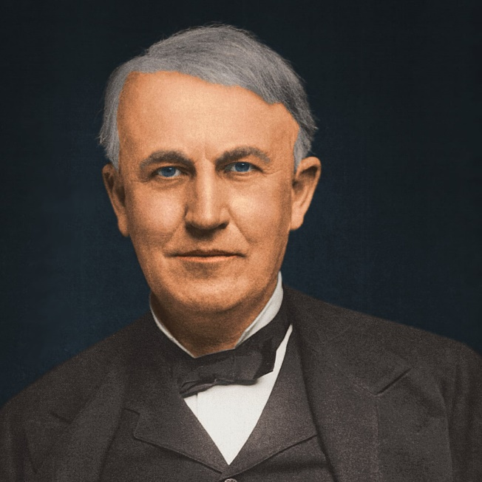
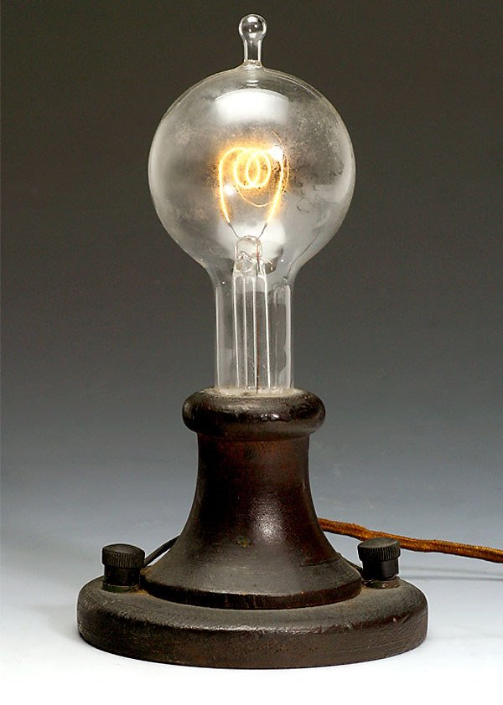
Who invented the light bulb?
Thomas Edison is credited as the man who invented the lightbulb, by January 1879, at his laboratory in Menlo Park, New Jersey, Edison had built his first high resistance, incandescent electric light. It worked by passing electricity through a thin platinum filament in the glass vacuum bulb, which delayed the filament from melting. Still, the lamp only burned for a few short hours.

Slide 5
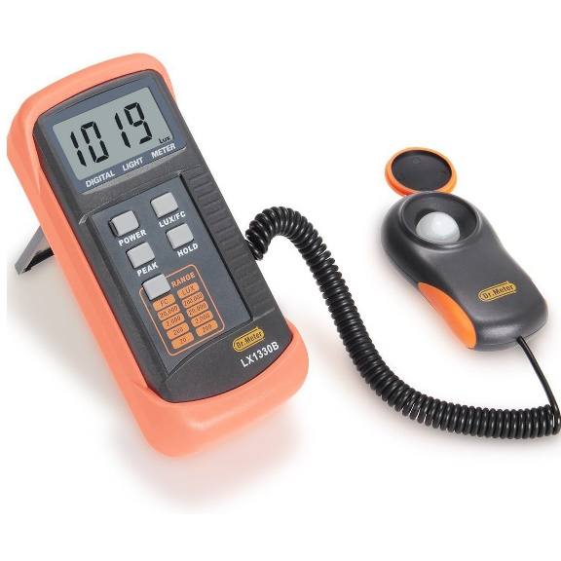
What is the unit of light?
Unit of light is Lux (lx):
Lux is basically the unit of illumination and is equal to one lumen per square metre.
You might be asking how to measure lux..
We use a light meter (also called lux meter) to measure the amount of light in a space or particular surface. The light meter has a sensor that measures the light falling on it and provides the user with a measurable illuminance reading.

Slide 6
From bulbs to energy saving fluorescent tube..
Normal bulbs
Energy saving fluorescent tube
An incandescent bulb typically consists of a glass enclosure containing a tungsten filament. An electric current passes through the filament, heating it to a temperature that produces light.
An energy saving fluorescent bulb is made of argon and a small amount of mercury vapor. This generates invisible ultraviolet light that excites a fluorescent coating (called phosphor) on the inside of the tube, which then emits visible light.

Slide 7
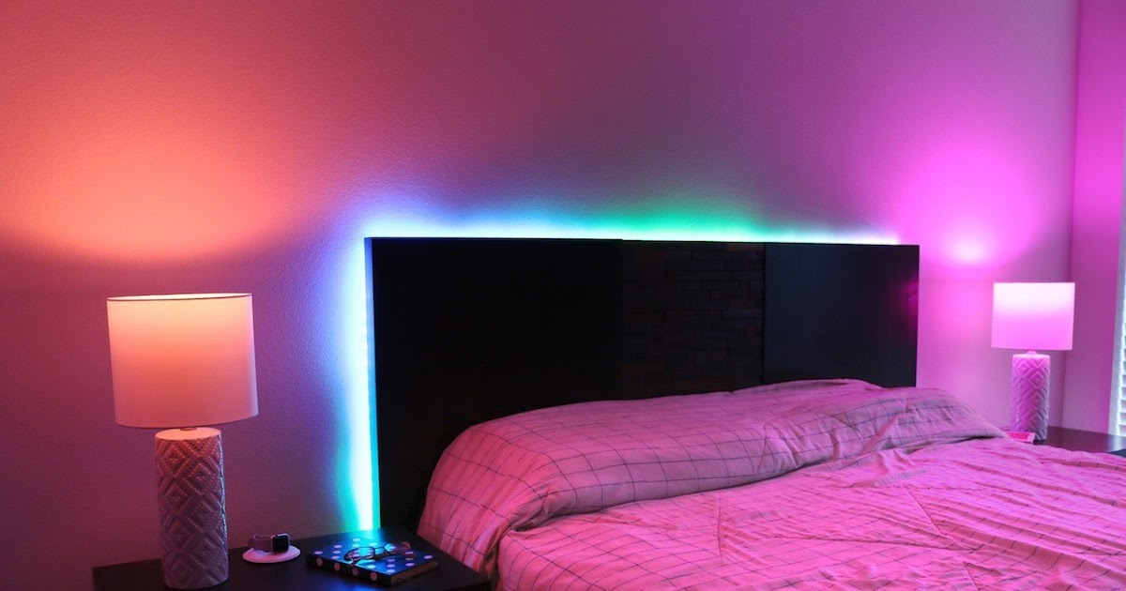
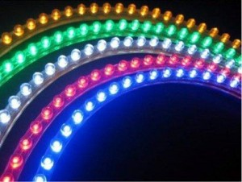
What are the LED lights in your room
LED stands for light emitting diode. LED lighting products produce light up to 90% more efficiently than incandescent light bulbs.
How do they work?
An electrical current passes through a microchip, which illuminates the tiny light sources we call LEDs and the result is visible light.

Slide 8
I hope u enjoyed my presentation Thank you for listening☺

